Slide 2
How We Got the English Bible
Part 4

Slide 3
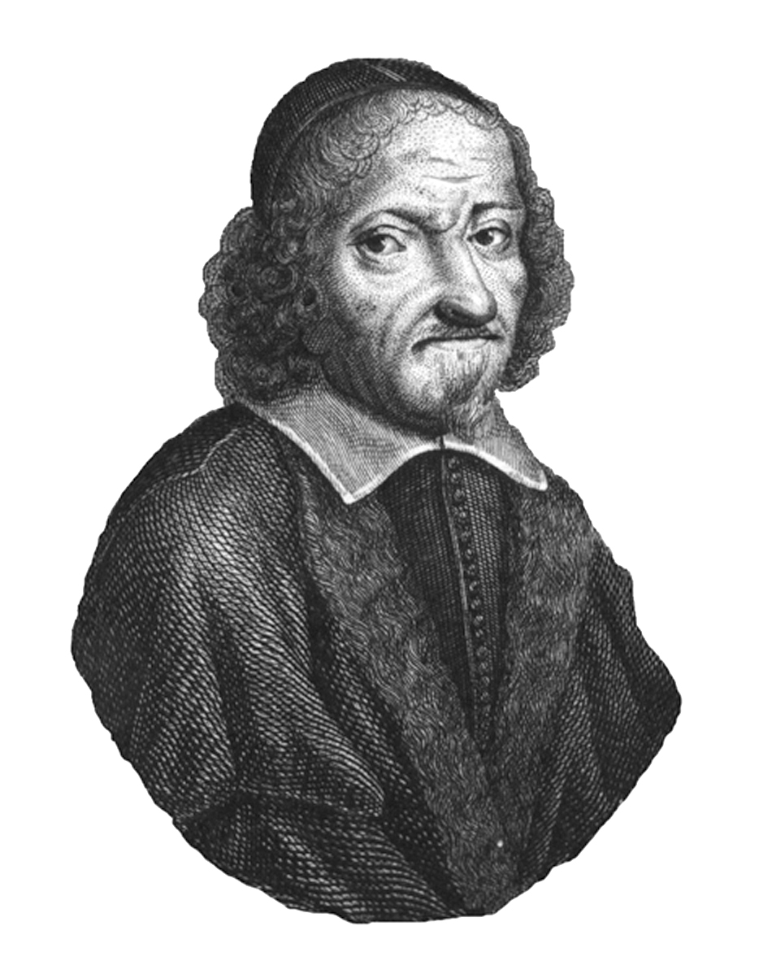
Miles Coverdale
Cromwell selected Coverdale to lead the new translation work.
Coverdale had devoted himself to sharing the gospel, preaching against a number of Catholic practices.
Worked with Tyndale to help complete Tyndale’s NT.

Slide 4
Coverdale Bible
Completed translation in 1535, printed in Zurich or Antwerp, then shipped to England.
First complete Bible published in English.
OT books ordered like Vulgate (not the Hebrew Bible)
NT books ordered like Luther’s Bible (not Erasmus’ Greek edition)
Chapter summaries added
Contentious marginal notes removed
Much of translation based on work of others

Slide 5
Coverdale Bible, part 2
Interesting turns of phrase:
"the pride of life" 1 John 2:16
"the world passeth away" I John 2:17
"enter thou into the joy of the lord" Matthew 25:21, 23
"and forgive us our debts as we forgive our debtors" Matthew 6:12
"tender mercies"
"respect of persons"
"lovingkindness"
"valley of the shadow of death" - Psalm 23
"better is a mess of potage with love, than a fat ox with evil will" - Proverbs 15:17 (this one didn't stick)
Odd renderings:
"the beer shall be bitter to them that drink it" - Isaiah 24:9
"Thou shalt not need to be afraid for any bugs by night." - Psalm 91:5

Slide 6
Sample of the Coverdale Bible
Faith is a sure confidence of thinges which are hoped for, and a certaynte of thinges which are not sene. By it ye Elders were well reported of. Thorow faith we vnderstonde, that the worlde and all the thinges which are sene, were made of naughte by the worde of God. By faith offered Abell vnto God a more plenteous sacrifice: by the which he optayned wytnesse, that he was righteous: God testifyenge of his giftes, by the which also he beynge deed, yet speaketh. By faith was Enoch take awaye, that he shulde not se death: and was not founde, because God had taken him awaye. For afore he was taken awaye, he had recorde that he pleased God. But without faith it is vnpossible to please God. For he that commeth vnto God, must beleue that God is, & yt he is a rewarder of them that seke him.
- Hebrews 11:1-6, Coverdale Bible, 1535

Slide 7
Reception by Henry
Bishops tried to slow walk the translation, but Henry forced their hand
Bible was immediately put into limited circulation.
Queen left a copy open on a desk at court for all to read
Bishops complained that everyone was now questioning things
Additional revisions of the Coverdale Bible followed

Slide 8
The Matthew Bible
John Rogers was also working on a sanctioned translation, based on Tyndale’s NT + prison translation of OT + Coverdale’s OT
Renumbered Psalms to match Hebrew Bible
Included 200 illustrations, book introductions, chapter summaries, and marginal notes
Inserted Tyndale’s initials at end of OT.
Published under the pseudonym Thomas Matthew
Tyndale’s work had now been formally approved by the king!

Slide 9
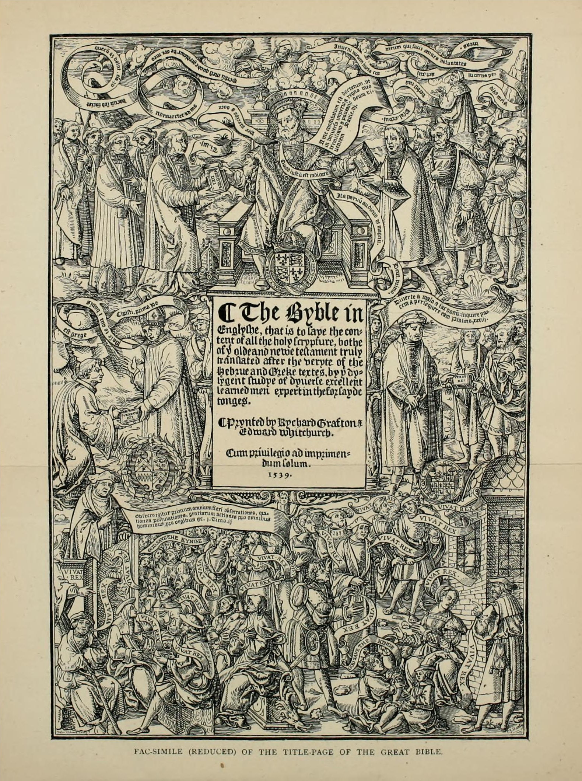
The Great Bible
Although King Henry approved, the Matthew Bible had Tyndale’s marginal notes
Clergy hated these notes!
Cromwell had Coverdale make a new version of the Matthew Bible without the notes.
Printing in Paris almost stopped by the Inquisition.
Printed sheets heisted out of Paris!
1539: Bible printed in London
Called the Great Bible because of its lavish size and adornment

Slide 10
Cromwell and Cuthbert
Anne Boleyn sent to the block in favor of Jane Seymour.
Cromwell urged Henry to marry Anne of Cleves (politics)
Henry detested Anne of Cleves and had Cromwell beheaded
Cromwell’s coat of arms removed from the Great Bible.
Cuthbert Tunstall’s name added to the title page of the Bible that was Tyndale’s work!

Slide 11
Henry’s Successors
Succeeded by Edward (age 9), a Protestant reformer.
Edward died at 15. Succeeded by older sister Mary.
Mary tried to turn back to Catholicism.
Many reformers killed (nickname: Bloody Mary)

Slide 12
Geneva Bible
Most scholarly and accurate Bible yet. Basis: Great Bible (OT), Tyndale (NT)
Added words in italics for first time
Very popular. Became household Bible for Protestants
Good turns of phrase:
"vanity of vanities"
"except a man be born again"
"Remember now thy Creator in the days of thy youth"
"Solomon in all his glory"
"My beloved Son in whom I am well pleased"
"a cloud of witnesses"
"a little leaven leaveneth the whole lump"

Slide 13
Bishops’ Bible
Reworking of Great Bible without contentious marginal notes
Not well done, never caught on
Crown made this the official Bible of the Church of England
New renderings that stuck:
Matthew 3:3 - "the voice of one crying in the wilderness"
Matthew 5:10 - "persecuted for righteousness' sake"
Romans 12:21 - "overcome evil with good“
Weird renderings
"Cast thy bread upon the waters" became "Lay thy bread upon wet faces"

Slide 14
King James I
Selected by Queen Elizabeth to succeed her.
Walked into a very unsettled religious situation in England.
Church of England was Catholic in organization, but not part of the Catholic church.
Puritans wanted to “purify” the church of “popish” practices
James didn’t want to change anything but wanted to deal with the Puritans.
Held a three-day conference to discuss things

Slide 15
Background of James I
Raised Presbyterian Calvinist.
Disliked Puritan idea of self-government
Was a student of the Bible in almost all its languages
Had a rough childhood, including rickets and a speech impediment
Believed in evil spirits
Before England, king of Scotland for 37 years. Shrewd ruler.

Slide 16
Conference with the Puritans
James came down hard on corruption in Church of England
Among other things, Puritans requested a new translation
James denied most of their other requests, but liked the idea of a new translation

Slide 17
Translation work begins
Best biblical scholars in England were sought out
54 translators selected, organized in 6 companies in 3 locations
Westminster, Oxford, and Cambridge selected for political reasons

Slide 18
Translation instructions
Translation to be based on Bishops’ Bible
Certain ecclesiastical terms kept (“church,” “charity,” etc.)
Minimal marginal notes
Chapters have new headings. Existing chapter and verse divisions kept.
Spelling of names standardized
Words not in the original rendered in distinctive type

Slide 19
The new translation is compiled
Translators worked from unbound Bishops’ Bibles to work from
Groups sent their work to each other for review
General Committee put everything together
Work took about six years

Slide 20
Translation comparisons
2 Samuel 1:27:
Tyndale: "How were the mighty overthrown."
KJV: "How are the mighty fallen."
Psalms 23
Bishops' Bible: "God is my shepherd, therefore I can lose nothing; he will cause me to repose myself in pastures full of grass, and he will lead me unto calm waters."
KJV: "The Lord is my shepherd; I shall not want. He maketh me to lie down in green pastures; he leadeth me beside the still waters."

Slide 21
Sample from John 1:1-10
In the beginning was the Word, & the Word was with God, and the Word was God. The same was in the beginning with God. All things were made by him, and without him was not any thing made that was made. In him was life, and the life was the light of men. And the light shineth in darknesse, and the darknesse comprehended it not. There was a man sent from God, whose name was Iohn. The same came for a witnesse, to beare witnesse of the light, that all men through him might beleeue. Hee was not that light, but was sent to beare witnesse of that light. That was the true light, which lighteth euery man that commeth into the world. Hee was in the world, and the world was made by him, and the world knew him not.

Slide 22
King James Version, first edition
Initial version had an error every ten pages
Physical volume was beautiful and had many reader helps:
Almanac
Table of holy days
Guide to the order of the Psalms
Lessons to be read at morning and evening prayer
Calendar for calculating date of Easter
Map of the Holy Land
38-page illustrated genealogy from Adam to Christ

Slide 23
Impact of the King James Version
Bible’s success was initially because of James’ enthusiasm for it
Puritans did not like it. Preferred Geneva Bible.
Over time, translation was more accepted and became the default for the English-speaking world.
Some archaic expressions were kept for “antique rightness” (“verily,” “it came to pass,” etc.)
Known as Authorized Version in England, though never officially authorized (but did replace Bishops’ Bible)

Slide 24
Conclusion
God has seen fit to make Himself known through the Bible
Through various twists and turns, He has worked to make the Bible available to us.
We now have this great resource freely available. Let us use it well!

