Slide 1
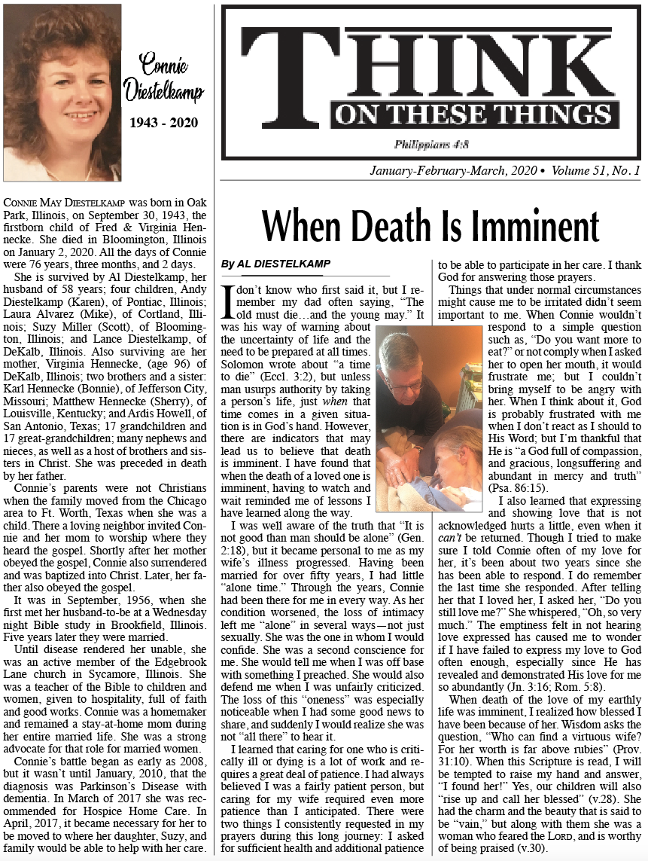

Slide 2
SOME IMPORTANT LESSONS TO REMEMBER
The wife of a preacher (Al Diestelkamp) started having problems in 2008 which was finally diagnosed as Parkinson’s Disease with dementia in 2010. She got progressively worse until in 2017 she was recommended for Hospice Home Care but within a month he realized he wasn’t able to care for her even with Hospice help, so they moved to live with a daughter and they cared for her 24/7 until she died Jan 2, 2020 -- the last couple of years she didn’t know anyone.
He wrote an article about “When Death Is Imminent” and noted:
Eccl 3:2 “there is a time to die…” and that “the old must die… the young may.” > Unless man intervenes (takes a life) we don’t know when it will be.
However, sometimes there are indicators (illness…) which may cause us to believe that death is imminent……
Then he noted some important lessons which we can learn, or be reminded of, when Watching and Waiting for a loved one to die.
I think they are some things we need to remember at all times….

Slide 3
SOME IMPORTANT LESSONS TO REMEMBER
1. “It is not good that man should live alone” – Gen 2:18 >
In this & similar situations the loved one is “There, but not really there…”
Companionship is gone: sexual, discussing things, sharing good news, etc……
This drives home the lesson we sometimes forget, which causes us to not really appreciate what we have… “It’s not good to be alone”…
The “wise man” said, “Two are better than one;…” - Ecc 4:9. He notes in this context that being alone is not good and that companionship – marriage, family, friends, etc… have many advantages.
2. Caring for critically ill or dying is lots of work and requires much patience… even for one who is already patient… In such situations (and perhaps many others) we need to pray for sufficient health and more patience… …
It is easy to become frustrated when someone wouldn’t respond: “Do you want more to eat?”, “Open your mouth…”, “Don’t do that…” ... ...

Slide 4
SOME IMPORTANT LESSONS TO REMEMBER
2. cont’d…
It is easy in frustration, to lose our patience, and become angry… and… >
Here’s another lesson we need to learn/remember:
Think about how God surely must get frustrated/grieved when we do not react as we should to his Word > “How oft did they rebel against him in the wilderness, And grieve him in the desert!” - Psa 78:40
We need to remember and be thankful he is “a God full of compassion, and gracious, longsuffering/patience and abundant in mercy and truth”- Psa 86:15
Rom 15:5 Now the God of patience and of comfort grant you to be of the same mind one with another according to Christ Jesus:
2 Pet 3:9 The Lord ... is longsuffering to you-ward, not wishing that any should perish, but that all should come to repentance.
2 Pet 3:15 And account that the longsuffering of our Lord is salvation;

Slide 5
SOME IMPORTANT LESSONS TO REMEMBER
3. This situation also reminds us that expressing and showing love that is not acknowledged hurts, even when it can’t be returned. Telling and/or showing someone you love them and getting NO response of any kind... ...
Should make us wonder how often we have failed to express our love to God as we should, especially since he has revealed and demonstrated his love for us so abundantly:
Jn 3:16 For God so loved the world, that he gave his only begotten Son, that whosoever believeth in him should not perish, but have everlasting life.
Rom 5:8 But God commendeth his love toward us, in that, while we were yet sinners, Christ died for us.
1Jn 3:16 Hereby perceive we the love of God, because he laid down his life for us: and we ought to lay down our lives for the brethren.
1Jn 5:3 & 2 Jn 6 … this is the love of God, that we keep his commandments:

Slide 6
SOME IMPORTANT LESSONS TO REMEMBER
4. When the death of a loved one is near or occurs: close friend, family member, especially our spouse we are reminded how blessed we were to have had them (“don’t miss the water until the well runs dry”):
David tells us that children are a blessing from God… Psa 127:3
Solomon, several times, tells us how friends are a blessing… Prov 17:17, 27:6
He also tells us the worthy wife is more precious than rubies - Prov 31:10-f
And we should never forget how blessed we are to know and have God – the God who loves, cares for us, and provides salvation from sin and a means whereby we can spend eternity with him in heaven...
And remember: Jesus answered said, If a man love me, he will keep my words: and my Father will love him, and we will come unto him, and make our abode with him. - Jn 14:23 We can have God with us ALL the time…

Slide 7
SOME IMPORTANT LESSONS TO REMEMBER
For Everyday... Not just when someone is “gone”...
1. It’s not good to be alone in this life... friends, family, spouse... = blessing
2. Virtue of Patience/Longsuffering... remember God’s patience/longsuffering
3. Acknowledge & appreciate love... especially God’s love for us
4. Blessing of good relationships... especially God continually with us

