Slide 2
How We Got the English Bible
Part 3

Slide 3
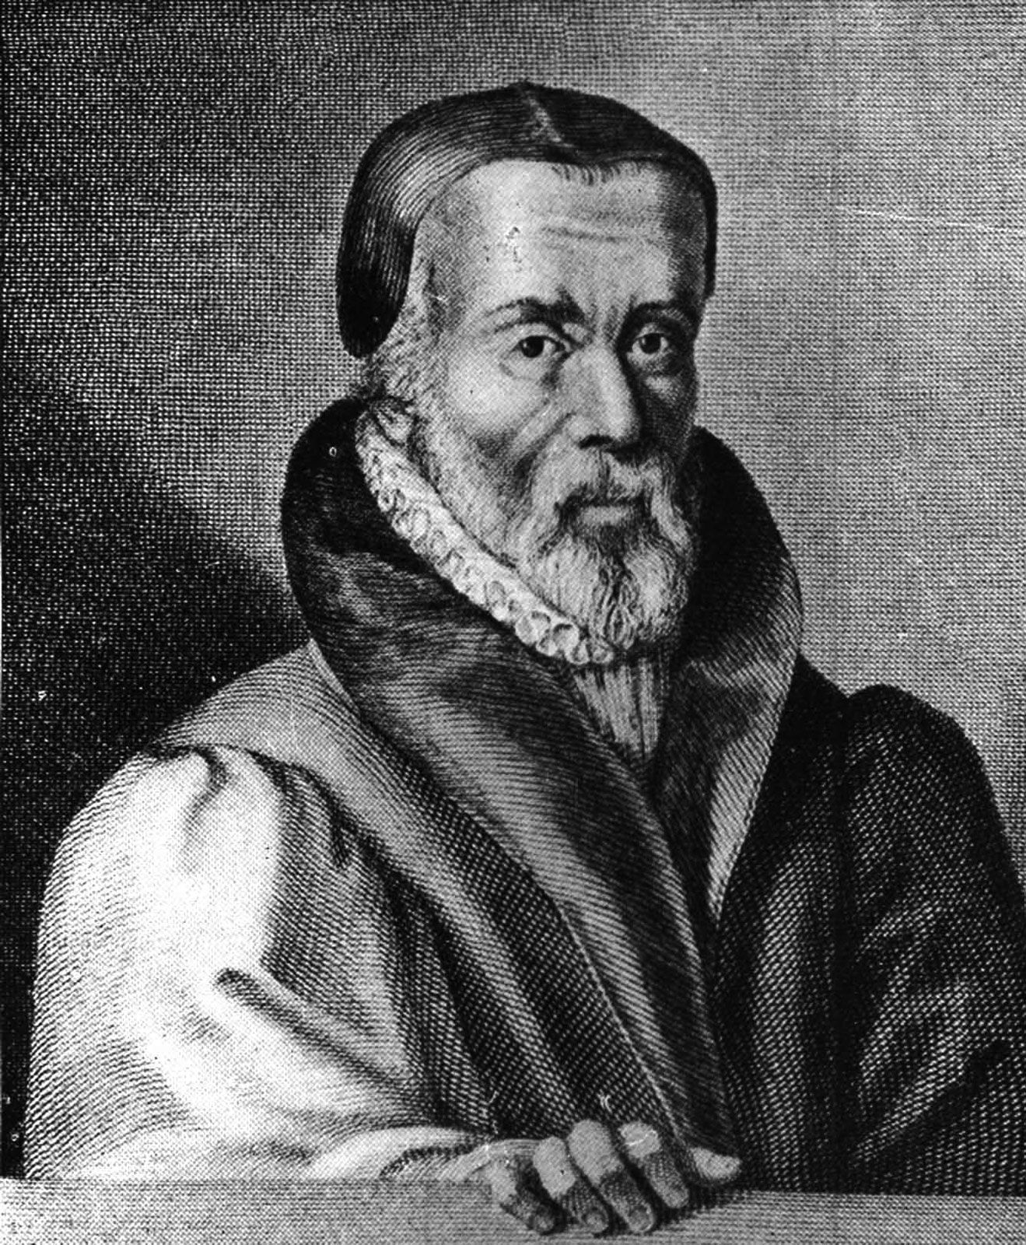
William Tyndale
Born in 1495 in Slimbridge, Gloucestershire
Taught at special grammar school.
Loved languages! Could read Latin at age 10.
Went to Oxford, age 12, then to Cambridge.
Protestant Reformation took hold by the time he left Cambridge.
Renaissance was happening and printing presses were now available.

Slide 4
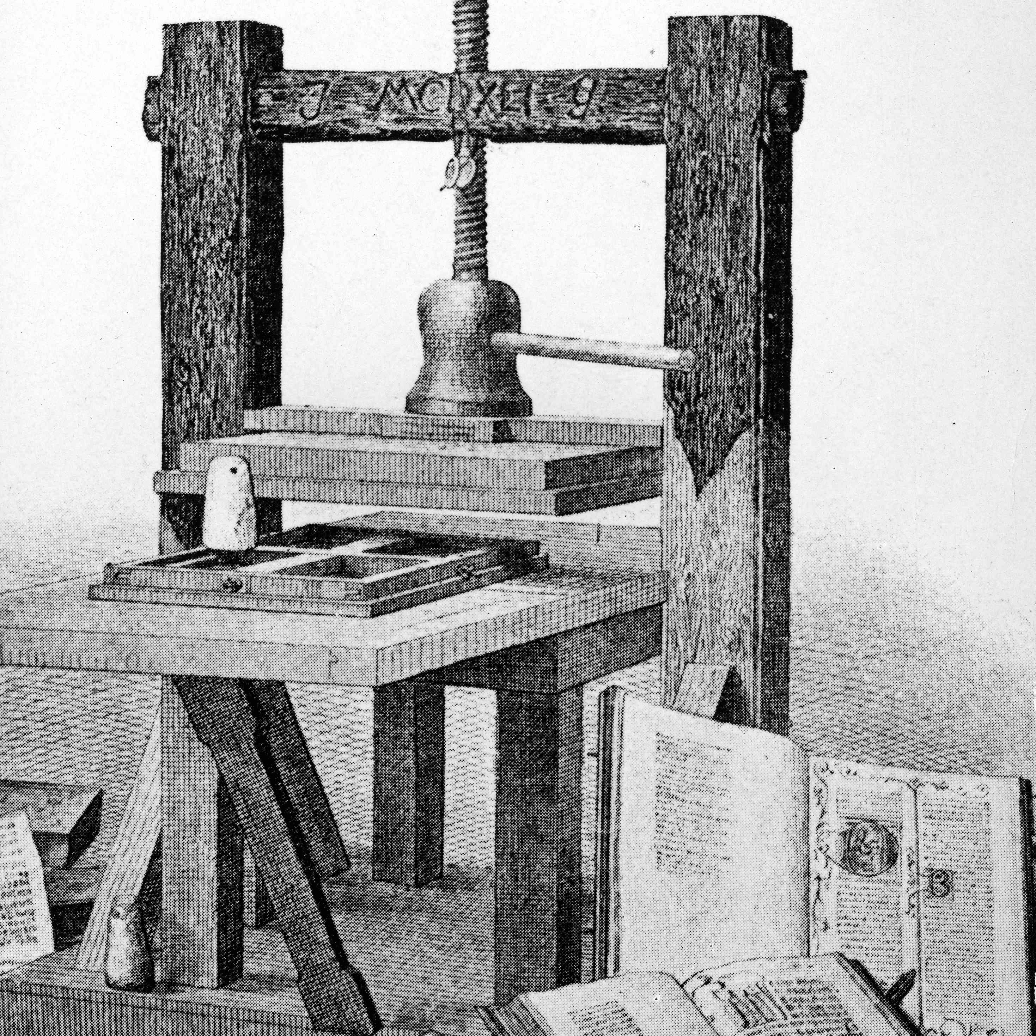
The printing press
Invented by Johann Gutenberg in 1450.
Improved die-stamping and casting molds made this possible.
William Caxton (“the father of English printing”) set up a press at Westminster in 1476.
Published nearly 100 books, many of his own translation.
His way of speaking influenced the English language.

Slide 5
Rejuvenation of Biblical studies
Biblical studies made great strides in the Renaissance.
Pope Nicholas I left a library of 5000+ Greek manuscripts.
Greek and Hebrew reference materials were published and Oxford and other colleges started teaching the languages again.
John Colet started lecturing on Romans, but did so straight from the scriptures, ignoring medieval interpretations.
Erasmus came to England to hear Colet and was inspired to make a fresh Latin translation of the NT (1516).
Bibles available in native language of every European country by end of 1500s.

Slide 6
The Catholic Church intervenes
Catholic Church welcomed the printing press at first.
Press was soon used to spread reform ideas. HRCC was not a fan.
Pope Leo X made a law preventing printing works on religious subjects without approval.
No one cared!
1517: Martin Luther’s 95 theses
They were quickly translated and spread everywhere. HRCC was not a fan.

Slide 7
Tyndale spreads “heresy”
Tyndale ordained a priest in 1521, but leaves school to be private chaplain and tutor for a family.
Preached at Saint Austin’s Green.
Frustrated by scriptural ignorance of clergy
His ideas stirred up local authorities.
He debated many, usually winning by citing scripture.
Accused of heresy for insisting on scriptural authority.
Decided his life’s work would be getting the scriptures into hands of the general public.

Slide 8
Dangerous time for a new translation
Tyndale left for London to find a patron.
Cuthbert Tunstall said no. (Remember this name for later!)
Luther’s rebellion set everyone on edge. No one wanted to be involved in Tyndale’s project.
King Henry VIII hated Luther more than any person on earth.
Henry tried to eradicate Luther’s followers.
Henry and Luther wrote tracts against each other.
The general public sided with Luther as the underdog.
Henry promised to burn any untrue translation.
Many Lutheran writings were burned in front of St. Paul’s Cathedral.

Slide 9
Tyndale finds help
Tyndale left the country and became a preacher, lodging with Humphrey Monmouth.
Tyndale spent his time translating the New Testament from Greek.
He spoke: Hebrew, Greek, Latin, Italian, Spanish, English, and French fluently
Monmouth was a member of the Christian Brethren, who subsidized Tyndale’s work.
1524: Tyndale leaves for Germany and meets Martin Luther.
1525: Tyndale’s English NT completed.

Slide 10
Printing Tyndale’s translation
Tyndale went to Cologne for publication.
Cologne was a haven for reformers at the time.
Catholic zealots also there!
Johann Dobneck tried to frustrate Tyndale’s plans
Tyndale escaped to Worms and had the printing done there.
NT copies were concealed in dry goods and sailed for England.

Slide 11
Response to Tyndale’s translation
King Henry was tipped off and a watch was set at all ports.
Henry was terrified that authority would be questioned
There had just been a revolt, causing 50,000 deaths
Translation was immediately well received by common people
Translation was exceptionally well done.
Used structure of Luther’s translation: chapter divisions, book order
Local authorities wrote laws prohibiting owning, selling, or distributing it.
Merchant ships were boarded and searched.
More books burned in front of St. Paul’s Cathedral
Pirate book trade developed

Slide 12
Sample of the Tyndale Bible
When he sawe the people he went vp into a mountayne and when he was set his disciples came to hym and he opened hys mouthe and taught them sayinge: Blessed are the povre in sprete: for theirs is the kyngdome of heven. Blessed are they that morne: for they shalbe conforted. Blessed are the meke: for they shall inheret the erth. Blessed are they which honger and thurst for rightewesnes: for they shalbe filled. Blessed are ye mercifull: for they shall obteyne mercy. Blessed are the pure in herte: for they shall se God. Blessed are the peacemakers: for they shalbe called the chyldren of God. Blessed are they which suffre persecucio for rightwesnes sake: for theirs ys the kyngdome of heuen. Blessed are ye when men reuyle you and persecute you and shall falsly say all manner of yvell saynges agaynst you for my sake. Reioyce and be glad for greate is youre rewarde in heven. + For so persecuted they ye Prophetes which were before youre dayes. – Matthew 5:1-12, Tyndale Bible, original spelling

Slide 13
Tunstall goes after Tyndale
Tunstall became obsessed with calling Tyndale to account.
Called on Sir Thomas More to debate Tyndale in public.
More published Dialogue Concerning Heresies, Tyndale responded.
More objected to translation of religious terms:
Priest, church, penance, confess, grace, charity
Thought words had special religious meaning and should be translated as such

Slide 14
Tyndale starts on the Old Testament
1529: Finished Pentateuch, sailed to Hamburg for printing
Caught in a storm and shipwrecked. Manuscripts lost!
Finally reached Hamburg and worked with Miles Coverdale.
Pentateuch completed in 1530, printed, and smuggled into England.
Fought pirate versions with purposeful errors.

Slide 15
King Henry and Thomas More
Henry sacked Wolsey, More took over.
More saw it as his job to eradicate heresy, especially Tyndale’s NT.
Henry gradually came around to support an English translation because he thought it strengthened the case for his divorce.
Henry started reducing the power of the church
Anne Boleyn was found with child. She and Henry quickly wed.

Slide 16
The Church of England
Henry’s marriage to Catherine nullified by Thomas Cranmer.
Anne Boleyn crowned as queen.
Pope excommunicates Henry and Cranmer for this.
1534: Henry cuts ties with Catholic Church, forms Church of England.

Slide 17
Tyndale captured
Through various schemes, Tyndale was captured by Henry Phillips in Antwerp and imprisoned at Vilvorde Castle
Tyndale gets his study materials and starts translating OT in prison
Decree of Augsburg (1530) made belief in justification by faith alone a capital offense
1536: Tyndale found guilty of heresy, strangled, and burned at the stake
More was beheaded, then declared a saint in 1935!

Slide 18
The state under King Henry
Thomas Cranmer: Head of church under King Henry
Was already married when promoted to a position requiring celibacy.
Thomas Cromwell: Head of state under King Henry
Cut back on monasteries to help finances
Sided with bishops and the queen to request a new English translation of the Bible

Slide 19
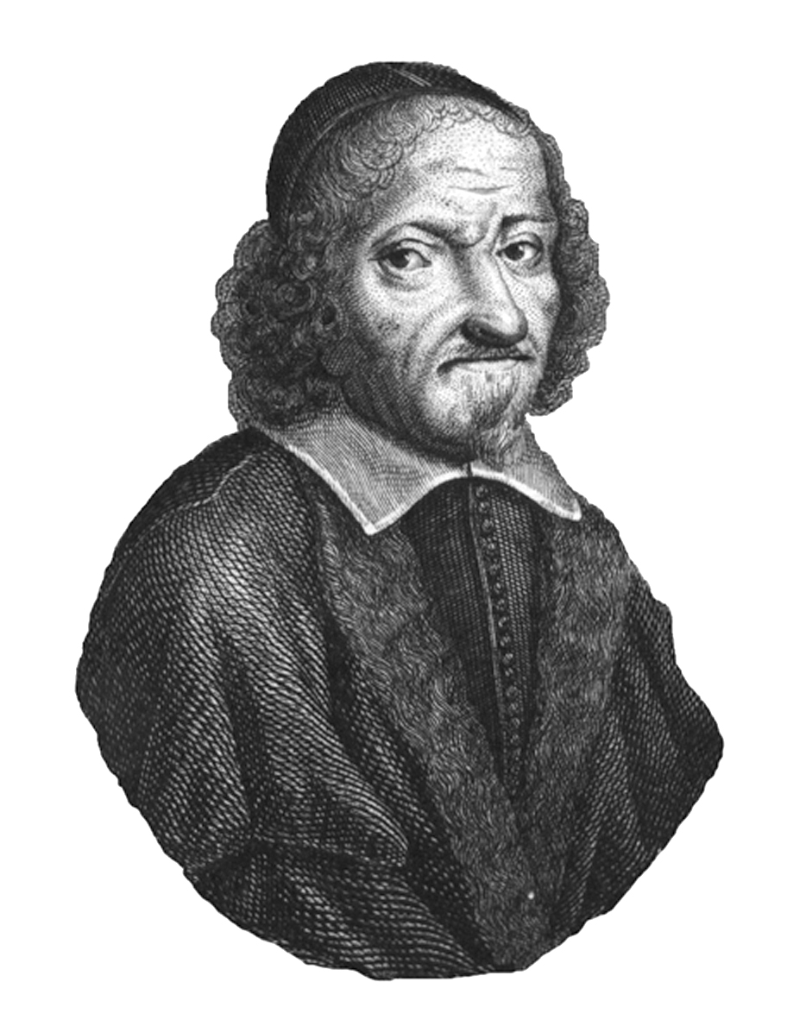
Miles Coverdale
Cromwell selected Coverdale to lead the new translation work.
Coverdale had devoted himself to sharing the gospel, preaching against a number of Catholic practices.
Worked with Tyndale to help complete Tyndale’s NT.

Slide 20
Coverdale Bible
Completed translation in 1535, printed in Zurich or Antwerp, then shipped to England.
First complete Bible published in English.
OT books ordered like Vulgate (not the Hebrew Bible)
NT books ordered like Luther’s Bible (not Erasmus’ Greek edition)
Chapter summaries added
Contentious marginal notes removed
Much of translation based on work of others

Slide 21
Coverdale Bible, part 2
Interesting turns of phrase:
"the pride of life" 1 John 2:16
"the world passeth away" I John 2:17
"enter thou into the joy of the lord" Matthew 25:21, 23
"and forgive us our debts as we forgive our debtors" Matthew 6:12
"tender mercies"
"respect of persons"
"lovingkindness"
"valley of the shadow of death" - Psalm 23
"better is a mess of potage with love, than a fat ox with evil will" - Proverbs 15:17 (this one didn't stick)
Odd renderings:
"the beer shall be bitter to them that drink it" - Isaiah 24:9
"Thou shalt not need to be afraid for any bugs by night." - Psalm 91:5

Slide 22
Sample of the Coverdale Bible
Faith is a sure confidence of thinges which are hoped for, and a certaynte of thinges which are not sene. By it ye Elders were well reported of. Thorow faith we vnderstonde, that the worlde and all the thinges which are sene, were made of naughte by the worde of God. By faith offered Abell vnto God a more plenteous sacrifice: by the which he optayned wytnesse, that he was righteous: God testifyenge of his giftes, by the which also he beynge deed, yet speaketh. By faith was Enoch take awaye, that he shulde not se death: and was not founde, because God had taken him awaye. For afore he was taken awaye, he had recorde that he pleased God. But without faith it is vnpossible to please God. For he that commeth vnto God, must beleue that God is, & yt he is a rewarder of them that seke him.
- Hebrews 11:1-6, Coverdale Bible, 1535

Slide 23
Reception by Henry
Bishops tried to slow walk the translation, but Henry forced their hand
Bible was immediately put into limited circulation.
Queen left a copy open on a desk at court for all to read
Bishops complained that everyone was now questioning things
Additional revisions of the Coverdale Bible followed

Slide 24
The Matthew Bible
John Rogers was also working on a sanctioned translation, based on Tyndale’s NT + prison translation of OT + Coverdale’s OT
Renumbered Psalms to match Hebrew Bible
Included 200 illustrations, book introductions, chapter summaries, and marginal notes
Inserted Tyndale’s initials at end of OT.
Published under the pseudonym Thomas Matthew
Tyndale’s work had now been formally approved by the king!

Slide 25
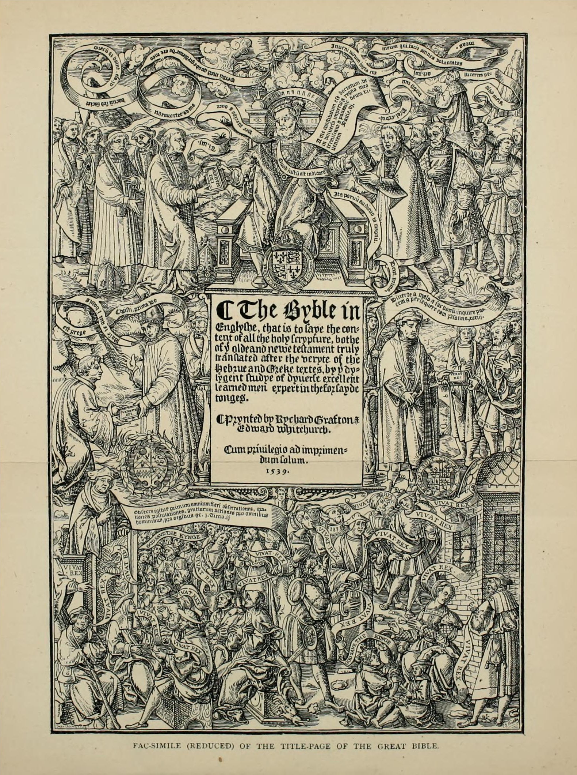
The Great Bible
Although King Henry approved, the Matthew Bible had Tyndale’s marginal notes
Clergy hated these notes!
Cromwell had Coverdale make a new version of the Matthew Bible without the notes.
Printing in Paris almost stopped by the Inquisition.
Printed sheets heisted out of Paris!
1539: Bible printed in London
Called the Great Bible because of its lavish size and adornment

Slide 26
Cromwell and Cuthbert
Anne Boleyn sent to the block in favor of Jane Seymour.
Cromwell urged Henry to marry Anne of Cleves (politics)
Henry detested Anne of Cleves and had Cromwell beheaded
Cromwell’s coat of arms removed from the Great Bible.
Cuthbert Tunstall’s name added to the title page of the Bible that was Tyndale’s work!

Slide 27
Stephen Gardiner, Bishop of Winchester
With Cromwell gone, Gardiner rose to power.
Tried to make Church of England Catholic in doctrine while still rejecting obedience to Rome
Got Act to Abolish Diversity of Opinion passed
Tried to remove English Bible and re-insert Latin words

