Slide 2
How We Got the English Bible
Part 2

Slide 3
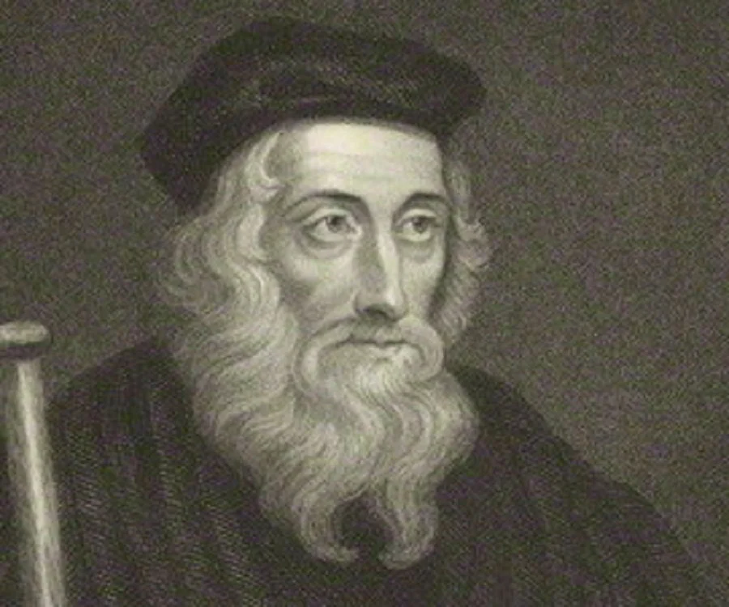
John Wycliffe
  Born in Yorkshire, about 1328
  Wanted to evangelize the common folk
  Went to Oxford in 1345
    It was not like college today!
  Wycliffe was insanely well educated.
  Had a hatred for wickedness.
  Was irreproachable in the conduct of his life, even by his enemies.
  Was a bold reformer and ran into problems with the HRCC.
  Responsible for (re) starting the spirit of religious inquiry and spiritual freedom

Slide 4
Corruption in the Catholic Church
  Pope John developed the system of selling indulgences.
    Based on the doctrine of “superabundant merits of the saints”
    Excess “credits” stored in the “Thesaurus meritorum sanctus” (Compendium of the Merits of the Saints)
    Pope could draw from this store and make transfers to anyone
    Store included the inexhaustible merits of Christ, thus was infinite
  Pope John XX greatly increased the church’s treasury
    Many new fees!

Slide 5
Wycliffe’s “heretical” beliefs
  There should only be priests and deacons.
  The legislative rights of the clergy belonged to Christ only.
  The priests’ office was only to preach the word.
  Ministry should be supported by donations. Not tithes.
  Many people in England agreed with Wycliffe!

Slide 6
Wycliffe prosecuted
  He was summoned repeatedly by the HRCC.
  Pope ordered Wycliffe to be investigated and Oxford to not allow his theories to be taught.
  Wycliffe was tried and let off with a reprimand, hampering the power of the HRCC in England for many years to come.

Slide 7
Two popes!
  Pope Urban VI started rebuking cardinals for their immorality.
  Cardinals tried to declare his election invalid.
  Urban replaced the cardinals.
  The old cardinals elected their own pope, Robert of Cumbray.
  Various countries lined up behind their favorite pope.
  Devout Christians were appalled at the situation.
  Wycliffe gave voice to their disagreements and didn’t think the papacy was scriptural at all.
    Argued for “scripture only” – not “scripture and tradition” as basis for authority.

Slide 8
The sad state of Bible knowledge
  Bible reading was rare in those days, even among the clergy.
  Priests generally only knew:
    The 10 commandments
    The Paternoster (Our Father)
    The Creed and Ave (Hail Mary)
  Ordinary Christians knew even less!
  Cult of saints was important
  Public worship was mostly ceremony with little real Bible teaching.
  Wycliffe rebuked the flimsy sermons.

Slide 9
The Wycliffe Bible
  Wycliffe commissioned a translation from the Vulgate into English in 1380.
  Translation was essentially word-for-word from the Vulgate and difficult to read.
  Nicholas Hereford translated from Genesis to Baruch 3:20, where others took up the work.
  Latin copies available had their own errors that had to be worked out.
  They had to standardize English along the way.
  John Purvey revised the translation.

Slide 10
  Christ stood by the river of Gennesaret … and fishers came down to wash therein their nets; and Christ went up into a boat that was Simon’s, and prayed him to move it a little from the land, and he sat and taught the people out of the boat. And when Christ ceased to speak, he said to Simon, Lead the boat into the high sea, and let out your nets to taking of fish. And Simon answering said to him, Commander, all the night travailing took we naught; but in thy word shall I loose the net. And when they had done this, they took a plenteous multitude of fish, and their net was broken. But they beckoned to their fellows that were in the other boat, to come and help them; and they came and filled both boats of fish, so that both were well nigh sunk. And when Peter had seen this wonder, he fell down to Jesus’ knee, and said, Lord, go from me for I am a sinful man.
  – Luke 5:1-8, Wycliffe Bible with modern spelling

Slide 11
  God reiside this Jhesu, to whom we alle ben witnessis. Therfor he was enhaunsid bi the riythoond of God, and thorouy the biheest of the Hooli Goost that he took of the fadir, he schedde out this spirit, that ye seen and heren. For Dauid stiede not in to heuene; but he seith, The Lord seide to my Lord, Sitte thou on my riyt half, til Y putte thin enemyes a stool of thi feet. Therfor moost certeynli wite al the hous of Israel, that God made hym bothe Lord and Crist, this Jhesu, whom ye crucefieden. Whanne thei herden these thingis, thei weren compunct in herte; and thei seiden to Petre and othere apostlis, Britheren, what schulen we do? And Petre seide to hem, Do ye penaunce, and eche of you be baptisid in the name of Jhesu Crist, in to remissioun of youre synnes; and ye schulen take the yifte of the Hooli Goost. For the biheest is to you, and to youre sones, and to alle that ben fer, which euer oure Lord God hath clepid. Also with othere wordis ful many he witnesside to hem, and monestide hem, and seide, Be ye sauyd fro this schrewid generacioun. Thanne thei that resseyueden his word weren baptisid, and in that dai soulis weren encreesid, aboute thre thousinde; and weren lastynge stabli in the teching of the apostlis, and in comynyng of the breking of breed, in preieris.
  – Acts 2:32-42, Wycliffe Bible, original spelling

Slide 12
Response to the Wycliffe Bible
  This translation was called heretical and unauthorized by the church.
  Never denounced as erroneous.
  Wycliffe began training preachers who became known as Lollards.
  1381: Peasants Revolt, partially blamed on Wycliffe and the Lollards.
  The state closed ranks against Wycliffe and arrested preachers.

Slide 13
Wycliffe’s death and aftermath
  1382: Wycliffe suffers a stroke and partial paralysis.
  1384: Wycliffe dies.
  Associates of Wycliffe were hunted down and forced to recant
    Including Nicholas Hereford!
  1408: Thomas Arundel (Archbishop of Canterbury) gets the Constitutions of Oxford passed.
    This greatly stifles freedom of thought.
    Even discussing Wycliffe’s ideas at all was forbidden!
    Denying transubstantiation could bring execution!
  Arundel went after Oxford.
  Wycliffe’s works burnt en masse.

Slide 14
God’s word spreads
  Arundel effectively split the Catholic church because of the persecution.
  Wycliffe Bible continued to spread, via whatever means possible.
  Lollards memorized large sections of the Bible.
  Wycliffe’s views spread to Bohemia, carried by Jerome of Prague.
  Jan Hus translated Wycliffe’s work to Czech.
  1415: Jan Hus burned at the stake.

