Slide 2
How We Got the English Bible
Part 1

Slide 3
What to take from this study?
God’s power and wisdom in making His word known
The reliability of the English translations
Appreciation for the work involved in translating
Understand how dangerous it is to stray from God’s design
Treasure God’s word!

Slide 4
The Bible itself
“Bible” means “book” in both Latin and Greek.
Contains 66 books
Written by about 40 men over 1500 years
As of 2006, over 4 billion Bibles have been printed in over 2400 languages.

Slide 5
Early writing
First writing on stone, clay, and papyrus.
Scrolls used until about 1st century A.D., then codices.
Codex = book
Papyrus came from the Nile delta
Paper came from China, roughly 300 B.C.
Not common in Western Europe until first or second century A.D.
Eventually, papyrus supply could not keep up.

Slide 6
Manuscripts
First copies of scriptures were manuscripts, which means written by hand.
Wycliffe Bible took 10 months – 2 years and cost was the annual wages for a laborer!
Books were inspired by God but written with human hands.
Exodus 4:11-16
Hebrews 1:1-2
I Corinthians 2:11-13
Ephesians 3:1-5

Slide 7
Book | Date | Book | Date
Job | Considered earliest, but date unknown | 2 Kings | 561-538 BC
Genesis | 1445-1405 BC | Judith* | Uncertain (538 BC – AD 70)
Exodus | 1445-1405 BC | Daniel | 536-530 BC
Leviticus | 1445-1405 BC | Haggai | 520 BC
Numbers | 1445-1405 BC | Baruch* | 500-100 BC
Deuteronomy | 1445-1405 BC | Zechariah | 480-470 BC
Psalms | 1410-450 BC | Ezra | 457-444 BC
Joshua | 1405-1385 BC | 1 Chronicles | 450-430 BC
Judges | 1043 BC | 2 Chronicles | 450-430 BC
Ruth | 1030-1010 BC | Esther | 450-331 BC
Song of Solomon | 971-965 BC | Malachi | 433-424 BC
Proverbs | 971-686 BC | Nehemiah | 424-400 BC
Ecclesiastes | 940-931 BC | Susanna* | 400 BC-AD 70
1 Samuel | 931-722 BC | Psalm 151* | 400 BC-AD 100
2 Samuel | 931-722 BC | Letter of Jeremiah* | 307-317 BC
Obadiah | 850-840 BC | Tobit* | 225-175 BC
Joel | 835-796 BC | Ben Sira (Sirach)* | 200-175 BC
Jonah | 775 BC | Bel and the Dragon* | 200-100 BC
Amos | 750 BC | Greek Esther* | 200-1 BC
Hosea | 750-710 BC | Prayer of Azariah* | 200-1 BC
Micah | 735-710 BC | 1 Maccabees* | 150-100 BC
Isaiah | 700-681 BC | 2 Maccabees* | 150-100 BC
Nahum | 650 BC | 1 Esdras* | 100 BC-AD 100
Zephaniah | 635-625 BC | Prayer of Manasseh* | 100-1 BC
Habakkuk | 615-605 BC | 3 Maccabees** | 100-1 BC
Ezekiel | 590-575 BC | 4 Maccabees** | 100-1 BC
Lamentations | 586 BC | Wisdom* | 50-20 BC
Jeremiah | 586-570 BC | 2 Esdras** | AD 100-200
1 Kings | 561-538 BC

Slide 8
Book | Date | Book | Date
James | AD 44-49 | Acts | AD 62
Galatians | AD 49-50 | 1 Timothy | AD 62-64
Mark | AD 50-60 | Titus | AD 62-64
Matthew | AD 50-60 | 1 Peter | AD 64-65
1 Thessalonians | AD 51 | 2 Timothy | AD 66-67
2 Thessalonians | AD 51-52 | 2 Peter | AD 67-68
1 Corinthians | AD 55 | Hebrews | AD 67-69
2 Corinthians | AD 55-56 | Jude | AD 68-70
Romans | AD 56 | John | AD 80-90
Luke | AD 60-61 | 1 John | AD 90-95
Ephesians | AD 60-62 | 2 John | AD 90-95
Philippians | AD 60-62 | 3 John | AD 90-95
Philemon | AD 60-62 | Revelation | AD 68-69 or AD 94-96
Colossians | AD 60-62

Slide 9
The Septuagint
Old Testament books all started as separate texts, but came to be part of collections:
The Law (Pentateuch) - by 400 B. C.
The Prophets - by 200 B. C.
Joshua, Judges, I and 2 Samuel, I and 2 Kings, Isaiah, Jeremiah, Ezekiel, and minor prophets)
The Writings - by 130 B. C.
Psalms, Proverbs, Job, Song of Solomon, Ruth, Lamentations. Ecclesiastes, Esther. Daniel, Ezra, Nehemiah, I and 2 Chronicles
Greek translation ordered by King Ptolemy II Philadelphus

Slide 10
The New Testament
Began to take shape in second century A.D.
Canon established in middle of third century A.D.
“Old Latin” translation from Greek created in second century A.D.
A Catholic aside…
Pope Damasus orders Eusebius Hieronymus (St. Jerome) to revise the existing Latin translation.
Jerome ends up creating a Latin translation of the entire Bible, which was known as the Vulgate.
Vulgate was not appreciated at first, but in regular use by 7th century A.D.

Slide 11
Christianity in Britain
According to tradition…
Christian missionaries arrived not long after the crucifixion.
Church formed at Glastonbury.
597 A.D.: Augustine of Canterbury arrives on a mission!
Augustine tried to unite with the existing Christians.
This went poorly.
Unity was forced by the Synod of Whitby in 664.
Britain becomes part of the Holy Roman Catholic Church.
The HRCC continually grows in power and complexity of structure.

Slide 12
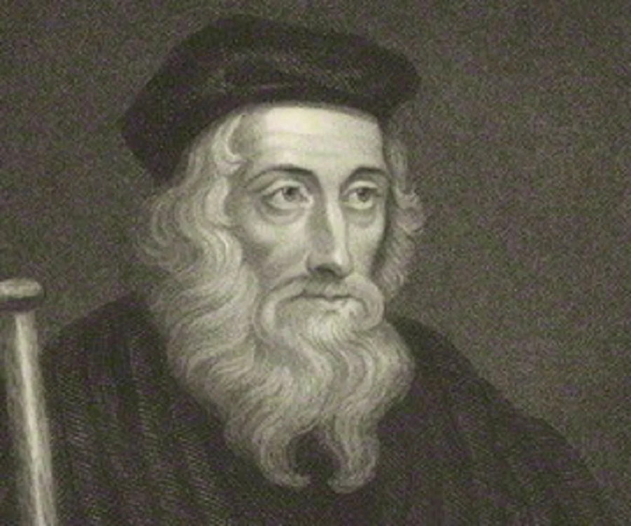
John Wycliffe
Born in Yorkshire, about 1328
Wanted to evangelize the common folk
Went to Oxford in 1345
It was not like college today!
Wycliffe was insanely well educated.
Had a hatred for wickedness.
Was irreproachable in the conduct of his life, even by his enemies.
Was a bold reformer and ran into problems with the HRCC.
Responsible for (re) starting the spirit of religious inquiry and spiritual freedom

