Slide 1
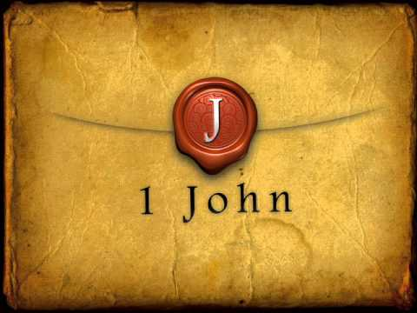
Determining the meaning:
Commentary, workbook?
OR
Read, read, read, read, read the text
(When you read this, you can perceive my
insight into the mystery of Christ Eph 3:4)
What is first John about?

Slide 2
Primary subject of letter is Jesus. Evidence for Jesus as an actual historical character is based upon objective, empirical evidence, 1-2
1 That which was from the beginning, that which we have heard, that which we have seen with our eyes, that which we beheld, and our hands handled, concerning the Word of life 2 (and the life was manifested, and we have seen, and bear witness, and declare unto you the life, the eternal [life], which was with the Father, and was manifested unto us); ASV
What is first John about?

Slide 3
Fellowship with Jesus possible 1:3-4
3 that which we have seen and heard declare we unto you also, that ye also may have fellowship with us: yea, and our fellowship is with the Father, and with his Son Jesus Christ:
4 and these things we write, that our joy may be made full. ASV
What is first John about?

Slide 4
Facts about Jesus
From the beginning 1:1; 2:13
Manifested 1:2; 4:2
Destroyed works of devil, 3:8
With the Father 1:2
Blood cleanses from sin 1:7; 3:5; 3:16
Propitiation for sin 2:2; 4:10
Is righteous 3:7
Have life through 4:9; 5:11
Savior of the world 4:14
The Son of God 4:15; 5:5
Begotten of God 5:1
Came by water and blood 5:6
Gives us understanding 5:20
Is the true God and eternal life 5:20
What is first John about?
JESUS

Slide 5
All are sinners 1:8,10
What sin is 3:4; 5:17
Two ways of walking: darkness, living in sin, or light, avoiding sin 1:6,7
How to avoid sin 3:6, 9; 5:18
Provisions for sin 3:5; 1:7; 2:2; 4:10
Consequences of life of sin 3:6, 8, 10
When we sin 1:9; 2:1
What is first John about?
SIN

Slide 6
Verbs in 1 John
Walking
Confessing
Keeping
Loving
Abiding
Practicing
Guarding
Purifying
an active life
continuous activity
present tense activity
not what we were
not what we intend to do
mandatory activity
responsibilities to selves
What is first John about?
ACTION

Slide 7
Liar, Lie
1:6, 10 2:4, 21, 22, 27 4:20 5:10
Antichrist,
2:18,19, 22 4:3
Children of the devil
3:10
False prophets
4:1
Spirit of error
4:6
What is first John about?
False Teaching

Slide 8
2:4,11,13,14,20,21,29 The one who says, "I have come to know Him," and does not keep His commandments, is a liar, and the truth is not in him;…But the one who hates his brother is in the darkness and walks in the darkness, and does not know where he is going because the darkness has blinded his eyes…I am writing to you, fathers, because you know Him who has been from the beginning. I am writing to you, young men, because you have overcome the evil one. I have written to you, children, because you know the Father…I have written to you, fathers, because you know Him who has been from the beginning…But you have an anointing from the Holy One, and you all know…I have not written to you because you do not know the truth, but because you do know it, and because no lie is of the truth…If you know that He is righteous, you know that everyone also who practices righteousness is born of Him.
What is first John about?
Knowledge

Slide 9
2:3,5,18 By this we know that we have come to know Him, if we keep His commandments…but whoever keeps His word, in him the love of God has truly been perfected. By this we know that we are in Him:…Children, it is the last hour; and just as you heard that antichrist is coming, even now many antichrists have appeared; from this we know that it is the last hour.
3:19,24 We will know by this that we are of the truth, and will assure our heart before Him…The one who keeps His commandments abides in Him, and He in him. We know by this that He abides in us, by the Spirit whom He has given us.
4:2,6.13 By this you know the Spirit of God: every spirit that confesses that Jesus Christ has come in the flesh is from God;…We are from God; he who knows God listens to us; he who is not from God does not listen to us. By this we know the spirit of truth and the spirit of error…By this we know that we abide in Him and He in us, because He has given us of His Spirit.
5:2,13 By this we know that we love the children of God, when we love God and observe His commandments.…These things I have written to you who believe in the name of the Son of God, so that you may know that you have eternal life.
What is first John about?
Knowledge

