Slide 1
Building a Personal Bible Study System

Slide 2
Bible Study
It’s important! Matthew 6:33
How do we get God’s word into our heads more deeply?

Slide 3
Zettelkasten
Write ideas on slips of paper (index cards).
Give each slip a name or number.
On each slip, add a list of references to other cards.
Keep all cards sorted in a box.

Slide 4
Sample Bible study system
Monday: Pick a topic
Tuesday: Find relevant scriptures
Wednesday: Read all scriptures. Summarize topic.
Thursday: Consult other materials.
Friday: Write Zettel card and file it.

Slide 5
Example card:

Slide 6
Why use this for Bible study?
Helps connect ideas and scriptures
Provides insights
Great resource for studying with others
Provides a framework for future study
Advice: Keep a “curiosity” list of things you want to study.

Slide 7
Practical considerations
Digital tools to make this easier:
Obsidian – free for personal use
Zettlr – free
Roam Research – paid
Notion – paid
The Archive – paid, MacOS-only

Slide 8
Example study: Nahum
Overview of the book
Outline of the book
Lessons for us

Slide 9
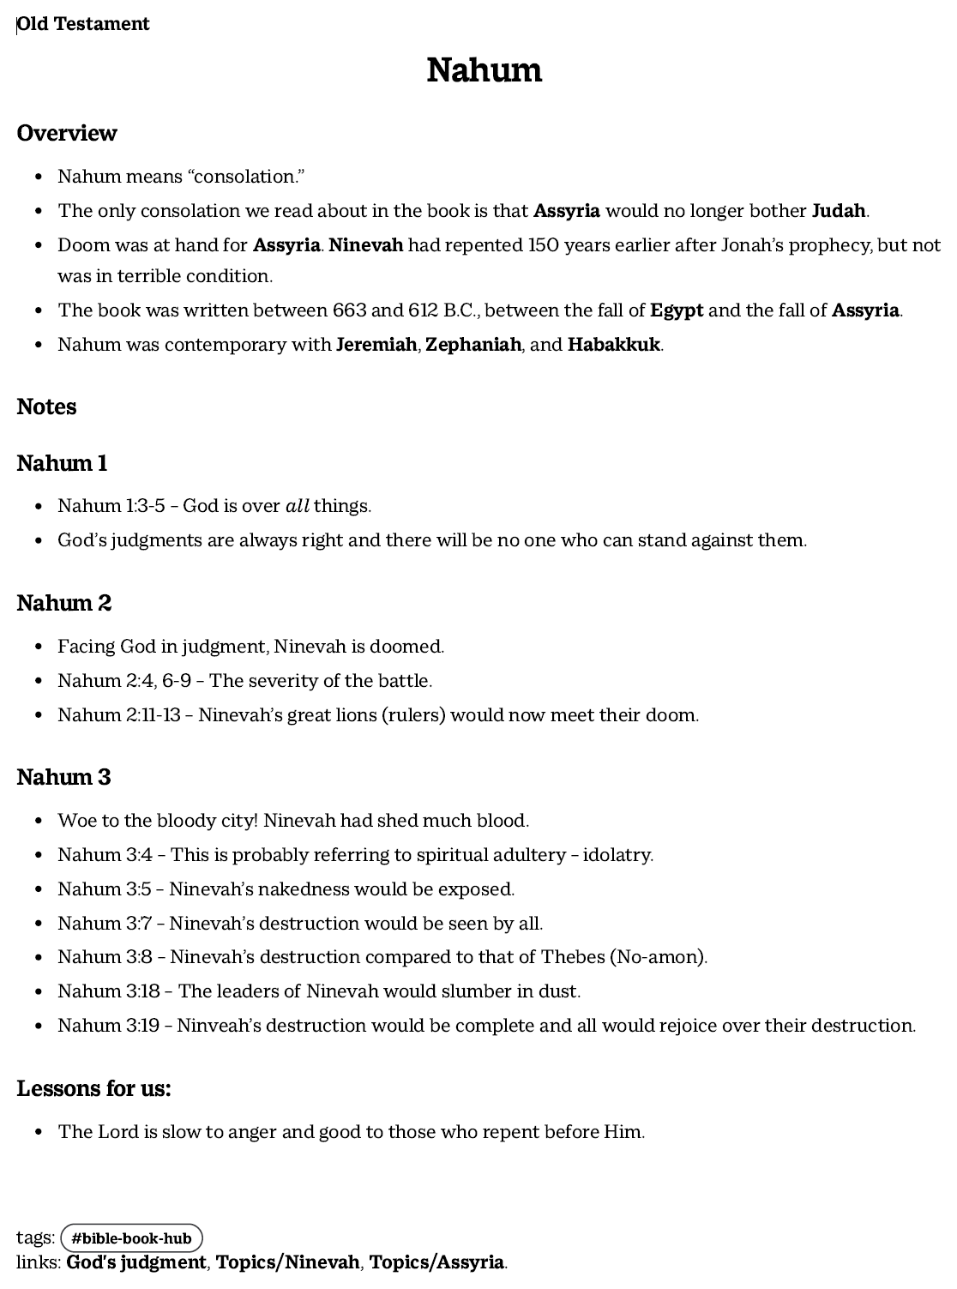

Slide 11
Example study: Cornelius
Was a Roman centurion, a Gentile.
Was a faithful man.
Received a vision to fetch Peter.
Peter came and preached.
Holy Spirit fell on all who heard.
Cornelius and those with him were baptized

Slide 13
Conclusion
Bible study is important!
If you’re already studying, keep at it!
If any of this helps, add it!
If you don’t have a study plan in place, now is the time to start!
Consistency > complexity
God’s word is the most valuable resource we have!

