Slide 1
Meditation

Slide 2
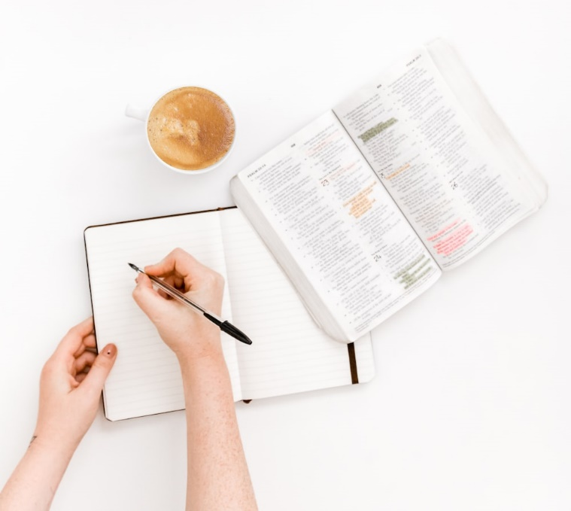
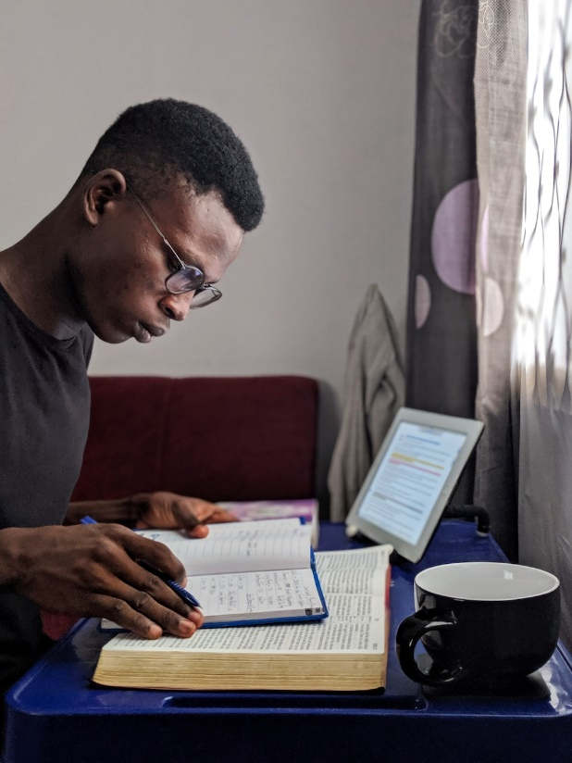
What is it?

Slide 3
What is meditation?
Psalm 77:6
I will meditate with my heart
And my spirit ponders
Psalm 77:12
I will meditate on all Your work
And muse on Your deeds
Isaiah 33:18; Psalm 73:16; Isa 14:16-17; 43:18
Contemplate
Dwell on
Consider

Slide 4
What does the Bible teach us?
Genesis 24:63
Joshua 1:8
Job 15:4
Psalm 1:2
Psalm 4:4
Psalm 19:14
Psalm 27:4
Psalm 49:3
Psalm 63:6
Psalm 77
Psalm 119
Psalm 143:5
Psalm 145:5
Psalm 104:34

Slide 5
Summary

Slide 6
Who
You
Young, old, or depends on the day
Book smart or practical
Lover of routine or… squirrel!
Just you
There is time for others for study and edification, but we need time alone with God
Moses spoke to God 1-on-1, THEN he came and others saw the glory of God in his face Exodus 34:29-35
God
Listening to God’s words
Thinking about God’s thoughts
Speaking to God

Slide 7
What
All the ways God has made himself known – print, people, planet
All the ways your walk interacts with God
Good times and bad
Joys and sorrows
Easy times and hard times
In strength and in weakness

Slide 8
When
Deuteronomy 6:6-9
At the beginning of the day
In the night watches
All throughout the day
Luke 1:29; 2:19; 2:51
In the middle of a conversation
When God does and declares wonderful, and maybe even perplexing things

Slide 9
Where
Anywhere Everywhere
Noisy or quiet
Alone or in a crowd
On your bed
On the road
In the city
In a desolate place
By the “sea” Mt 13:1
On the “mountain” Mt 15:29
A secluded place Mk 1:39
Corner of a coffee shop, or McDonald’s, a park, library, your closet, porch, or portable isolation (headphones)
On a mower or tractor
In your car
Instant meditation – turn off the radio!

Slide 10
How
Methods
Read, Examine, Apply, Pray (REAP)/Revelation, Observation, Prayer, Engagement (ROPE)
Read, understand, look for God/Christ,
Read, study, memorize, apply, remember
Daily routine
Reading
Journaling, copywork
Weekly routine
Read the same passage every day for a week
Focus on one passage or topic, with a different angle each day
Sing
Get a spiritual song stuck in your head
Two key aspects
Spend time in the Word
Spend time with the Word in you

Slide 11
How
But I can’t focus!
Maybe that’s okay
Find purpose
For others
For yourself
Techniques
Start with meditating on meditating
Find silence
Whatever silence helps you the most – auditory, visual, mental, physical
Visual reminders – cards, markerboard/chalkboard
Phone reminders
Buddy system – one or a group

Slide 12
How – Tips from friends
The world's noise gets in the way of what God is trying to tell us so much.....it's hard to just listen sometimes. I meditate in the church, or I try to meditate in nature. If the weather is nice, a walk, or sit on my porch in the morning or evening when the world is still....surrounded by God's creation, or just sitting by a window, when the weather isn't so nice and just enjoy what God has given us.

Slide 13
How – Tips from friends
I copy scripture in the morning. I just started the book of Job. It makes me slow down and gives me time to think about what is being said. I listen to scripture being read at night. Not much meditating going on then because it doesn't take long before I'm sound asleep but on nights I struggle to sleep, it's a great way to focus my mind on things above.

Slide 14
How – Tips from friends
One thing that helps me in preparing for my own meditation is looking through other verses that are parallel in any way to a particular passage that I’m thinking about, to get a fuller idea of other aspects to consider. Considering cross references￼ and searching a concordance can often help me to see different angles for deeper meaning.
One overarching purpose of meditating on the scriptures seems to be to test our understanding and to internalize the instruction.

Slide 15
How – Tips from friends
Looking at the who, what, when, where, and why and then, comparing different versions to get the fuller meaning helps me.

Slide 16
How – Tips from friends
During study time, I like to write the text, underline key words or repeating concepts. Draw a picture of it. Make lists of what I learn about God or key characters. Research the customs, festivals, lifestyles, etc of that time.
Then after study time it is easier to dwell on these things. Meditation on God’s word can be done while doing mundane tasks, driving, lying in bed as you drift off to sleep. During meditation you can imagine it’s a movie and think about what it would feel like to be seeing what’s happening, or what it would feel like if someone said that to me.

Slide 17
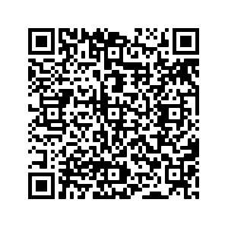
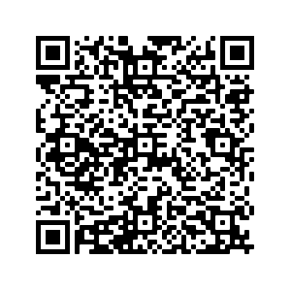
How – Tips from friends
nwcocmn.org
Andy Cantrell
Hearing from God: Meditation
10/30/22 - Sun AM Bible Study
The Value of Meditation
09/06/20 - Sun AM Worship

Slide 18
How – Tips from friends
I like to read and listen to a chapter in the morning, then read it again at night. Each reading almost always reveals something previously overlooked.

Slide 19
How – Tips from friends
Occasionally I'll attempt a new memory passage (not just A verse)...learning it gives me impetus to meditate on it. I read it aloud emphasizing different words, think about how each phrase is worded, read it in different translations, and just pray/work to understand clarity of meaning to the original audience.
Practically, I write out the passage on a note card (or a few) and place where I can see it often even when doing other tasks or when I have free moments.
Right now I have a passage written in dry erase on my bathroom mirror.
I also try to share with a sister or two what the Lord is helping me see. Just that act of sharing often reveals something new as my mind contemplates how to speak it.

Slide 20
How – Tips from friends
I am not sure what the real idea of "meditation" entails. This comment is more just a technique of Bible study. A year or so ago, I decided to rephrase/summarize the stories in the book of Joshua. The idea was to rephrase & summarize in a way that I might tell the stories to my older grandchildren (9 to 12 ish). In the attempt to retell and summarize the stories, it made me look deeper, think deeper, and connect better than just a straight reading.

Slide 21
How – Tips from friends
Meditate during the slow moments of the day. Before you get up or at night when all is quiet. No distractions.

Slide 22
How – Tips from friends
Sometimes I carry around scripture notecards on a key ring. They are in my purse or by my bed to glance at throughout the day. Posting scriptures around my house is something I have done as well, in places where you spend some time and can read them while you work or get ready.
Of course having passages memorized is the best way to meditate because they are just there in your heart when you need them.
In general I am also not good at this or consistent with it. I struggle with not just making Bible reading a check off my to do list for the day and actually making it a part of who I am for the day.

Slide 23
How – Tips from friends
(From a preacher) It's hard for me to slow down and meditate because any time I'm reading and studying, my brain wants to start outlining another sermon. But the best I do is when I start reading the Bible and then just try to think about what it was like, usually focused on some person's experience. What was it like to be Peter is this situation, or to be the angel delivering some news to someone, etc.

Slide 24
How – Tips from friends
Any scene in the bible I look at it from the Stage Set ideology of having to put it on stage for an audience. Context is always huge. How did people act/react? Responses. Impacts. Phrases used meant what to who?
We will be told in lessons to take the scripture and make it personal. I have to do all of the above to gain understanding. Understanding for me is not too easy. It takes time looking at the whys and whats to make gains.
So... I ponder.

Slide 25
How – Tips from friends
Perhaps discuss the consequences of not meditating on God’s Word as we are commanded vs. the benefits as discussed in Joshua 1:8 and other passages.

Slide 26
How – What works for me
Start in the morning – it’s hard to remember from the night before
Immerse in the text
Ask questions
Before leaving study, identify what you are going to think about.
Make it small and focused, i.e., memorable
Walk. At the right speed.
Stare
Stop doing

Slide 27
Why?
Deuteronomy 6:1-3, 12, 20-21, 25
For yourself
For your family
That it may be well with you
That you may prosper and multiply in your promised land
Deuteronomy 8:2, 11, 14, 18, 19-20
That you may remember
Beware that you do not forget the LORD your God
Then your heart will become proud and you will forget the LORD your God
But you shall remember the LORD your God
It shall come about if you ever forget the LORD… you shall perish

Slide 28
Why?
Psalm 1:3
To be like a tree firmly planted
Fed by living waters
Bringing its fruit
Leaf that does not wither
Proverbs 5:6
The adulteress does not ponder her path

Slide 29
Why?
Philippians 4:8
Finally, brethren, whatever is true, whatever is honorable, whatever is right, whatever is pure, whatever is lovely, whatever is of good repute, if there is any excellence and if anything worthy of praise, dwell on these things.

