Slide 1
Trends in Technical Communication
Missouri State University
Technical Writing Conference
April 23-24, 2010
Tom Johnson • idratherbewriting.com • @tomjohnson
Notes:
Introduce self
Blog tagline
Keeping up with trends is one of the high priorities of professionals (STC Suncoast chat)

Slide 2
A Literacy Revolution
Image 1
“I think we're in the midst of a literacy revolution the likes of which we haven't seen since Greek civilization.” — Andrea Lunsford
Notes:
I read this article in Wired a while ago about a literacy revolution. Andrea Lunsford name caught my eye from the time I used to teach composition.
All those 25 things about you, those blog entries, those 500 text messages a day start to add up. Students are smart about adjusting the tone and style to fit the context.
The advice I always gave to students when I was a teacher was that, if you want to improve your writing, write. George Orwell has the same advice. If you want to be a writer, write.
Today, lots of people are writing – maybe not composition essays, but emails, texts, blog posts, facebook messages. It may not be a big chunk of writing, but it begins to add up and has helped give way to the idea that …. “anyone can write.”
-------------
Lunsford: http://www.wired.com/techbiz/people/magazine/17-09/st_thompson#ixzz0lc1O1zIO
Flickr: zawezome: http://www.flickr.com/photos/_lovenothing/3772984885/sizes/l/

Slide 3
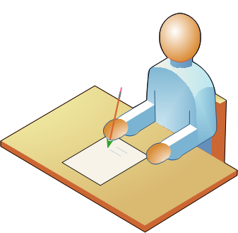
“1. Anyone can write.”
Project Manager
Business Analyst
Secretary
QA Engineer
Intern
Your cousin
Notes:
This is an assertion that really bothers a lot of technical writers. Threatens their security in what they assume to be their core skill.
But more and more this is a pervasive idea that I see in IT environments. For example, we recently had a Developer’s conference. People who weren’t developers followed the technical writing track, because if you can’t develop, at least you can write.
I see it in my day-to-day tasks. When we have communications we need to send out to customers, the project manager likes to write the first draft simply so he can nail down the content. He then passes it off to me to review the language. But really the core task of writing is something he feels comfortable and natural in doing.
Can he actually write? As good as any college-educated person. The writing may be full of passive voice, formalese, and fuzzy constructions, but overall it’s understandable.

Slide 4
“Anyone can write”
Hybrid Roles
Social Media
Multimedia
Collaborative Authoring
Notes:
I’m going to build on this idea that “anyone can write” and see its effect on four main trends in the tech comm field: hybrid roles, social media, collaborative authoring, and multimedia.
In many cases this assertion is what is helping drive the trend.

Slide 5
Must do something more…
“Doing what you're told to do and what you're expected to do is nowadays simply not enough anymore. You always have to do something more than what you're basically supposed to be doing ."
—Bogo Vatovec
Notes:
Every year I try to attend the trends panel at the STC Summit. One of constant messages in these trends panels is that you have to do something more. This is something that Bogo Vatovec, a tech comm project manager in Berlin says. If writing is you’re only skill, you’ll soon be fired. More and more, writing is looked at as a commodity, an inherent skill that everyone is expected to have. It’s not something that you can base your career security on. You have to do something more.

Slide 6
Become a Hybrid
“To be successful over the next 10-15 years, tech comm people are going to have to become hyphenated. You can't just be a technical writer. You have to be a technical writer-usability expert. Or a technical writer-accessibility expert. Or a technical writer-project manager.”
—Jack Molisani
Notes:
Jack Molisani is another industry expert. He runs a staffing company that specializes in IT people, including technical communicators. I interviewed Jack at a conference a while ago. He says much the same as Bogo – that you have to do something more. Only Jack says you have to become a hybrid. I asked Jack how he had become a hybrid, and he replied that he’s a project manager, conference producer, IT staffing president.

Slide 7
Hybrid Possibilities
Usability
Quality assurance
Audiovisual
Marketing
Web design
Instructional design
Training / e-learning
Business analysis
Content management
Social media, such as blogging or podcasting
Corporate communications
Information architecture
Graphic design
Content strategy
Notes:
In the field of technical communication, you have plenty of opportunities for becoming a hybrid. In fact, one of the challenges the STC society faces as a whole is providing content for the diverse skillsets within the organization. Here are a few of the possibilities you could pursue. I recently gave a talk about how I moved from Overlooked to Center Stage (so to speak) by playing other roles.
I started playing roles in quality assurance, usability, audiovisual, and collaborative authoring. Playing these other roles helped transform me from a quiet, unnoticed person in meetings to someone who constantly contributed to the design and development of the product.

Slide 8
Notes:
Lynda.com is one of my favorite sites. They provide video tutorials for a ton of software applications. In their most recent newsletter, I saw an advertisement for a technical writer job posting. As I looked closer, I saw that this person really needed to have an in-depth audiovisual skillset, someone who would easily fit into a production studio. They’re not just looking for someone who can write, but someone with experience working with web tools, flash, final cut pro, after effects, and Illustrator. This is an example of the hybrid role.

Slide 9
Doc Guy and his XML class
Notes:
Have a hybrid role can also help you get your first job. One of my colleagues decided to take a course in XML and XSLT in college. When he started looking for a job, this skillset caught the attention of a hiring manager. The company was moving to XML and needed someone to help them make the transition. My colleague Paul landed the job.
Paul later went to work for a text analytics company, and he started to learn another skillset: linguistics. The more he learned about linguistics, the more valuable and capable he became in his documentation role.

Slide 10
Double Major? Minor?
Secondary domain?
Image 2
Notes:
If I could turn back the clock on my career and return to college, I would double-major in something. Probably English and graphic design, or English and Digital Media, or English and computer science.
I loved the immersion in literature and the opportunities to find my writing voice. But I could have also considered minoring in a secondary knowledge domain. Perhaps minoring in health science, or engineering, or some finance. Not only are skills important, but knowledge expertise in a secondary domain is just as important, if not more.
http://www.flickr.com/photos/skywhisperer/2462141919/sizes/m/ photo by skywisperer

Slide 11
Knowledge Domain Expertise
“I started my accounting Master's degree in January 2008, having never had an accounting class before but having had work experience in accounting, and I have found that I really enjoy the classes. I will finish up in June 2009 and then take review classes and then sit for the CPA exam.” —Heidi Hansen
Notes:
http://heidilhansen.blogspot.com/2009/03/accounting-textbooks-and-general-update.html
One of my professional colleagues, Heidi Hansen, did exactly this. She was working for an accounting software firm in Seattle when she began to realize something. In order to write documentation that went beyond simply navigating and clicking buttons in the interface, but instead could provided instruction for real business-driven scenarios, she would need to increase her knowledge of Accounting. She entered a masters program in accounting and buried herself in Accounting books (for example, those listed above). She later became a project manager.
When you possess expertise in the knowledge domain you’re software addresses, you can begin to take your help material to the next level. I know this because I used to work for a financial firm and would struggle – without a Series 7 license – to even understand what the software was for, much less how people could use it business contexts. One day we visited a financial advisor in the field (it was a field trip for our whole team), and we asked him if he accessed any of the help materials that we wrote. He responded that he had never actually looked at any of the help. It was a let down to us, but I later realized that our help didn’t ever go beyond simple how-to instructions in the interface. The real situations that users would be in wasn’t really in our help because it was a knowledge domain we knew little about.

Slide 12
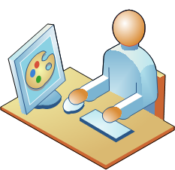
I stepped out of my role many times
“I was hired as a technical writer for a small software development group. They had a team of programmers and technical support staff, but no marketing department. They hired a consultant for any marketing materials they couldn't handle on their own…Being someone who quickly gets bored with the "same old" routine, I kept my eyes open for an opportunity to spread my wings. My chance came prior to an annual software industry conference….I designed an auto-running PowerPoint presentation… The presentation was a hit. After that time, I became their primary source for marketing copy and was included in marketing strategy meetings. …They found that my in-depth understanding of the software helped me write more convincingly than the consultant.” —Wendy Cunningham
Notes:
Sometimes you enter a job as a technical writer, but then later expand into other fields and roles. For example, Wendy Cunningham is a writer who started out working at a software company that outsourced their marketing materials. When it came time for the company to produce a slick-looking PowerPoint for a trade show, Wendy exercised her PowerPoint prowess and impressed the company with her additional skillset. After that, the company stopped outsourcing their marketing jobs and instead had Wendy do them. Sometimes you have to look for opportunities to move beyond writing into another role.

Slide 13
Content Strategy
Image 3
Notes:
I was recently in Atlanta and learned that an entirely new group of people are meeting on a regular basis to discuss the emerging practice of Content Strategy. Many of the people attending this new group are people who also attend the Society for Technical Communication meetings, so it’s another example of technical communicators branching out into something more.
Content strategy fits well into a technical communicator’s skillset, because the overall question you’re asking, as a content strategist, is what overall message you’re communicating to your audience with your content. But it’s not just written content. It’s everything from the platform to the architecture to the brand. The content strategist is asking questions like these: what are we trying to achieve, how are we measuring success, what content is already out there, and so on.
Talk about Will Sansbury and his move here. Proliferation of social media is making this more of an imperative.
http://www.flickr.com/photos/7819129@N07/4029599309/sizes/o/

Slide 14
Social Media

Slide 15
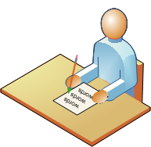
“2. Everyone is writing.”
Anyone can write.
Project Manager
Business Analyst
Secretary
QA Engineer
Intern
Your cousin
Notes:
I started out by saying there’s a pervasive assumption in IT environments that anyone can write. And therefore technical writers have to do something more than simply write. They have to become hybrids with another skillset or knowledge domain to maintain their value.
But there’s another idea that follows on the heels of the idea that “anyone can write.” It’s the fact that “everyone is writing.” I mentioned earlier that people are writing on blogs, on Twitter, Facebook, and other social media sites more than ever before. Rather than threatening the technical writer’s skillset, this prolific amount of content available, often from customers, turns out to work to the technical writer’s advantage.

Slide 16
A pipeline of
customer data
“Now the technical communicator is in essence the keyholder on a pipeline in of customer data, which is essential to product development… . So now instead of just giving the manual which goes in the box because they have to, now tech comm has a conversation going with the client post-sale, to see where their problems are, to see how their customer experience has been with the product over time. And because that conversation is intimate about the details of the customer experience with the technology, then that becomes very valuable data.” —Noz Urbina
Image 4
Notes:
A couple of years ago I attended a conference and interviewed Noz Urbina, a tech comm expert somewhere in Europe, about the role of social media in technical communication. He explained that the technical communicator’s involvement in social media puts the technical communicator in a position to gather immense amounts of data from customers. This data proves to be valuable in developing products.
It seems like prior to the explosion social media, the customer’s voice was somewhat mute. If people didn’t like your product, they may have griped to friends about it, but that was about it. Now everyone has a voice, and some have megaphones. If people are unhappy with your product, or if they have some form of feedback (usually to improve your product), they can immediately post the comment to Twitter, Facebook, or some other site. They can write blog posts about it. They can add their voices to forum posts and as comments on your own company’s site. They can create podcasts reviewing your product.
When technical writers engage in social media, listening to their customers, such as with keyword alerts and other methods, they can tap into this user knowledge in a powerful way. They can better understand the pain points of their customers. They can better understand the scenarios of frustration and write better help to address these problems. They can get a clearer idea of the enhancements and feature sets their products need to have.
http://www.flickr.com/photos/baggis/225007470/sizes/l/ by travis s.

Slide 17
User knowledge drives everything
Notes:
The more you tap into user knowledge, the more valuable you become on your project team. This knowledge of user behavior drives almost everything when it comes to software development. Business analysts gather requirements from customers, interaction designers create user interfaces to allow customers to perform the tasks they want to do, and program managers define the roadmap and feature set of the product. All of these tasks require knowledge of your users, what they want and need and are trying to do. Without this knowledge, you might as well be shooting arrows in the dark at a target you can’t see. The more you tap into this knowledge, the more you become a key player in the design and development of the products you work on. You move beyond simply documenting what is and instead start driving what should be.

Slide 18
Notes:
Companies should be listening to their customers and responding to their customers in the places where their customers are having conversations. This is one of the principles Anne Gentle, a tech-savvy technical communicator in Texas, explains in her book, Conversation and Community.
Anne explains that one of the first strategies for engaging in social media with your customers is to listen. Not to simply join Twitter or start a blog and start broadcasting to your customers, but to begin listening to their conversations, to start being a participant in those conversations. Later, at a future point when you’re accepted in the community, you can then start driving the conversations as well. But the first and most important step companies can take is to simply listen.

Slide 19
Notes:
Sooner or later most companies take the plunge and decide to start a blog. Sometimes they do this because they realize it makes sense for search engine optimization. Other times they engage in social media simply because not engaging makes them looked outdated. AuthorIt is a help authoring software company in Australia. Last year they finally decided to create a blog, and they even contacted me to ask my advice on a few matters.
You can see that they’ve branded the blog well. It fits right in with their color scheme and looks like an integral part of ther site. Only one thing is wrong: the content is unappealing. As far as I can tell, the AuthorIt blog looks like little more than a vehicle for disseminating marketing material, product information and announcements, and other public relations type of material. When I go to the blog, I rarely find anything interesting.
Companies engaging in the social media arena are immediately at a trust disadvantage. Users assume that companies will shy away from honesty and transparency and move towards the constant promotion of their products. When your content fits this stereotype, your blog loses influence. When the company perceives the blog has little influence, the effect spirals downward. They devote fewer resources to it, making posting fresh content a smaller priority, and before you know it, the blog is like a half dead dog on the side of the road.

Slide 20
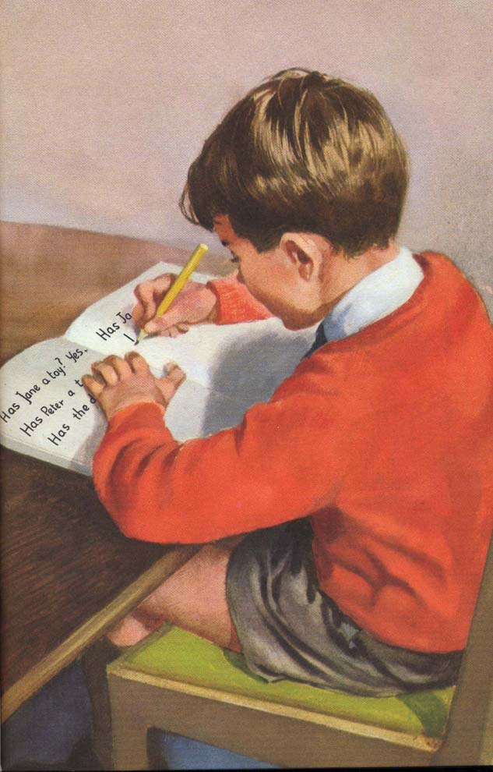
Anyone can write the blog — but not really
Person assigned to write the company blog
Image 5
Notes:
Part of the problem company blogs either die or become impotent is because they also suffer from the idea that “anyone can write.” While it may be true that the intern who is working for $8 an hour can craft clear e-mail messages, to write compelling content for a blog, you need someone who has more writing talent. Some of the best bloggers out there have writing backgrounds. For example, Penelope Trunk has a blog called The Brazen Careerist. It’s one of the most popular, engaging blogs out there. She has a background in writing, like many others who have found success.
To write an engaging blog, you need a strong sense of story, an ability to create constant material, with little or no time, an ability to keep your audience up to date on the latest news and trends.
http://www.flickr.com/photos/larkingabout/401687521/sizes/o/
Larking About

Slide 21
Notes:
In a company blog, you also want to apply another strategy: focus on your customers. TechSmith’s Visual Lounge blog is a good example of this. Many of their posts highlight videos that customers have created using their software. It works well to put the focus off of their company and to avoid the trap of recycling marketing material and instead shine the spotlight on their customers and what they’re doing with the TechSmith products.

Slide 22
Collaborative authoring

Slide 23
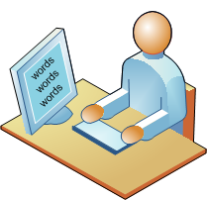
3. Many are sharing.
1. Anyone can write. > 2. Everyone is writing.
Business Analyst
Project Manager
Secretary
Secretary
QA Engineer
Your cousin
Intern
Notes:
I’ve said that anyone can write, and that everyone is writing. There’s another aspect of this writing explosion. People aren’t writing in vacuums. They aren’t producing content that remains on their computers. They’re sharing the content. They’re collaborating with each other to create the content. No person is an island out there. Many people are building on each other’s writing in the content creation process.
Wikipedia is the success of success stories of this collaborative writing trend. Wikipedia convinced us that the wisdom of the crowd idea does actually work.

Slide 24
Multi-sourcing
Image 6
Notes:
Because people are sharing their writing, the idea of “single sourcing” is falling by the wayside. It no longer works to have one writer be the single source for all the content that is produced. While it’s cool when you can make single sourcing work (and with some projects, you’re really just the long writer), ultimately to facilitate collaboration we’re moving from single sourcing to multi-sourcing. Multi-sourcing takes writing from many different sources and combines or mashes them together.
http://www.keycontent.org/tiki-index.php?page=Why+Single-Source+when+you+can+Multi-Source%3F

Slide 25
Image 7
Notes:
When you start to pull content from a lot of different sources and authors together, you might have what’s called a DocMashup. This is a drawing from Mike Hiatt’s site, Mashstream.com. In a DocMashup, the technical writer is no longer the one driving all the content. The tech writer is more like a “guide on the side.” He or she is the one who is pulling and organizing all of this content. The writer is bringing it together and presenting it for the user, but is not the person generating all the content. The DocMashup works partly because of RSS feeds that can pull together content. RSS is a format that can be syndicated and pulled, mixed and mashed. But the content can also be static links that the DocMashup organizer pulls together. The DocMashup becomes more like a portal into other content rather than being the destination for the content itself.
http://mashstream.com/mashups/the-docmashup/

Slide 26
?
Notes:
One reason people are collaborating is because anyone can write. My manager was recently asked to help write and rewrite the content for the new version of the lds.org site. At first he wasn’t sure how to approach it, because like any large organization, there are a lot of different departments with different types of content. For example, on the lds.org site above, if one person were tackling the rewrite of this site, the person would need to know about everything rom Adoption Services to Family Finances to Pregnancy Consulting. No one knows all of this. You could spend time interviewing a ton of experts all day, carefully taking notes and then asking them review your writeups, but why? Why not just allow others to write, and then clean up their writing? That’s the only sane way to approach a task like this. Collaboration makes sense.

Slide 27
Image 9
Image 10
Notes:
One of the problems with multi-sourcing and pulling content from all kinds of different people and sources, however, is that it makes structured authoring nearly impossible. The explosion of social media content seems to be at odds with the emergence of structured authoring and strategies like DITA, which require the content to be formatted with specific tags. The screenshot above shows the tags necessary to structure content with the DITA XML model. But if you’re multi-sourcing your content, having non-technical people write it, you can’t ask them to structure their content in DITA tags. You end up either structuring it yourself, and then reverting to the single source model again. Or you have to revert to another model: the wiki.
http://www.ditausers.org/training/DITATopics/

Slide 28
Notes:
Wikis are about the only sane way to do collaborative authoring with large groups of people. This wiki is the wiki we use to drive all of our community projects. We have hundreds of volunteers come to this site not only to find information they need for their projects, but also to add their own content as well. We have an internal person who manages the wiki overall, but the majority of the content creation is done by the community participants. It just wouldn’t work any other way.
While creating some API documentation for some of the tools the community members would be using, my colleague initially created the API documentation in Flare, a help authoring tool. It looked good and was well organized, with expandable sections based on what you were trying to find. But the community leader decided against the non-wiki format because it didn’t allow community members to add their own examples and code snippets. At first my colleague was upset about this, but soon realized, after a few weeks of seeing actual contributions from the community, that the wiki was the better choice.

Slide 29
Notes:
The WordPress Codex is my favorite wiki. This is another example of a project whose documentation couldn’t be tackled any other way except with a wiki. There are so many different ways to implement and tweak and modify the code that runs WordPress, you would need a whole team of technical authors to even document it. But with the Codex wiki, dozens of different developers can provide code snippets, add tips or tricks, and generally provide the content for hundreds of topics that would otherwise not be written in a traditional tech writing setup.

Slide 30
Notes:
Even the FBI apparently has a wiki to enable knowledge collaboration. They found that key information was often trapped inside long-time employees who simply kept the knowledge to themselves. The wiki provided a way for them to share their knowledge with others. Again, the wiki provides a way for subject matter experts to share their information. To have one or more writers go around to interview and extract this information from SMEs all around the FBI would be ludicrous. You just need a collaborative platform to enable this sharing.
http://fcw.com/articles/2008/09/26/fbi-creates-knowledge-wiki.aspx

Slide 31
Need a wiki? Just choose one
Notes:
http://www.wikimatrix.org/
One of the problems with wikis, however, is that there is no standard wiki syntax. There are more than 100 different wiki platforms, and each platform has a different markup syntax. For example, with Mediawiki, one asterisk creates a bulleted list, a pound sign creates a numbered list. But it may be a different markup with Dokuwiki and so on. This makes it somewhat difficult because the whole idea of collaborative authoring is to simplify and dumb-down the authoring experience so that the masses who aren’t technical can contribute.

Slide 32
Notes:
Here’s an example of the code for the Missouri State University page on Wikipedia. If you’re unfamiliar with mediawiki syntax, it may be somewhat offputting and would discourage people from contributing.
As a result, wiki syntax has to be kept fairly simple to avoid intimidating users. But when you keep the syntax simple, you also frustrate other users who need to do more complicated things.
For example, SharePoint 2007’s wiki is pretty basic. It even has a WYSIWIG interface so you never have to even look at the code. The problem with this, however, is that it’s so basic it’s primitive. If you want to create a numbered list that has a bulleted sublist, you’re out of luck. The numbered list restarts after the bulleted list, and going into the code to override is just a poor experience.

Slide 33
Notes:
Here’s an example of a wiki from Embarcadero. They’re using Mediawiki, and I just want to point out some of the additional advantages of wiki authoring that traditional help authoring tools lack. This is the regular page that you see. By default mediawiki generates a table of contents based on the heading structure for the page. There are several tabs across the top.
http://docwiki.embarcadero.com/

Slide 34
Notes:
If you click the Discussion tab, you can ask a question or raise an issue about the content. So this becomes a space where users can interact and write questions and find answers. People who are watching this page will be notified when additions are made here.

Slide 35
Notes:
The History tab shows you who has made edits on the page. If someone makes an edit that you don’t like, you can roll back to a previous version. More important, though, you can compare revisions to see the exact edits they made. With a page that has multiple authors who have collaborated over time provides a more accurate picture about the realities of the writing process. Usually good content that covers a technical angle on something builds on multiple authors with revisions over time.

Slide 36
Multimedia

Slide 37
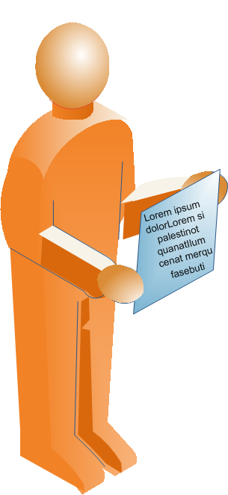
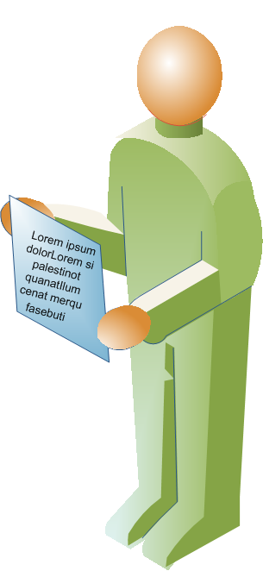
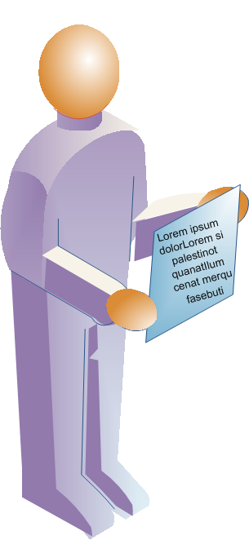
4. Few are understanding.
1. Anyone can write. > 2. Everyone is writing. > 3. Many are sharing.
?
?
?
?
?
?
?
Notes:
I’ve been talking about this idea that more and more people are writing and sharing content. You would think that with this abundance of information, learning any software application would be a piece of cake. When you want to figure something out, you just Google it and voila, there’s your answer in clear English.
While sometimes this kind of phenomenon happens, I still think that the technology gap is as present as ever, if not growing. People still get incredibly frustrated when they can’t figure something out. All of these words aren’t overcoming the problem of communicating technical concepts clearly and easily to non-technical people. People still get frustrated.

Slide 38
Image 9
Notes:
While I think the written word is helpful and indispensable in many aspects of technical communication, I think it also misses the mark. It seems like the number of colleagues I meet who create videos as part of their help materials is an astounding minority. Many technical communicators never do video. Many students rarely learn video. And yet, if you were to ask someone their preferred method for learning a new software application, 90 percent would say they want someone to show them the app. A video is the closest way to imitate that friend showing you the app.
We’re all visual people, learning a visual interface. Why would text be the default medium of instruction? Shouldn’t the default medium be something more visual?
http://www.flickr.com/photos/sybrenstuvel/2468506922/sizes/o/
By sybren a. stuvel

Slide 39
Notes:
A couple of years ago I attended a Wordcamp in my area. I’ve always been frustrated by the WordPress Codex and the lack of a full-time technical writer on the WordPress team. During Wordcamp, Matt Mullenweg, the founder of WordPress, was standing in line next to me. I asked him about the help material for WordPress. He mentioned that they were hiring a screencaster to provide screencasts on WordPress.
It turns out this proved to be incredibly successful. People loved the screencasts. They are simply so much more engaging than written instructions. WordPress even created a wordpress.tv site that focuses entirely on screencasts and other videos about WordPress.

Slide 40
Notes:
These TV sites are a trend. Adobe’s not a dumb company. For their abundance of products, they also need a TV site, and they have one: Adobe.tv.

Slide 41
Notes:
One of the reasons people dislike video is because at some point, they’ve been tainted with the idea that videos are long and tedious. They’re going to have to sit down for 30 minutes listening to some boring narrator drone on and on.
Really with video, the best strategy is to keep the videos short – under 3 minutes as a general rule. Any more than that an you start losing your audience. That’s why I like lynda.com. They get it. They break up their videos into little chunks and allow the user to watch just the chunk the user wants to see. This increases the amount of active learning and engagement with the user. It puts the user in control.
As a video creator, you don’t have time to implement mesmerizing cinematic effects to keep the audience’s attention, but if you keep the videos short, you still keep the audience’s attention because it allows them to click and select just what they want to see.

Slide 42
A Twitter model for videos
“Most [users] don’t have the tools or narrative capabilities to hold the attention of an audience for any real span of time. This is especially true in the screencasting realm which is why I’d like to propose the notion of TweetCasts–120 seconds or less of webcam or screen video. That’s all the time you get to make your point. If you need more time, break your content into chunks, give viewers a rest between segments and try engaging them through a different medium. — Brooks Andrus
Image 10
120 seconds
Notes:
Brooks Andrus even argues that we should adopt the Twitter model of brevity when it comes to videos.
http://www.flickr.com/photos/loopsta/2083172764/sizes/o/ loopsta

Slide 43
Notes:
http://wordpress.org/development/2009/12/wordpress-2-9/
To give you an example of the appeal of video, let’s look at a sample video. When WordPress released 2.9, they could have included a long list of the features that would be included in this release. They could have asked users to read through three pages of text. Instead, they provided a video. Videos just like this have had millions of views. They’re appealing and engaging to watch, and you immediately get the concepts just by viewing the video.

Slide 44
Notes:
One of the problems with video in the past was the difficulty of creating it. Videos looked fuzzy if resized to a smaller dimension than the capture dimension, and the whole process from start to finish required more technical skills than many users had. But youtube now renders your videos into HD for free and makes uploading videos almost a no-brainer. Creating videos can be fairly easy. Of course you can get more sophisticated with your microphone setup, your voiceover technique, and your post-production, but you don’t have to. You can now also add captions for your videos, allowing the content to appear in more search engines.

Slide 45
“Anyone can speak”?
Notes:
The flip camera is also giving way to a new genre of video: the two minute videocast. Here I’m communicating my ideas orally rather than with the written word. Eventually this new technology will probably give way to the idea that anyone can speak and record video.

Slide 46
Contact Information
Tom Johnson
Idratherbewriting.com
tom@idratherbewriting.com
@tomjohnson (Twitter)

Slide 47
Image Sources
image 1
Flickr: zawezome: http://www.flickr.com/photos/_lovenothing/3772984885/sizes/l/
image 2
http://www.flickr.com/photos/skywhisperer/2462141919/sizes/m/ photo by skywisperer
image 3
http://www.flickr.com/photos/7819129@N07/4029599309/sizes/o/ by Richard Ingram
image 4
http://www.flickr.com/photos/baggis/225007470/sizes/l/ by travis s.
image 5
http://www.flickr.com/photos/larkingabout/401687521/sizes/o/
Larking About
image 6
http://www.keycontent.org/tiki-index.php?page=Why+Single-Source+when+you+can+Multi-Source%3F
Rick Sapir
image 7
http://mashstream.com/mashups/the-docmashup/
Mike Hiatt
image 8
http://www.flickr.com/photos/sybrenstuvel/2468506922/sizes/o/
By sybren a. stuvel
image 9
http://www.flickr.com/photos/sybrenstuvel/2468506922/sizes/o/
By sybren a. stuvel
image 10
http://www.flickr.com/photos/loopsta/2083172764/sizes/o/ loopsta

Slide 48
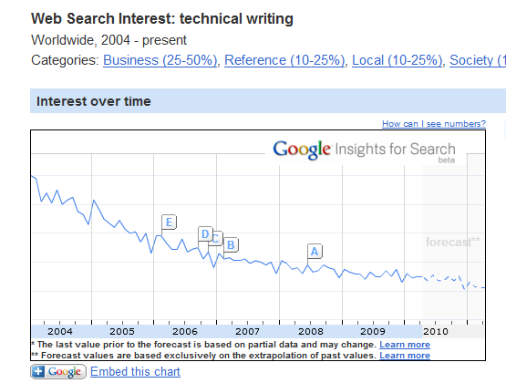
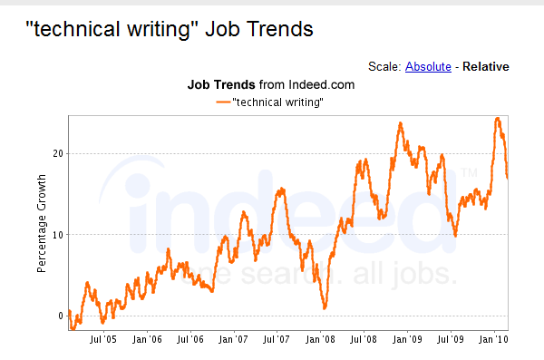
Notes:
To close, I want to end with this perplexing contrast of trends. The trend at the top is from Google’s insights for search. It appears that fewer people are searching for the words “technical writing.” However, if you look at job trends on indeed.com, the words “technical writing” are appearing more and more in jobs.
I don’t know exactly how to explain this discrepancy, but here’s one possibility. People are searching less on Google for “technical writing” because technical writing is becoming less of a specialty. Now people are just writing technical content, without drawing attention to this activity as a special skillset.
In job postings, technical writing is increasingly becoming expected of more and more jobs, and so appears in more job descriptions as a core component of a person’s task.

