Slide 1
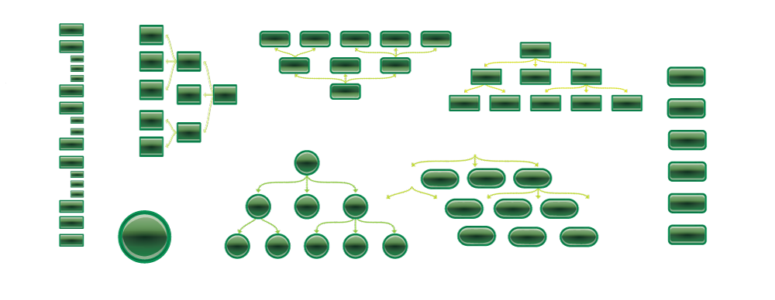
Organizing Help Content: Breaking Out of Topic-Based Hierarchies
STC Summit Sacramento 2011
Tom Johnson • idratherbewriting.com • @tomjohnson • #stc11

Slide 2
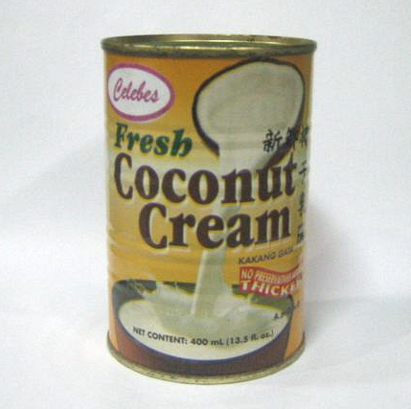
Where would you find this in a grocery store?
Image from TradeKorea

Slide 3
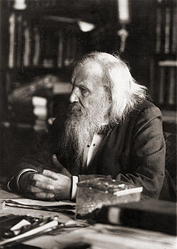

There isn’t an absolute order to find
Radiolab excerpt
Image from Wikipedia

Slide 4
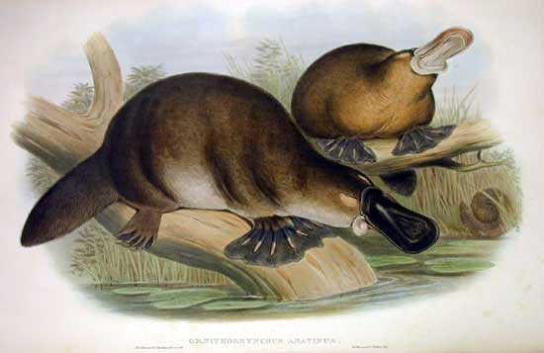
Topics frequently overlap.
lays eggs • venomous • beaver’s tail • otter feet • duck’s bill
Image from Wikipedia

Slide 5
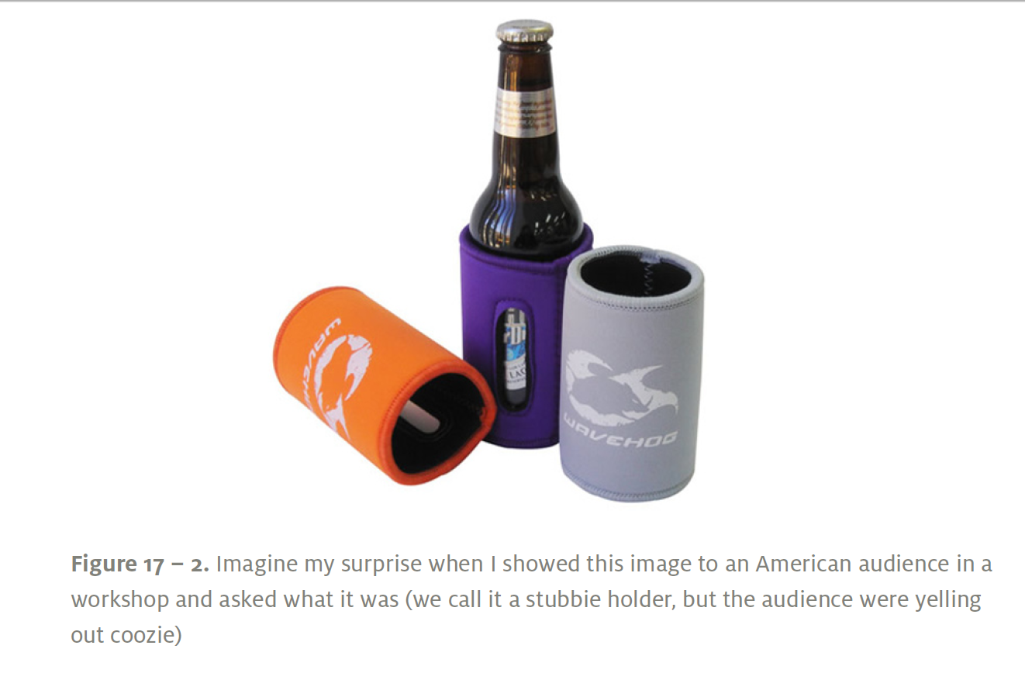
Search fails when users don't know exact terms.
From Donna Spencer’s Practical Guide to Information Architecture

Slide 6
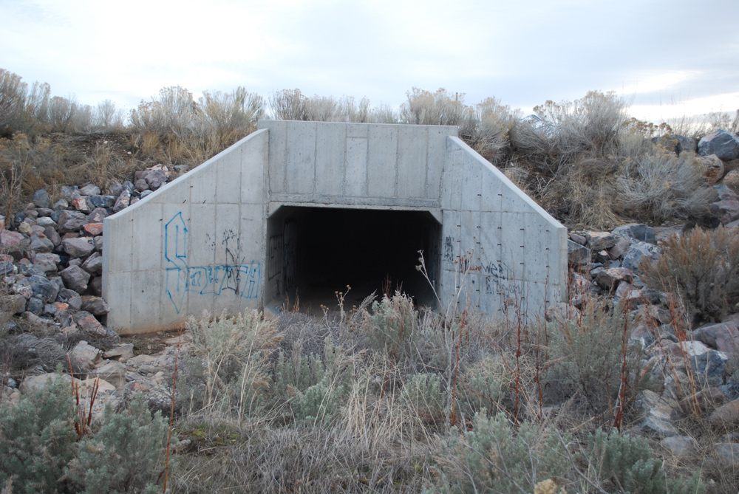
Search fails to help you discover unknown unknowns.
“There are known knowns. These are things we know that we know. There are known unknowns. That is to say, there are things that we now know we don’t know. But there are also unknown unknowns. These are things we do not know we don’t know.” -- Donald Rumsfeld, qtd. by Peter Morville

Slide 7
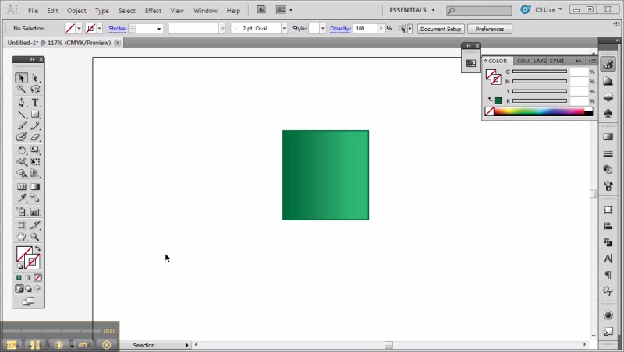
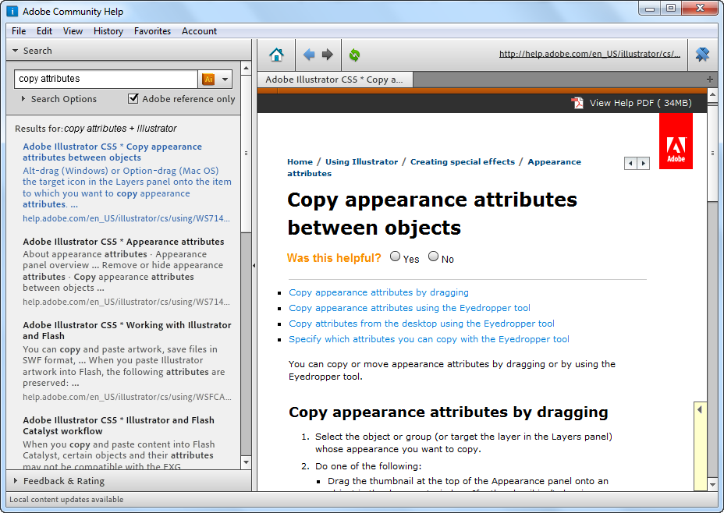
Youtube video link

Slide 8
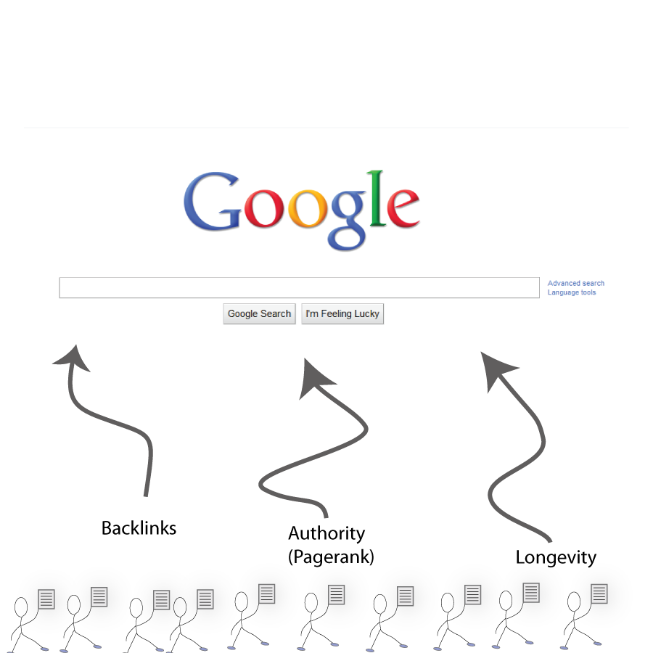
How Google Determines Aboutness

Slide 9

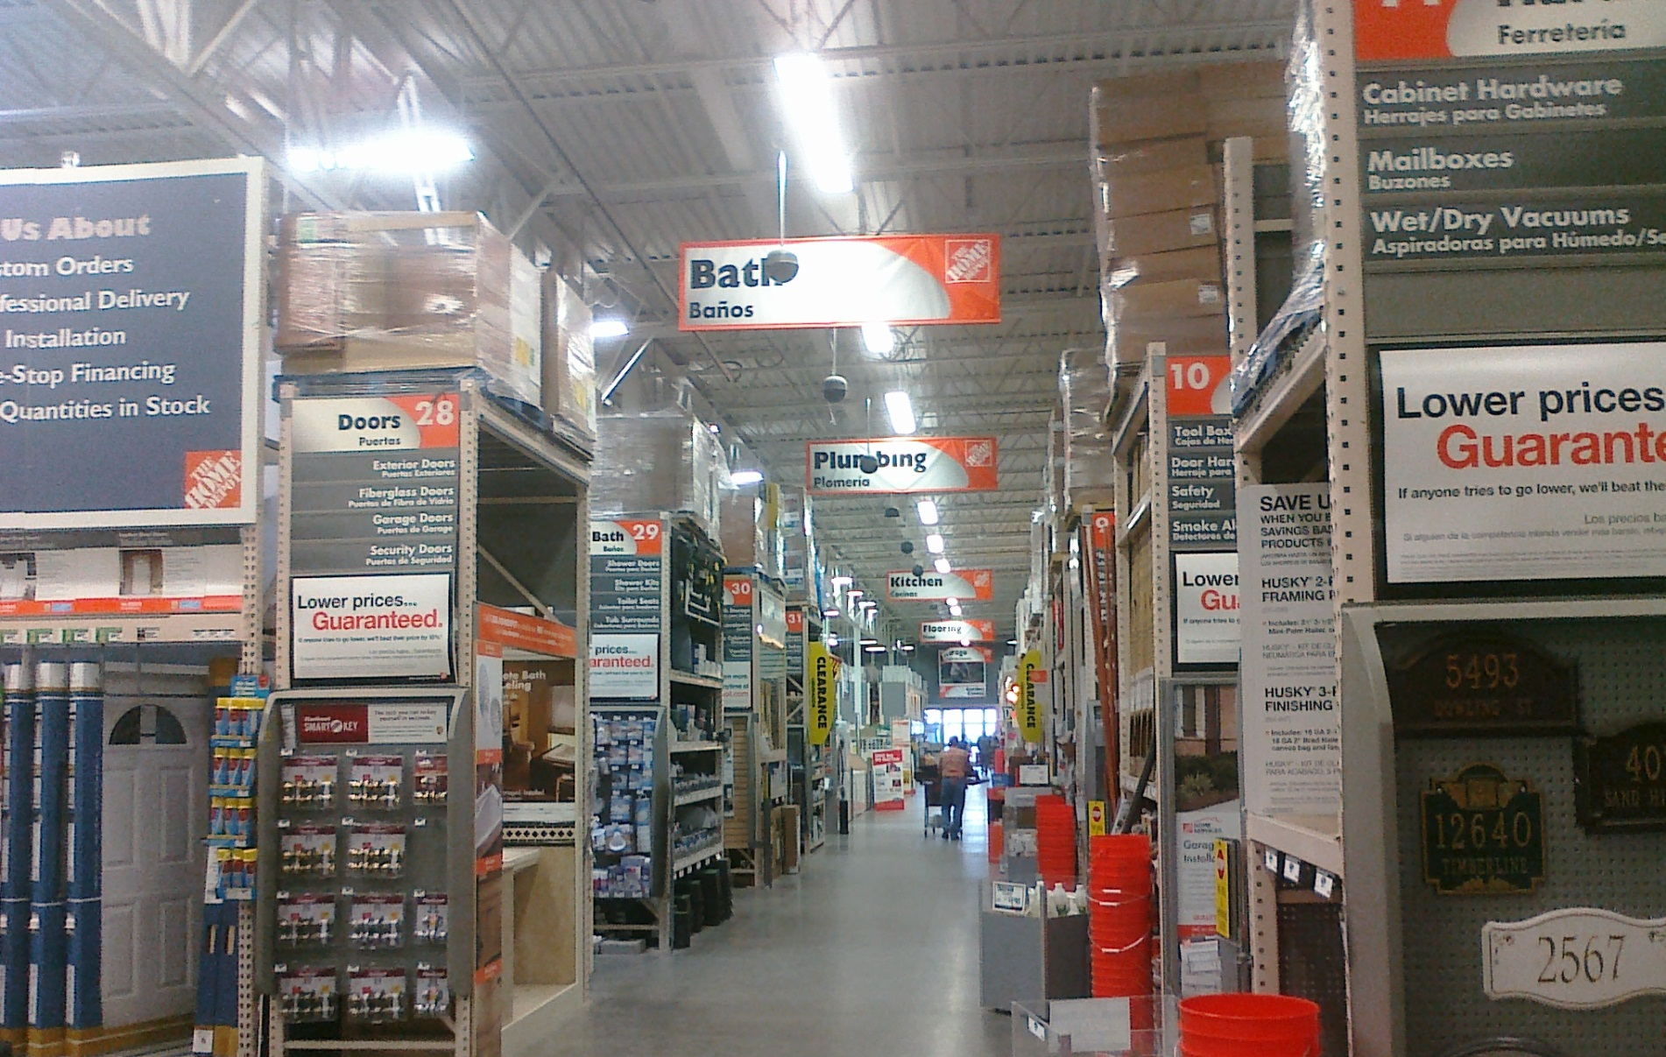
Digital spaces allow near infinite rearrangements
See David Weinberger’s Everything Is Miscellaneous

Slide 10

You can create navigation filters based on your content’s facets.
Image from gwilmore on Flickr

Slide 11
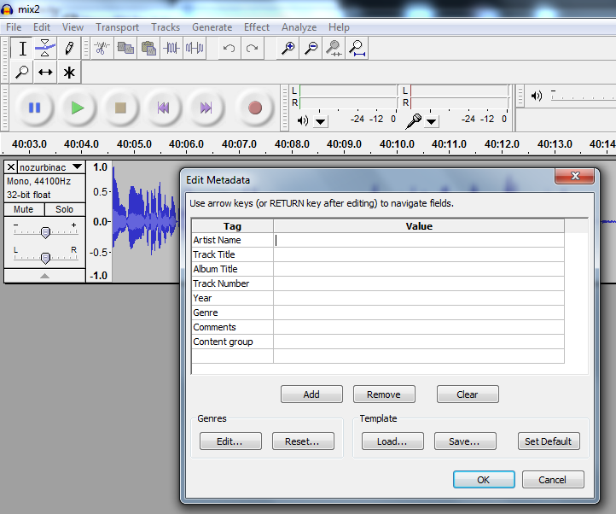
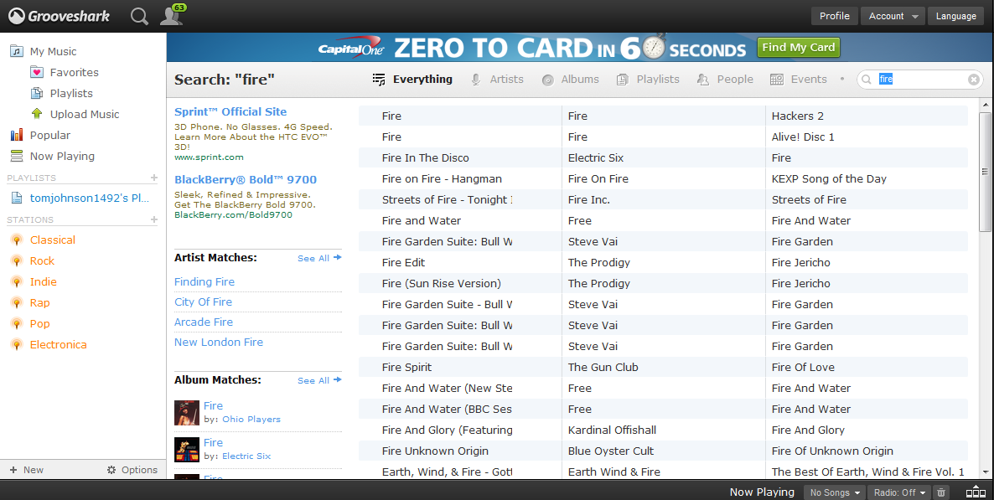
You can push and pull topics in various arrangements through metadata.

Slide 12
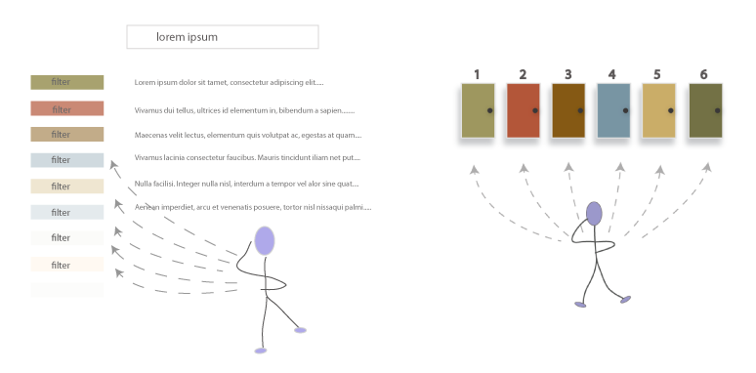
Two Types of Entry Points
Dynamic Navigation
Static Navigation

Slide 13
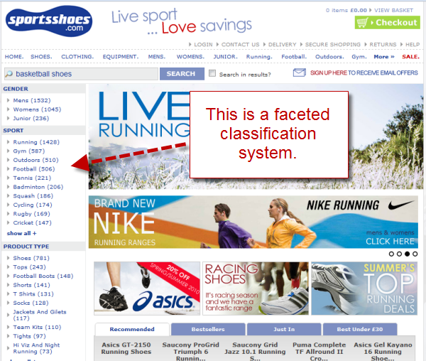
Example from Sarah Maddox/Matthew Ellison

Slide 14
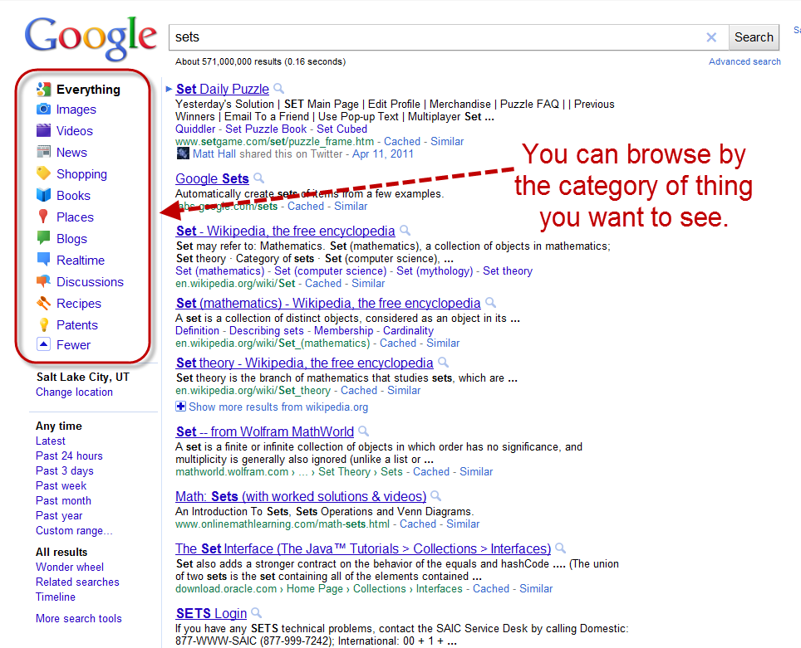

Slide 15
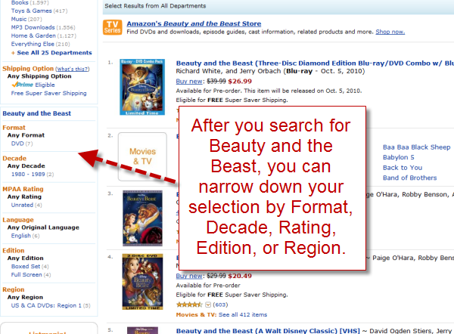

Slide 16
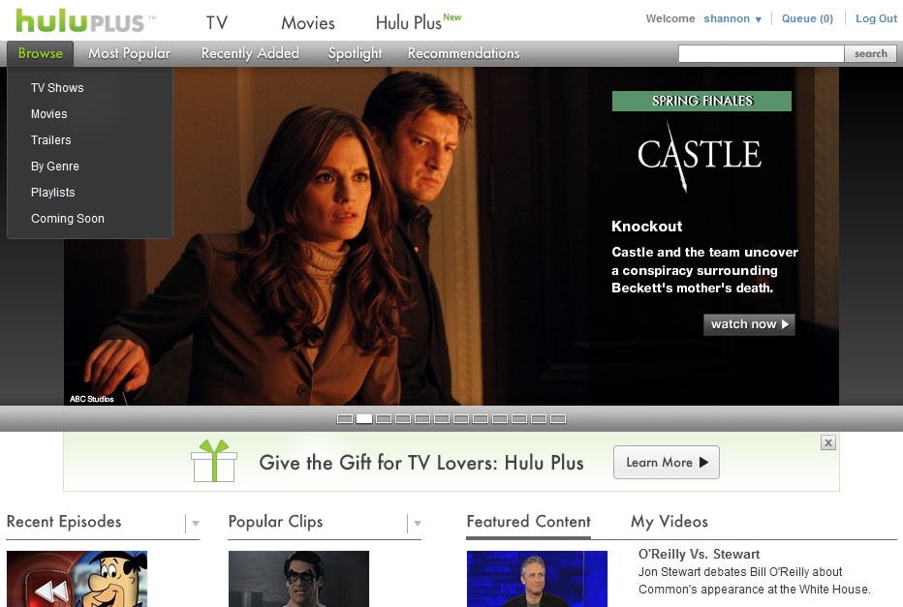
You can choose different entry points into the content.

Slide 17

“Faceted navigation is arguably the most significant search innovation of the past decade.”
–- Peter Morville, Search Patterns

Slide 18
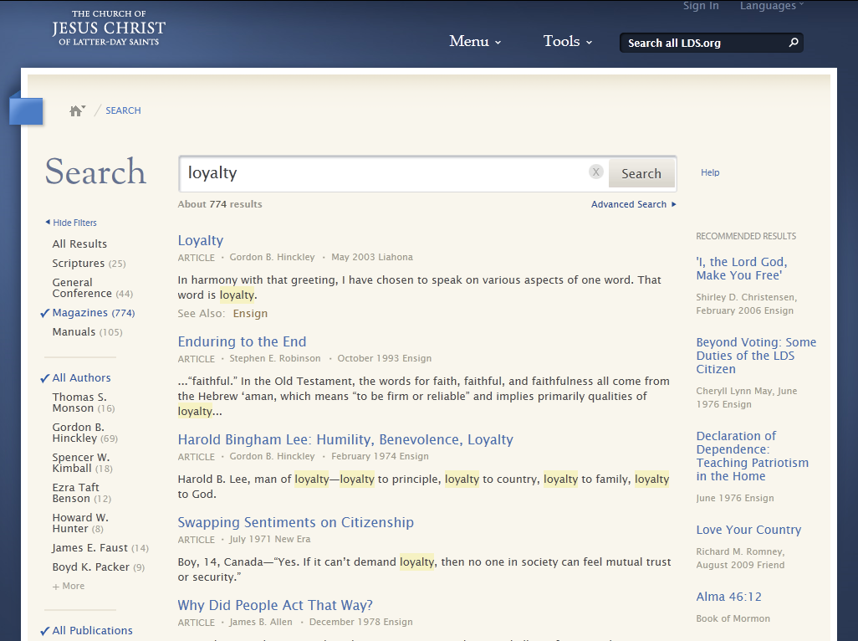
demo

Slide 19
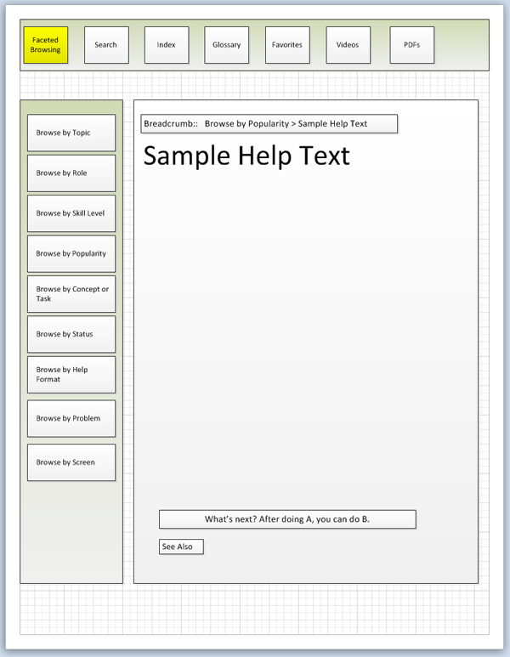
Different entry points into the content.

Slide 20
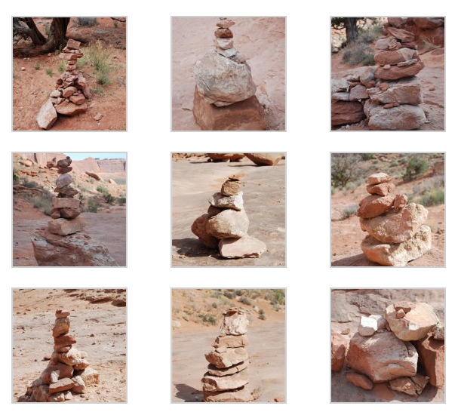
To facilitate multiple arrangements, you have to chunk your content.

Slide 21

The Alarm Clock Metaphor
Metaphor from Mark Baker’s blog, Every Page Is Page One

Slide 22
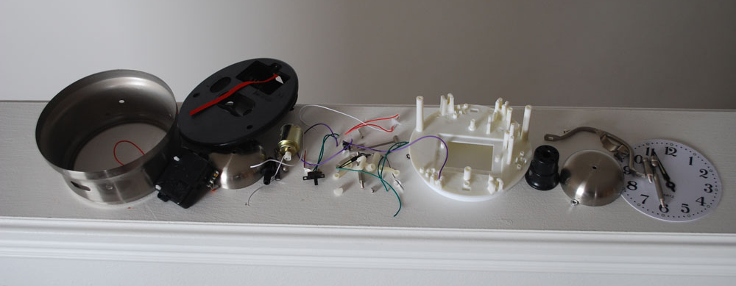
Break content into small chunks…

Slide 23
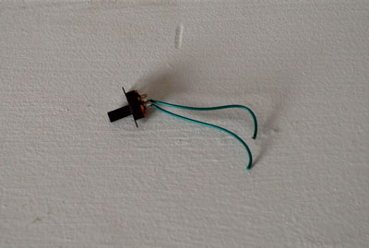
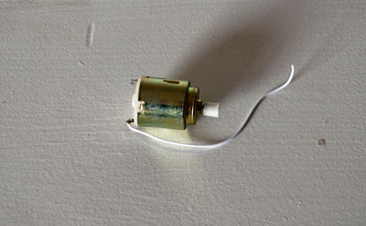
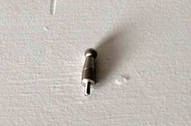
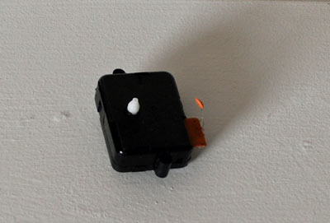
But only if they have meaning alone.

Slide 24
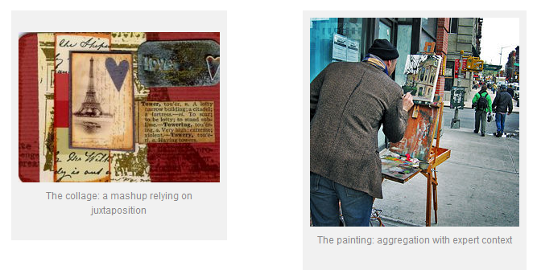
The Collage Versus the Painting
From Don Day’s blog, Learning by Wrote

Slide 25
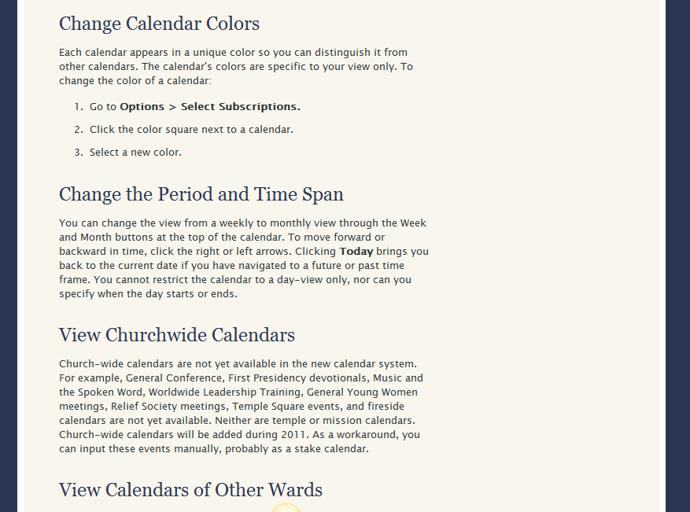

Slide 26
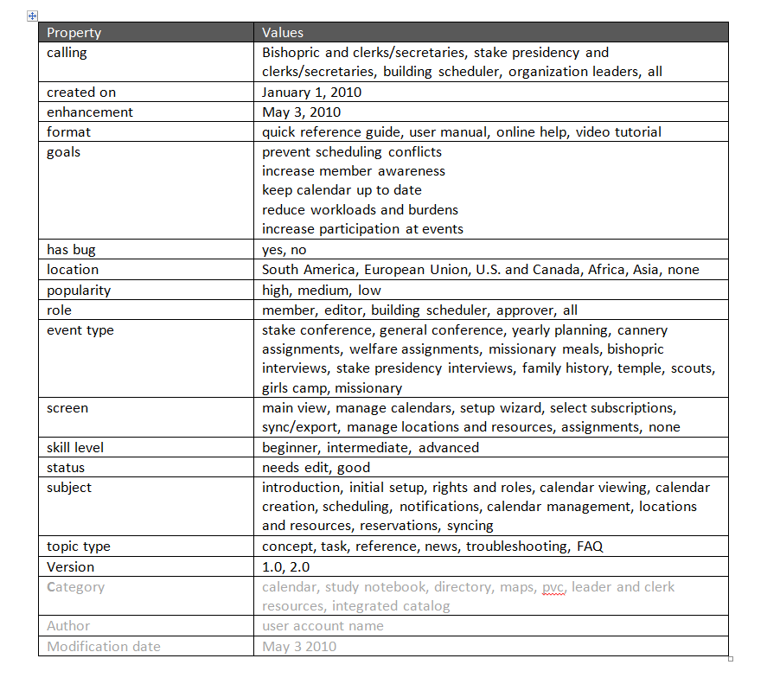
My attempt at metadata

Slide 27
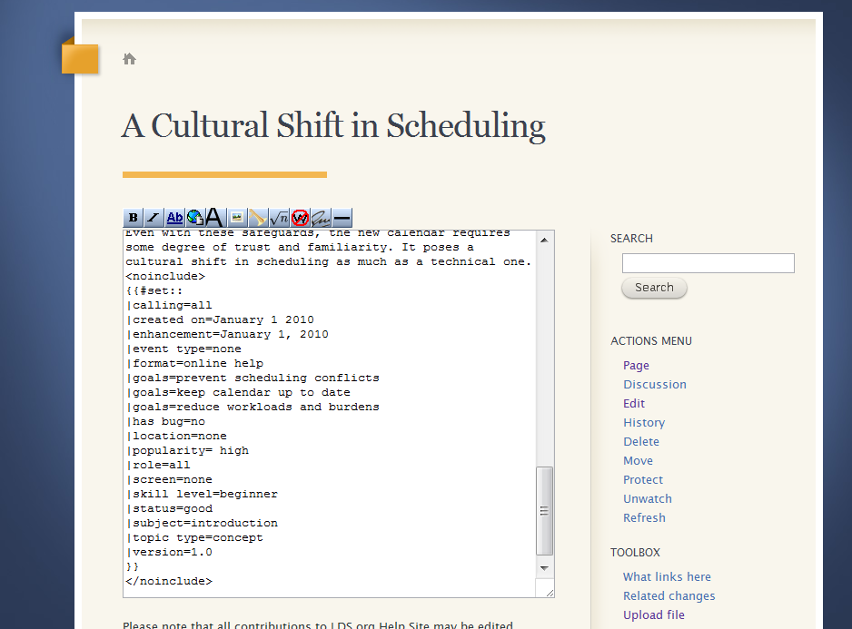
Insert metadata into each topic

Slide 28
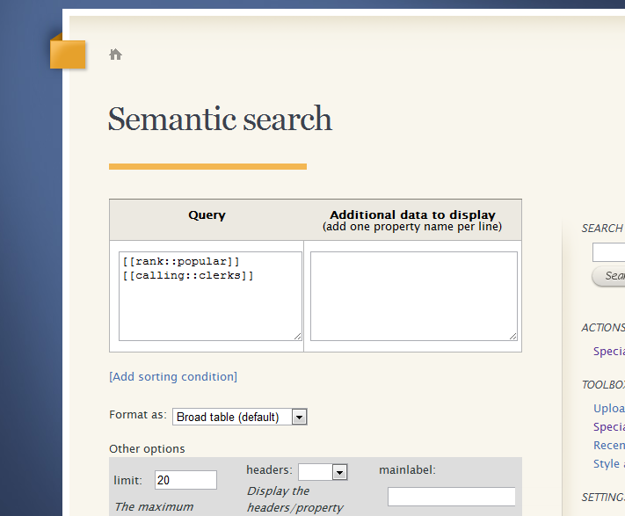
Run the queries based on the metadata

Slide 29
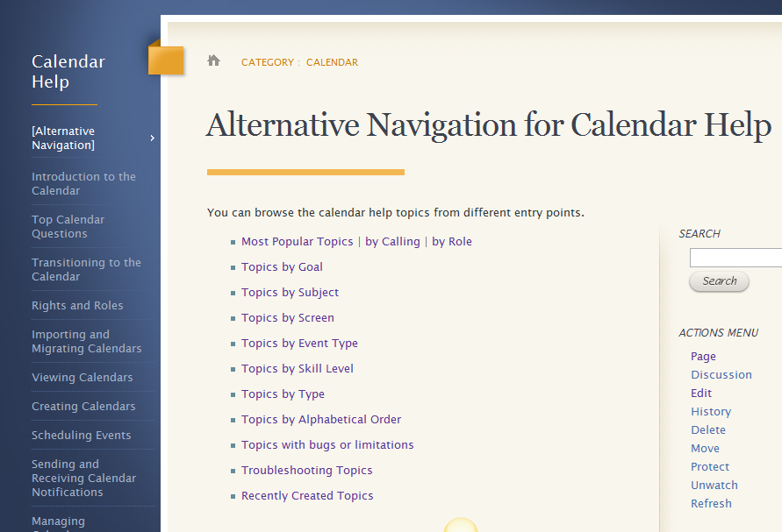
Give users navigation options

Slide 30
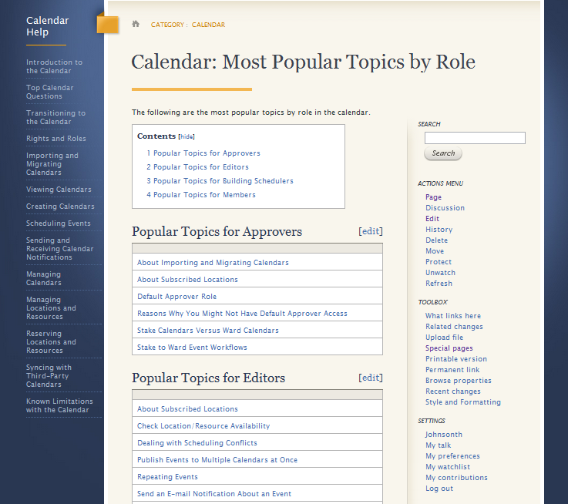
New problem: Everything is a list

Slide 31
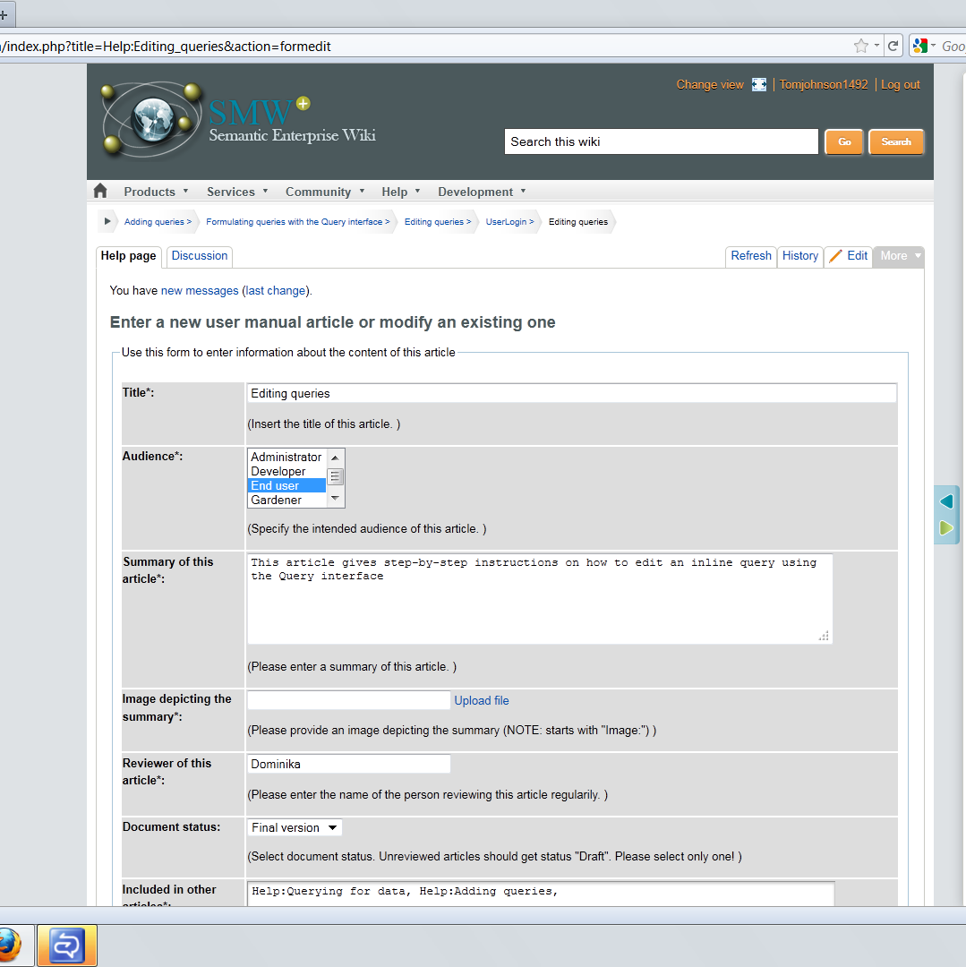
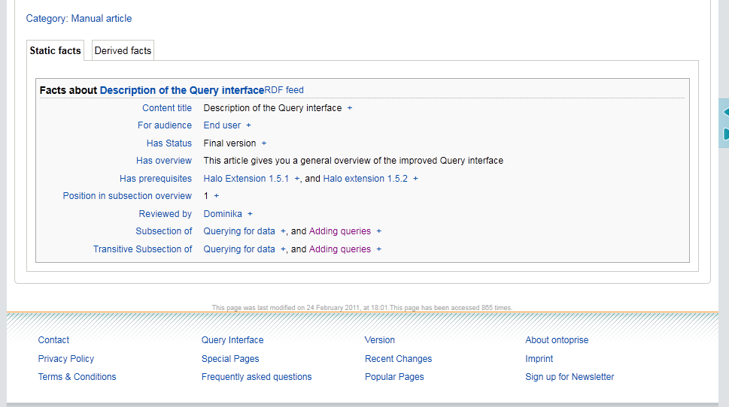
The Semantic Enterprise wiki’s approach
http://smwforum.ontoprise.com

Slide 32
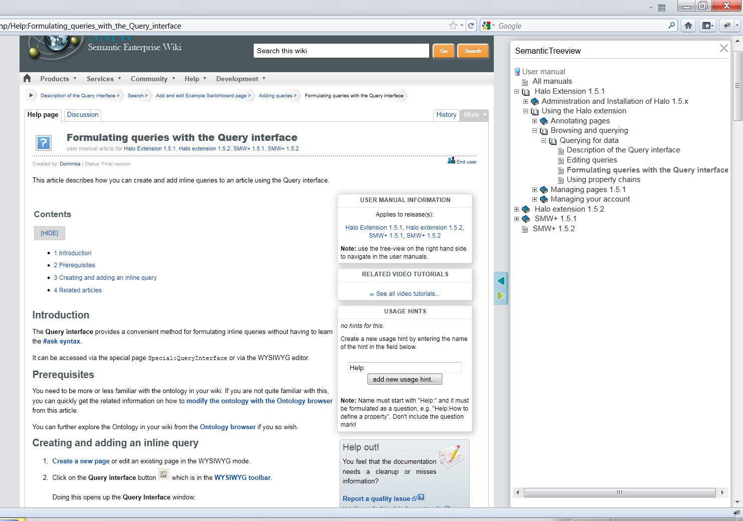
Giving Context to Isolated Chunks

Slide 33
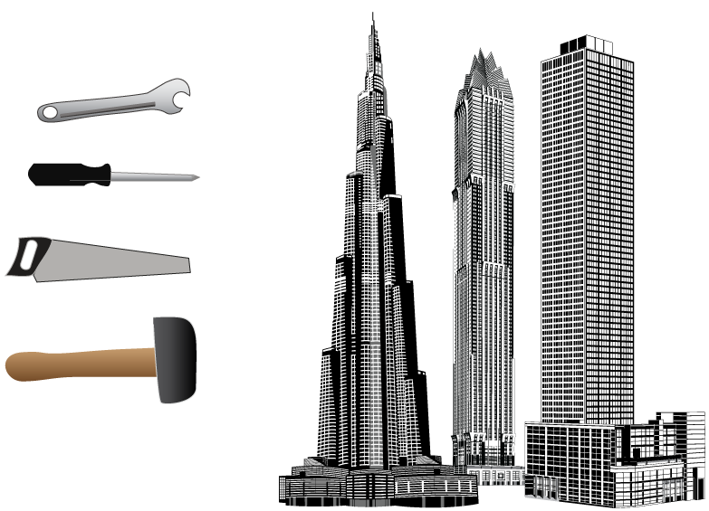
Our tools aren’t capable of the task
Skyscrapers by freevector

Slide 34

Contact Information
Tom Johnson
Blog: Idratherbewriting.com
Email: tom@idratherbewriting.com
Twitter: @tomjohnson

