Slide 1
Publishing Strategies for API Documentation
By Tom Johnson
www.idratherbewriting.com
October 15, 2014

Slide 2
API doc world

Slide 3
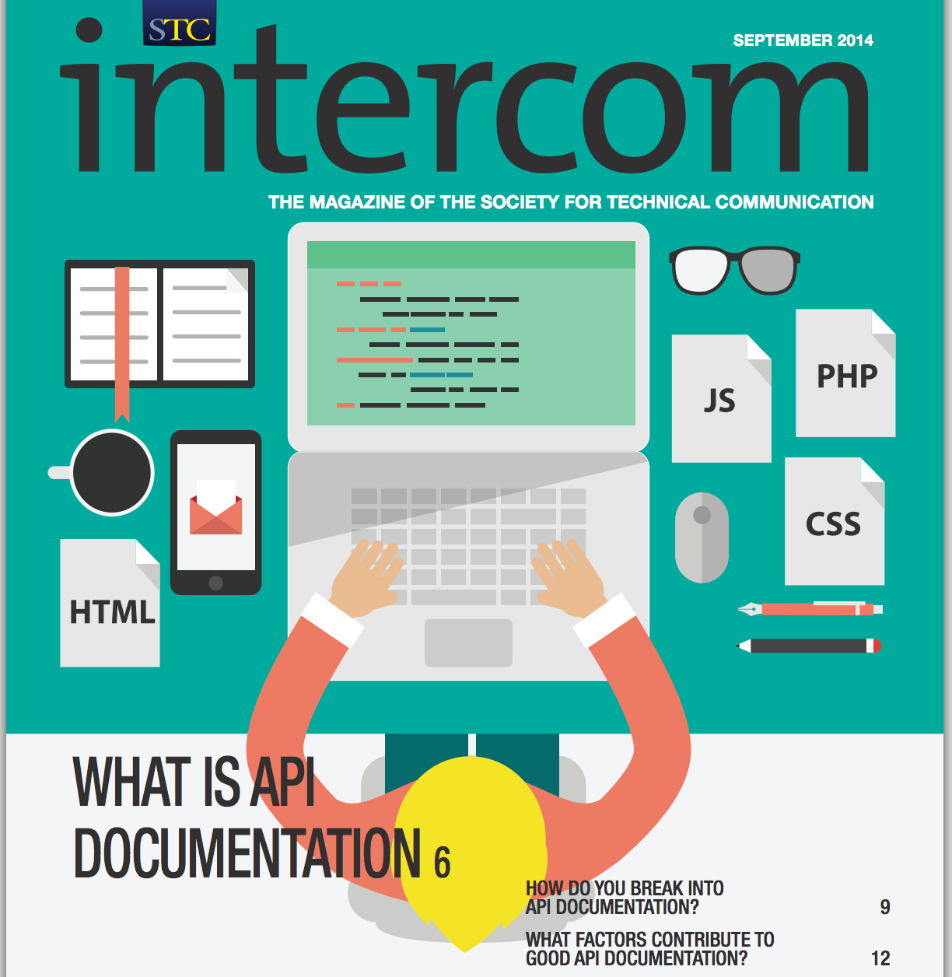
More info needed

Slide 4
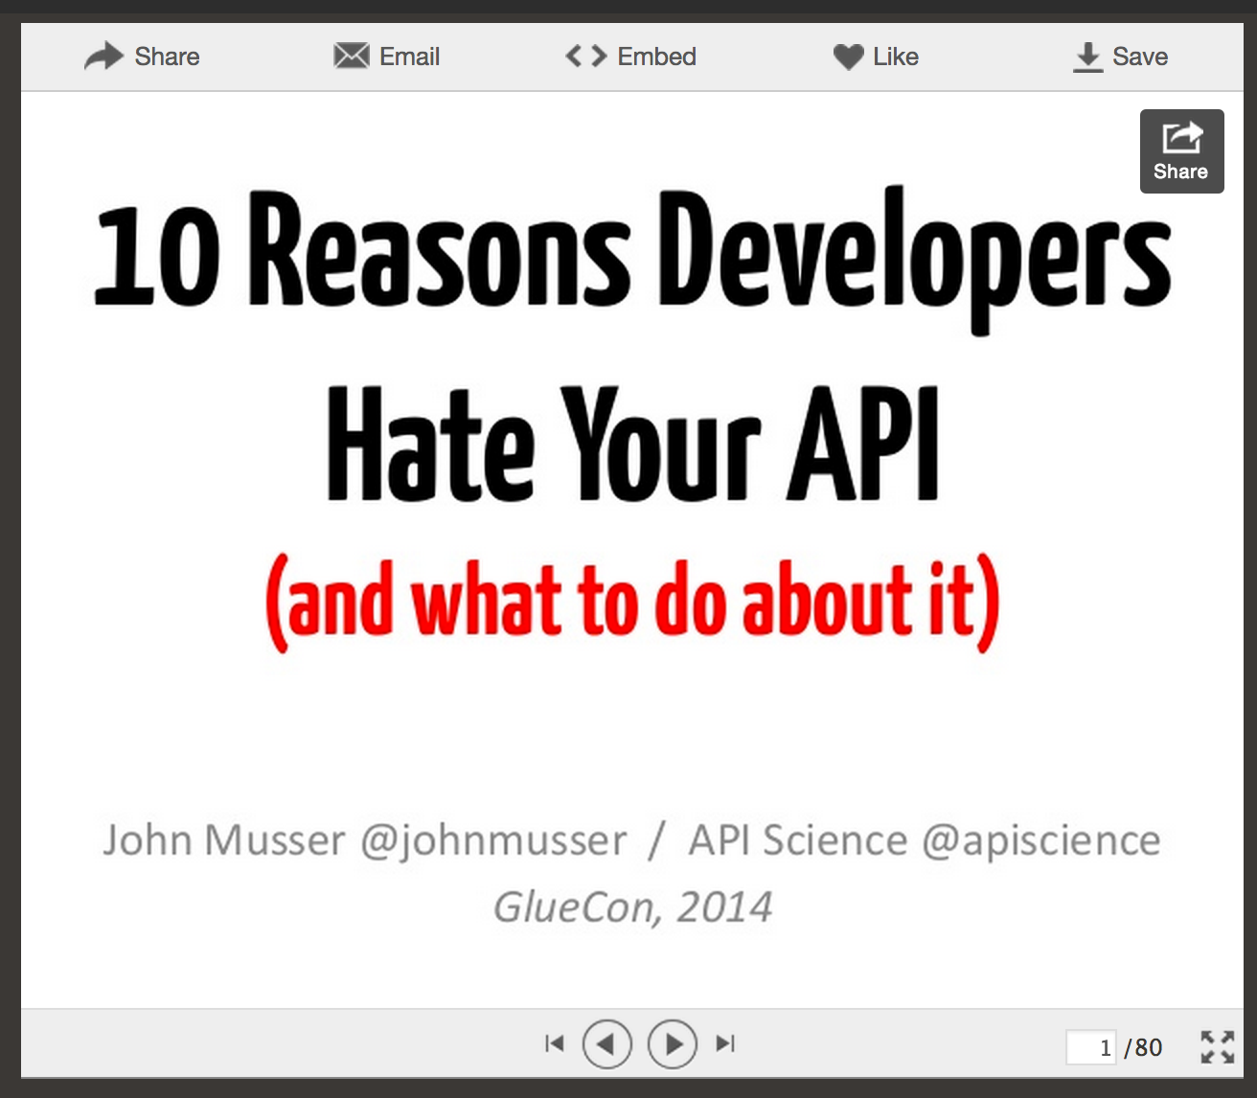
Presentation by John Musser, founder of programmableweb.com, which has directory of 12,000+ APIs
Notes:
ttp://www.slideshare.net/jmusser/ten-reasons-developershateyourapi

Slide 5
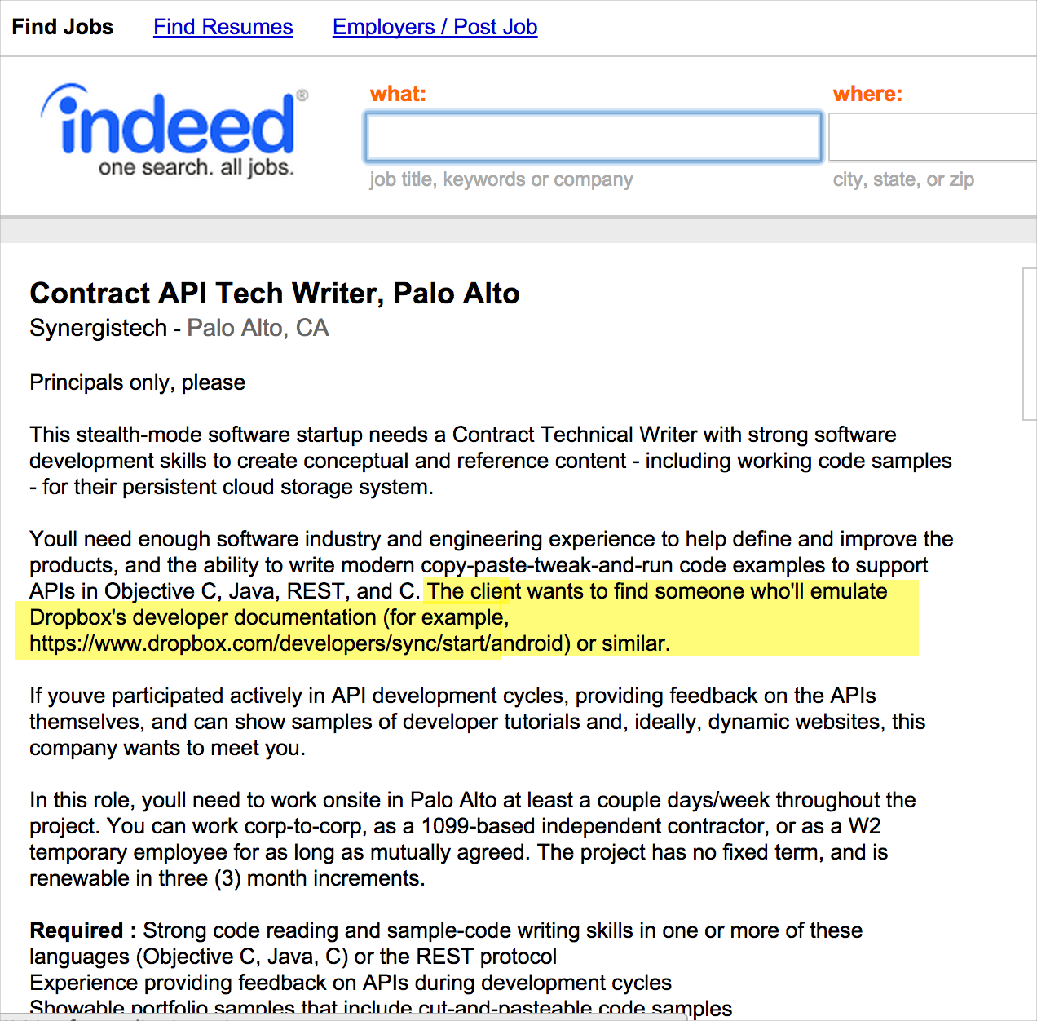
Says, “The client wants to find someone who'll emulate Dropbox's developer documentation”

Slide 6
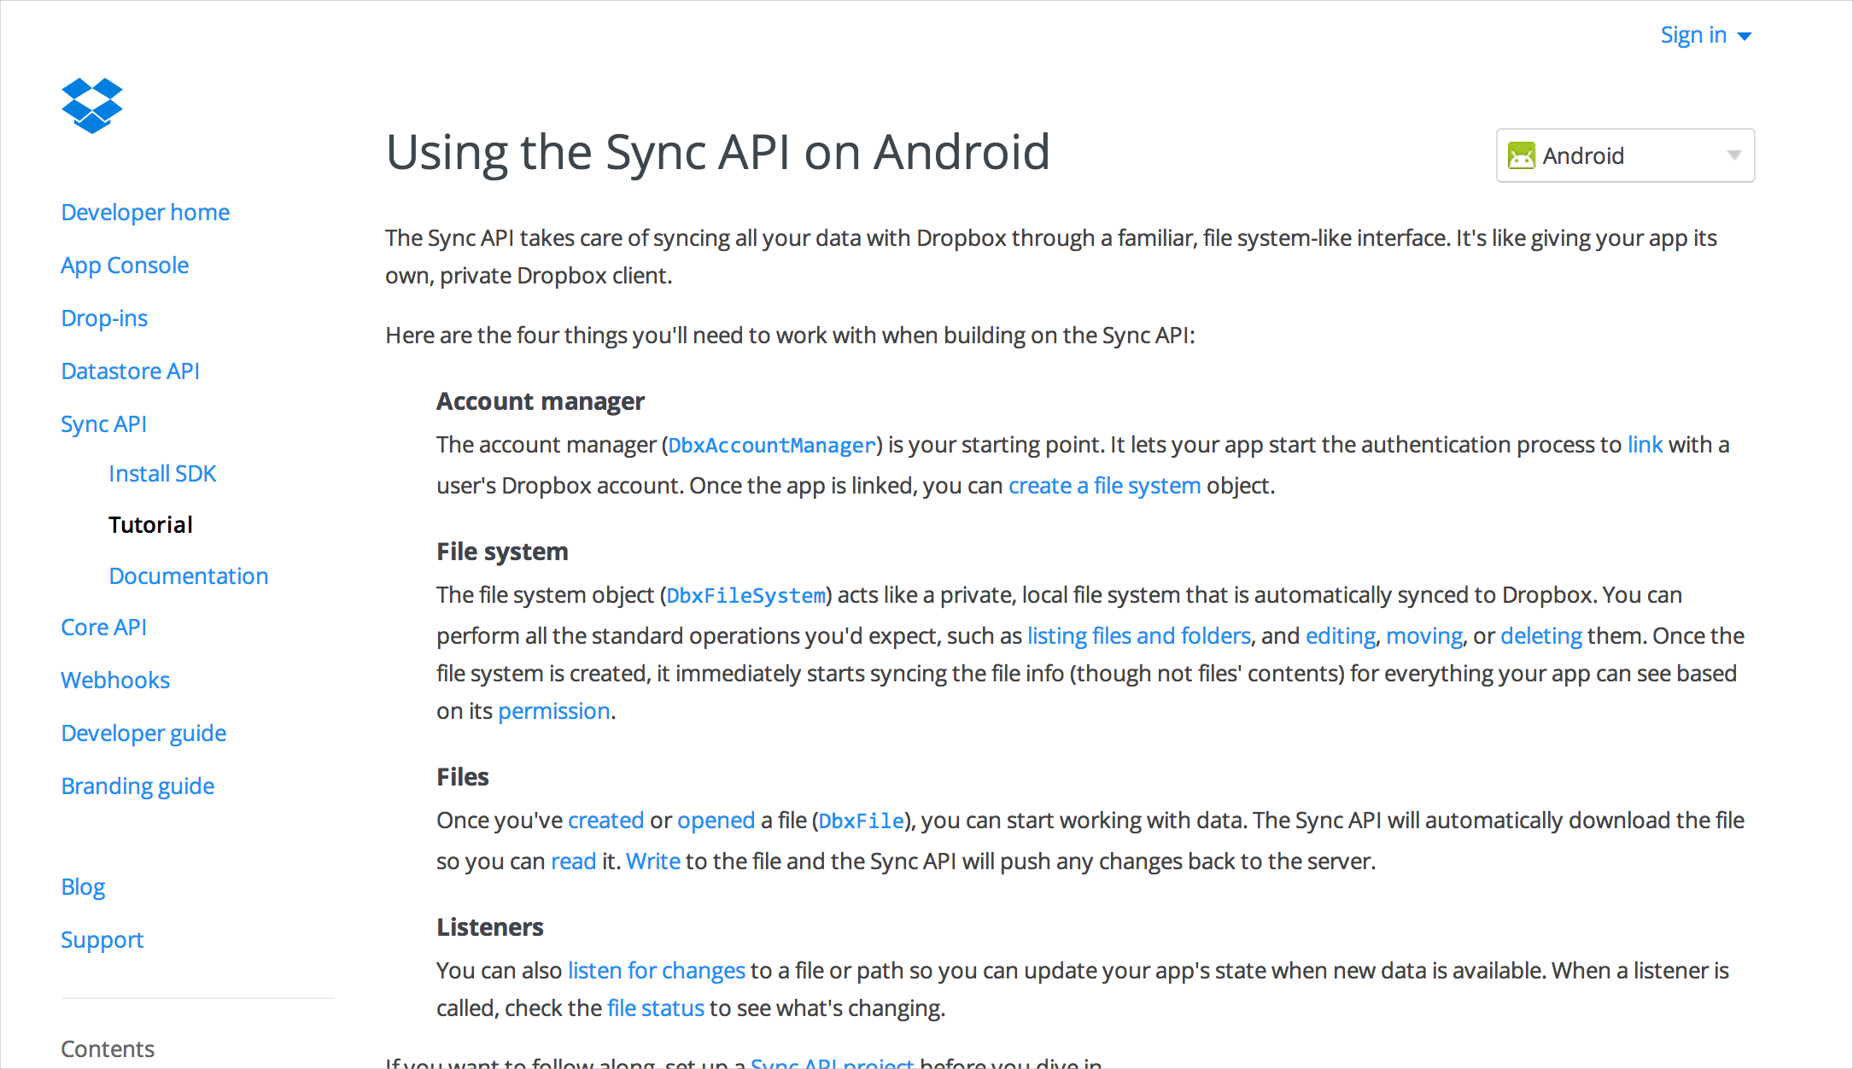
With APIs, docs are the interface

Slide 7
Presentation outline
Native API Docs
REST API Docs
10 Best Practices
Topics not covered:
Writing the technical content
Interacting with developers
Learning to read code
Understanding the different languages
Commenting on code samples
Creating getting started, hello world tutorials

Slide 8
Native API Docs

Slide 9
Some basics about the API landscape
System B
System A
Lots of different types of APIs – for example:
Native APIs that you download and add to your project before compiling.
REST APIs that you access through HTTP web requests.
API

Slide 10
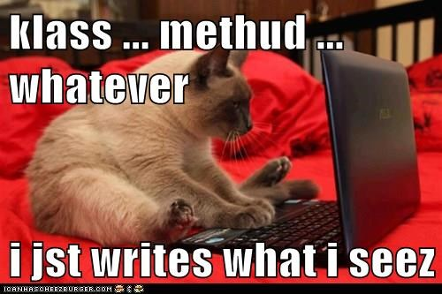
The tech writer’s responsibility

Slide 11
The concept of auto-doc
/**
* Reverses the order of the elements in the specified list.<p>
*
* This method runs in linear time.
*
*
* @param list the list whose elements are to be reversed.
* @throws UnsupportedOperationException if the specified list or
* its list-iterator does not support the <tt>set</tt> operation.
*/
public static void reverse(List<?> list) {
int size = list.size()
if (size < REVERSE_THRESHOLD || list instanceof RandomAccess) {
for (int i=0, mid=size>>1, j=size-1; i<mid; i++, j--)
swap(list, i, j);
} else {
…
Add documentation in the source code, structuring it with specific syntax that a documentation generator can read.
Notes:
Source code: http://www.docjar.net/html/api/java/util/Collections.java.html

Slide 12
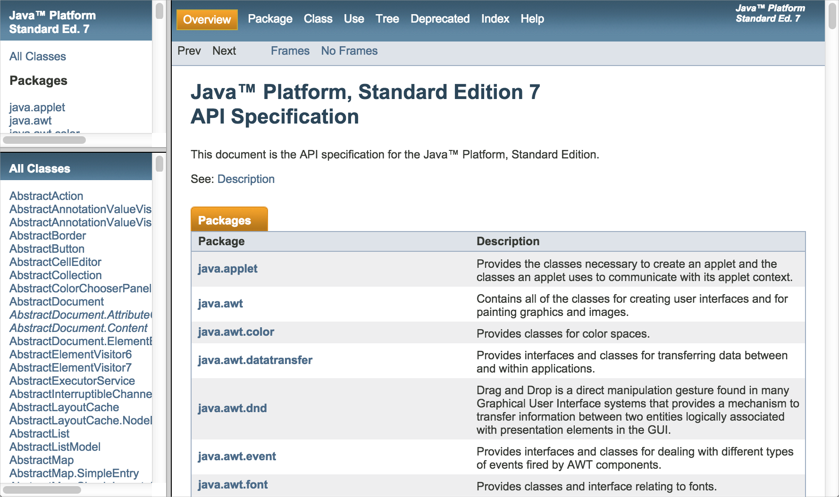
Auto-doc output
Javadoc
Doxygen

Slide 13
Javadoc
- Commonly used.
- Works only for Java.
- Run it from your IDE.
- Automate into builds.
- Explore other doclets.
- Has frame-based - output.
- Can skin with CSS.
- Looks professional.

Slide 14
Doxygen
- Commonly used.
- Works with Java, C++, C#, and others.
- Has easy front-end GUI.
- Point it at your source files.
- Automate into builds.
- Can include non-source files (Markdown).
- Frame-based output.
- Can skin.

Slide 15
Doxygen has GUI front-end
Specify the source directory of your files.

Slide 16
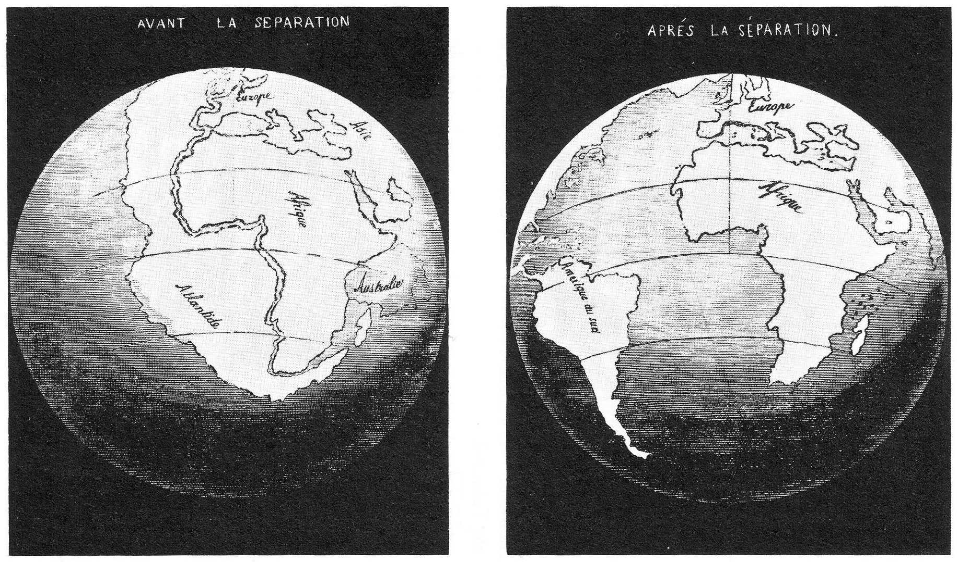
Pros of in-source documentation
- Avoids documentation drift
- Allows the person who creates the code (and so best understands it) to also document it
- Includes tooltips when others incorporate the library into their projects
Continental drift
Doc
Src
Src
Doc

Slide 17
Cons of in-source documentation
Subject to Curse of Knowledge
Not task-focused
Suffers from lack of ownership
Doesn’t integrate with other content
Gives illusion of having real doc

Slide 18
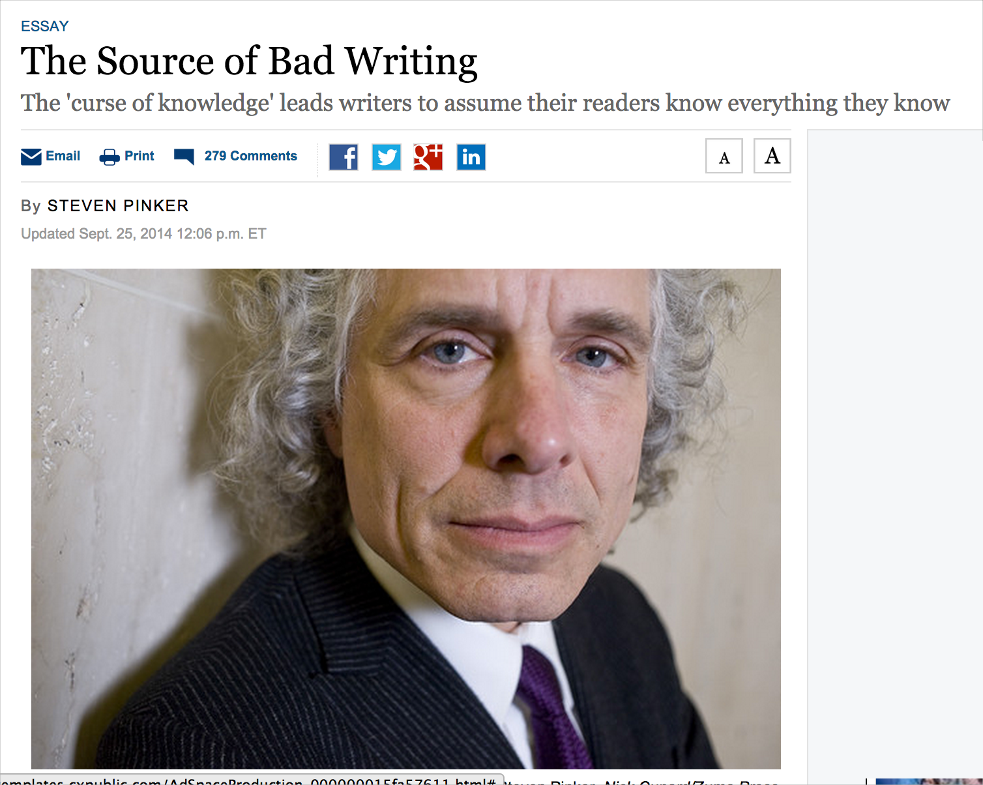
Problem 1: Curse of Knowledge
A developer who creates the API may assume too much of the audiences’ technical ability. As a result, the descriptions aren’t helpful.
Notes:
http://online.wsj.com/articles/the-cause-of-bad-writing-1411660188

Slide 19
Problem 2: Not task-focused
Auto-doc is feature-based doc approach. Task-based doc includes multiple calls and workflows in support of goals. It might make use of several different objects and methods across the reference doc.

Slide 20
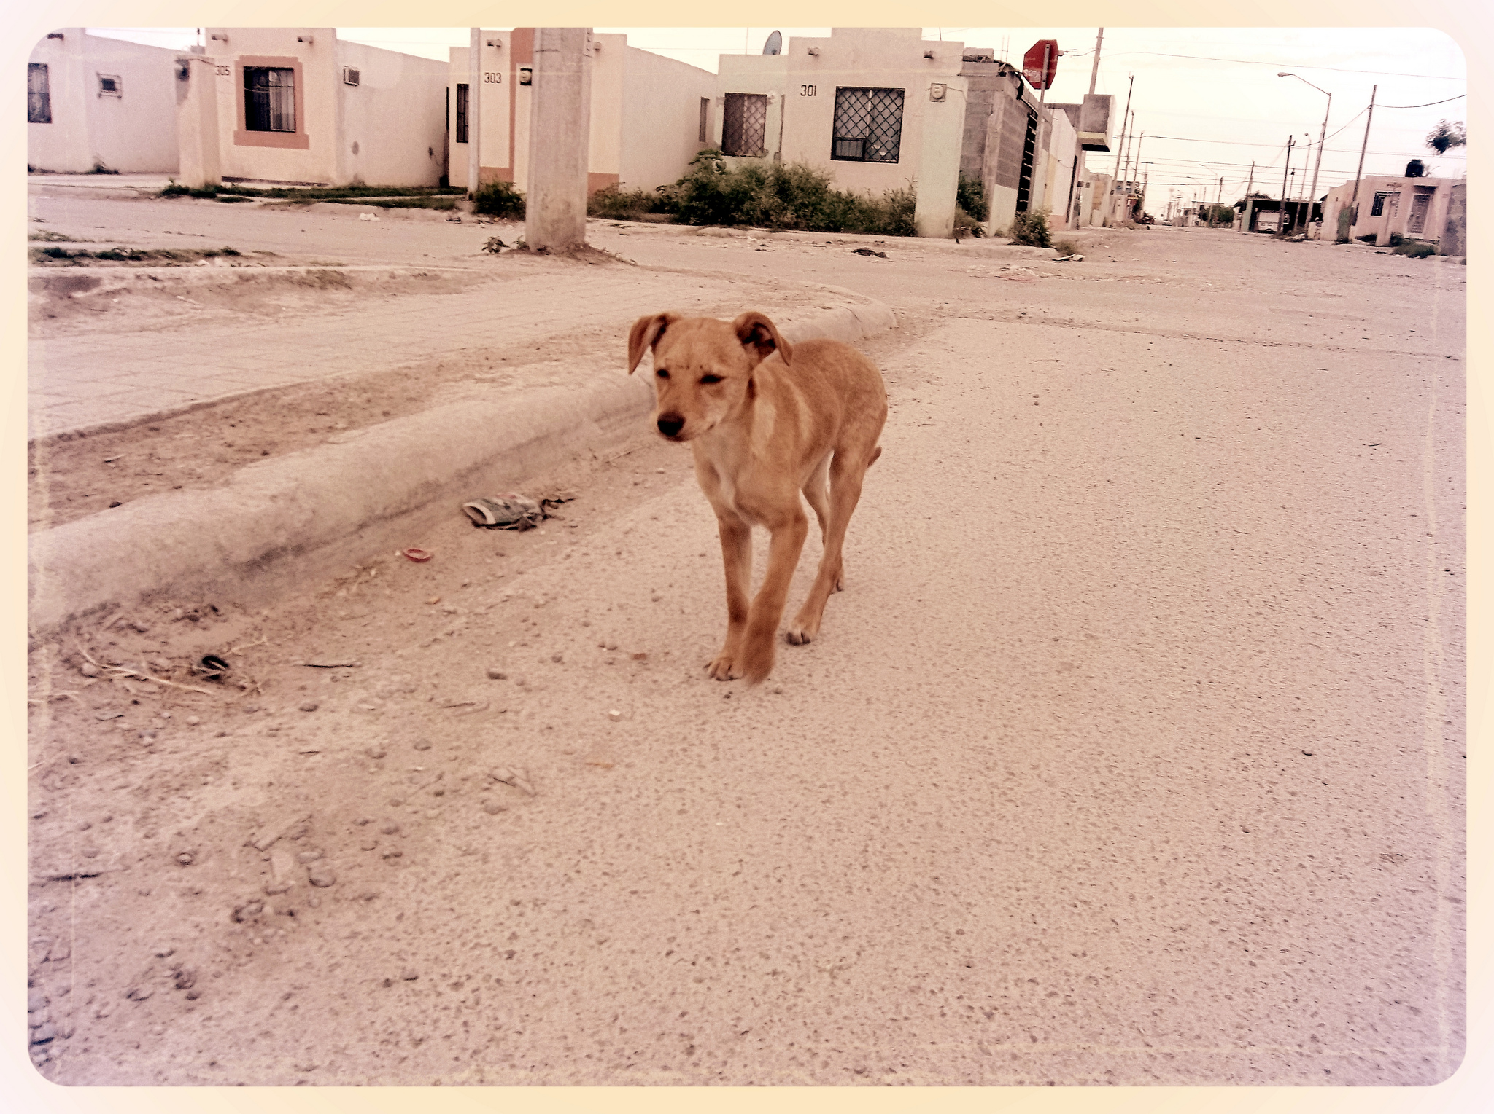
Problem 3: Lack of ownership
Auto-doc is owned like a stray dog or wiki is owned. Someone may contribute some food or a page without care for the whole. Usually there isn’t a developer overseeing all the doc. Tech writers feel less responsible when auto-doc is a separate from their output.
Auto-doc is a stray dog.

Slide 21
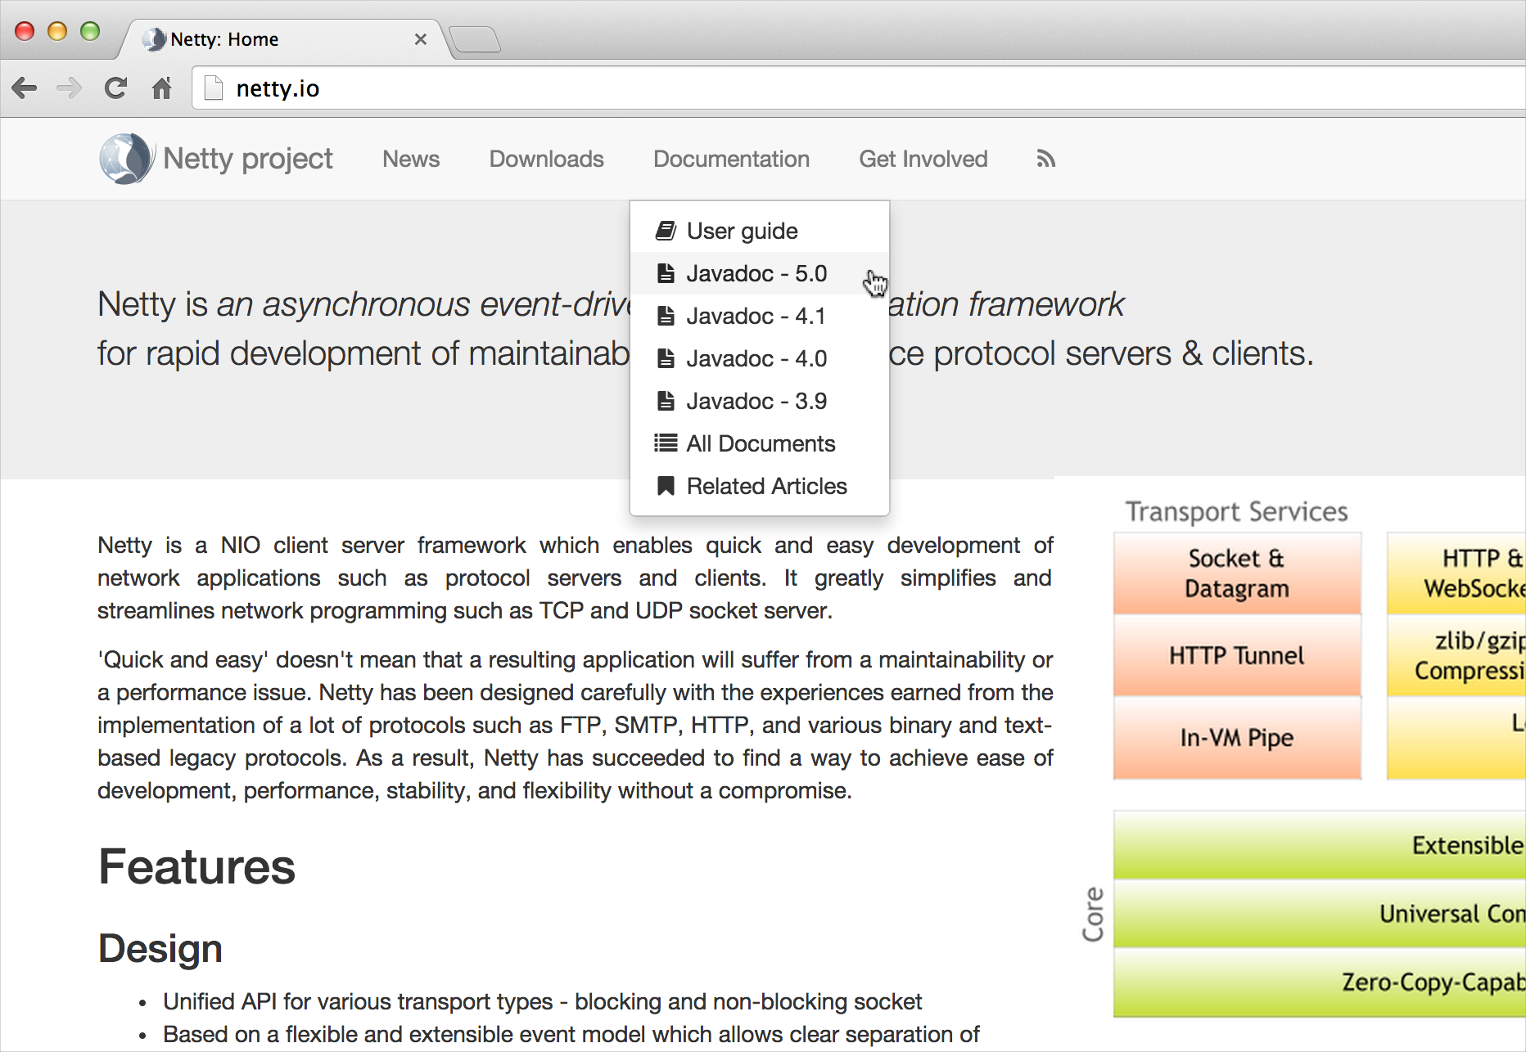
Problem 4: Doesn’t integrate
Auto-doc doesn’t integrate directly into a website except as a link from your other web pages. Like a HAT-produced webhelp file, the auto-doc is its own little website.

Slide 22
Problem 5: Gives illusion of real doc
“… auto-generated documentation is worse than useless: it lets maintainers fool themselves into thinking they have documentation, thus putting off actually writing good reference by hand. If you don’t have documentation just admit to it. Maybe a volunteer will offer to write some! But don’t lie and give me that auto-documentation crap”. – Jacob Kaplan Moss
Looks real but isn’t.
Notes:
Another source: “Auto-generated documentation that documents each API end-point directly from source code have their place (e.g., its great for team that built the API and its great for a reference document) but hand-crafted quality documentation that walks you through a use case for the API is invaluable. It should tell you about the key end-points that are needed for solving a particular problem and it should provide you with code samples.” https://communities.cisco.com/community/developer/blog/2014/09/03/introducing-devnet-slate

Slide 23
Question: Would merging auto-doc with regular doc help solve integration and ownership issues?

Slide 24
Merge option 1: Leverage DITA to pull source doc into tech comm tools
You run the Docfacto DITA doclet inside Eclipse just like Javadoc, but you select a custom DITA Doclet. Files get converted to reference topic types. With Docfacto Links, you can add links to and from in-source files.

Slide 25
Merge option 2: Abandon tech comm tools for dev tools that use markdown

Slide 26
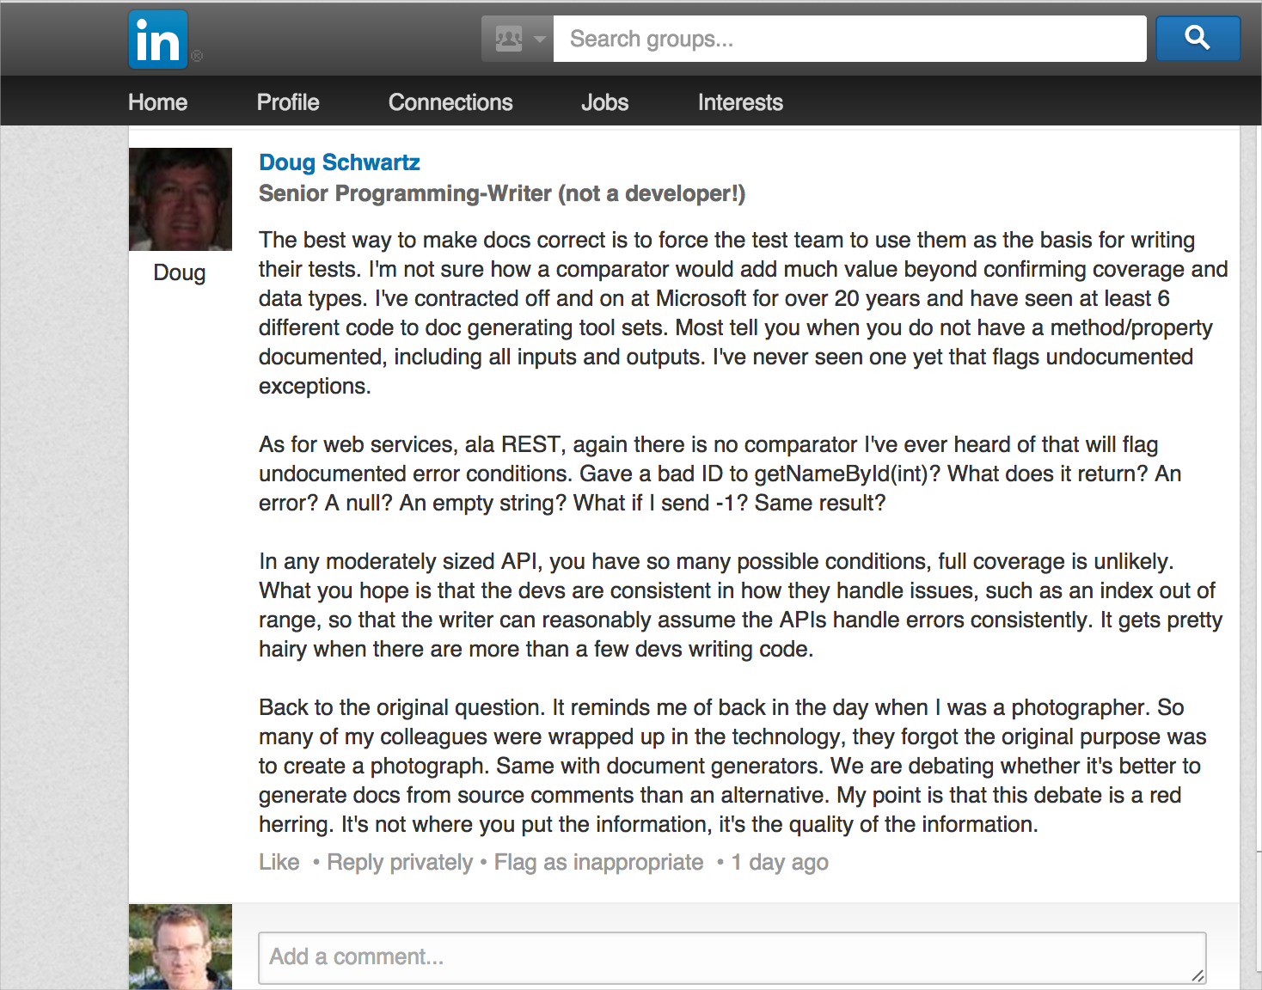
“… It reminds me of back in the day when I was a photographer. So many of my colleagues were wrapped up in the technology, they forgot the original purpose was to create a photograph. Same with document generators. We are debating whether it's better to generate docs from source comments than an alternative. My point is that this debate is a red herring. It's not where you put the information, it's the quality of the information.” – Doug Schwartz

Slide 27
REST API Docs

Slide 28
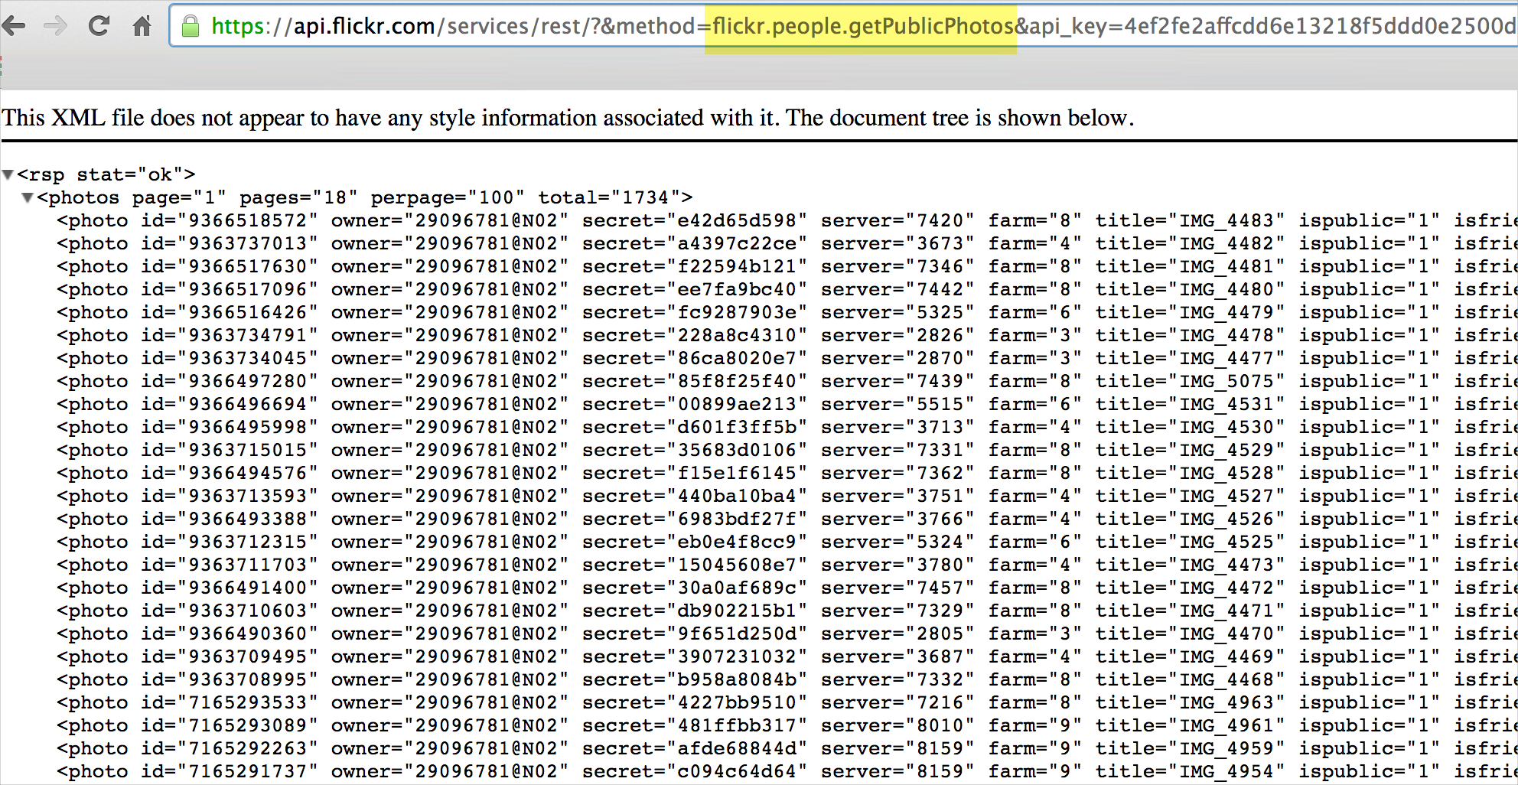
REST API basics
HTTP Request
URLs requests return specific data
Response

Slide 29
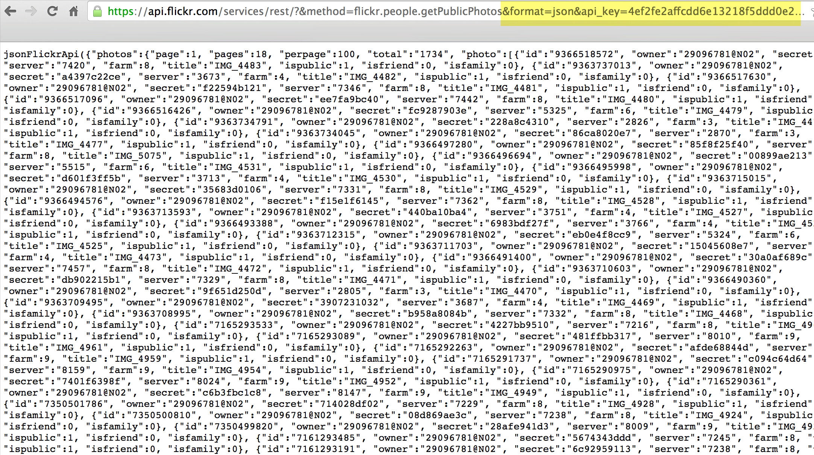
Responses in JSON or XML
Configuration parameters
Response in JSON format

Slide 30
Klout Example
Request
Response
This kind of tutorial lives outside the reference docs.

Slide 31
cURL calls
HTTP requests are often demonstrated through cURL calls, with different HTTP methods:
GET – retrieve
POST – edit
PUT – create
DELETE – remove

Slide 32
No auto-doc with REST APIs because source language varies so much
“The beauty of Web APIs is that they can be written in whatever language you like and in whatever manner you like. As long as when an HTTP request comes in, the proper HTTP response goes out, it doesn't matter how it actually happens on the server. But this very flexibility makes automated documentation nearly impossible, since there's no standard mapping between what an API request is and what the code is that generates its response.”
-- Kin Lane, APIevangelist.com

Slide 33
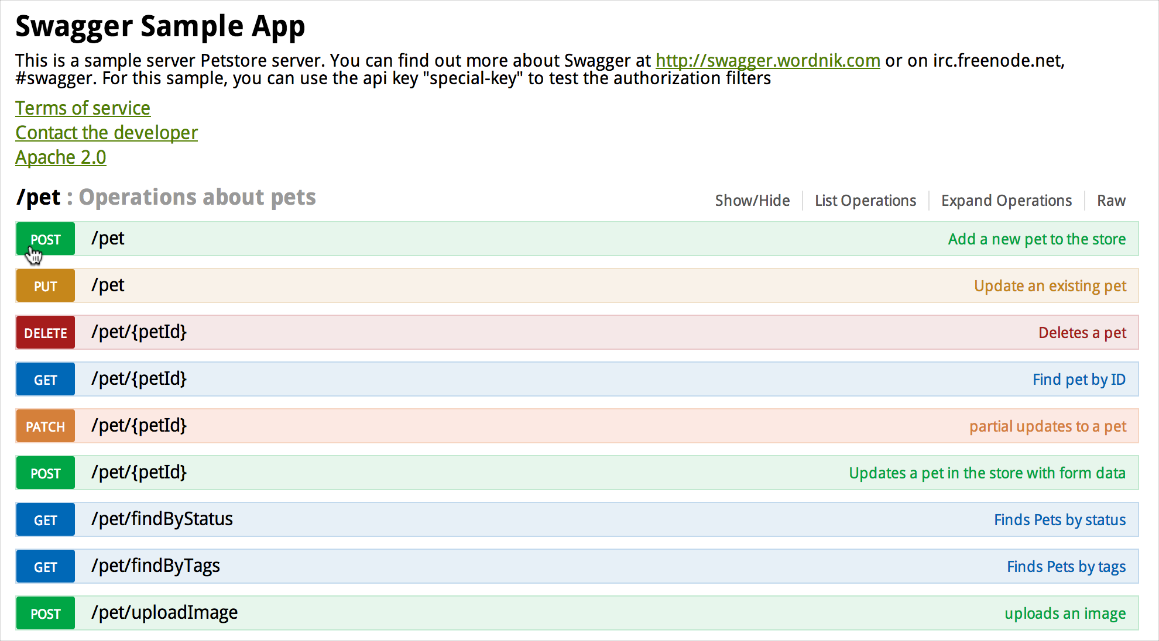
But REST APIs have some endpoint generator possibilities, with Swagger
Generates an endpoint based on values you enter
Notes:
Also enunciate http://enunciate.codehaus.org/ and https://github.com/mashery/iodocs

Slide 34
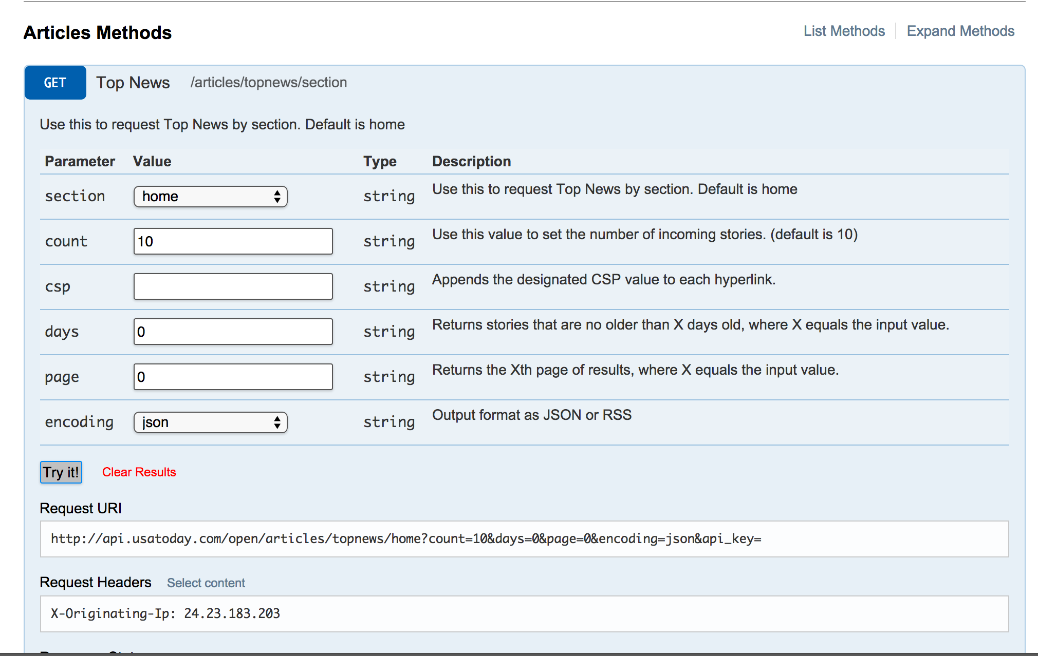
And Mashery.io
This is an API for USA Today.
Notes:
http://developer.usatoday.com/io-docs

Slide 35
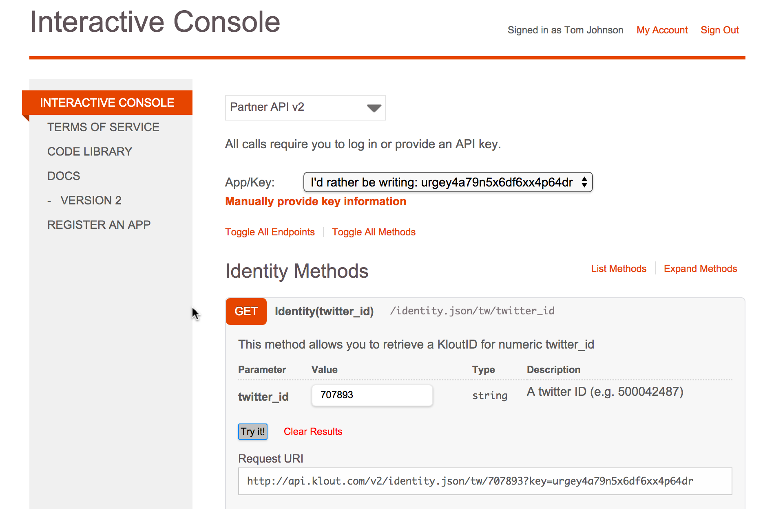
Mashery with Klout
Doc becomes interactive when you’re signed in.
Notes:
http://developer.klout.com/io-docs

Slide 36
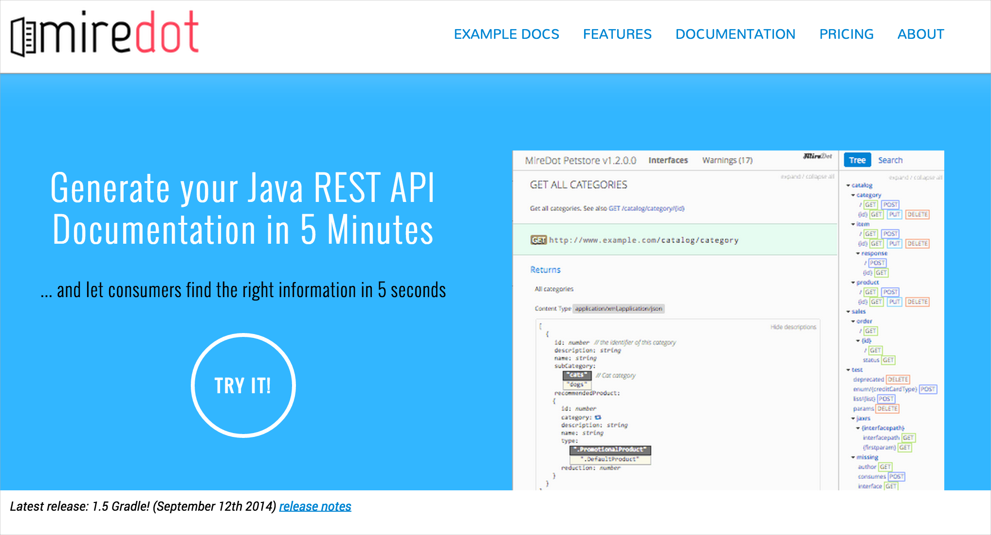
Miredot (auto-doc for Java REST)
Source code must be Java.

Slide 37
Sample REST API doc sites
Many API doc sites are modern looking and awesome. Remember, the API Doc is the product interface, so it has to look good.

Slide 38
Programmableweb.com: API Directory
12,000 + APIs

Slide 39
Constant Contact API
One seamless website, merging all information on the same site.

Slide 40
Yelp API
Website is branded with similar branding as product.

Slide 41
Dropbox API
Clean and simple look. Minimalist.

Slide 42
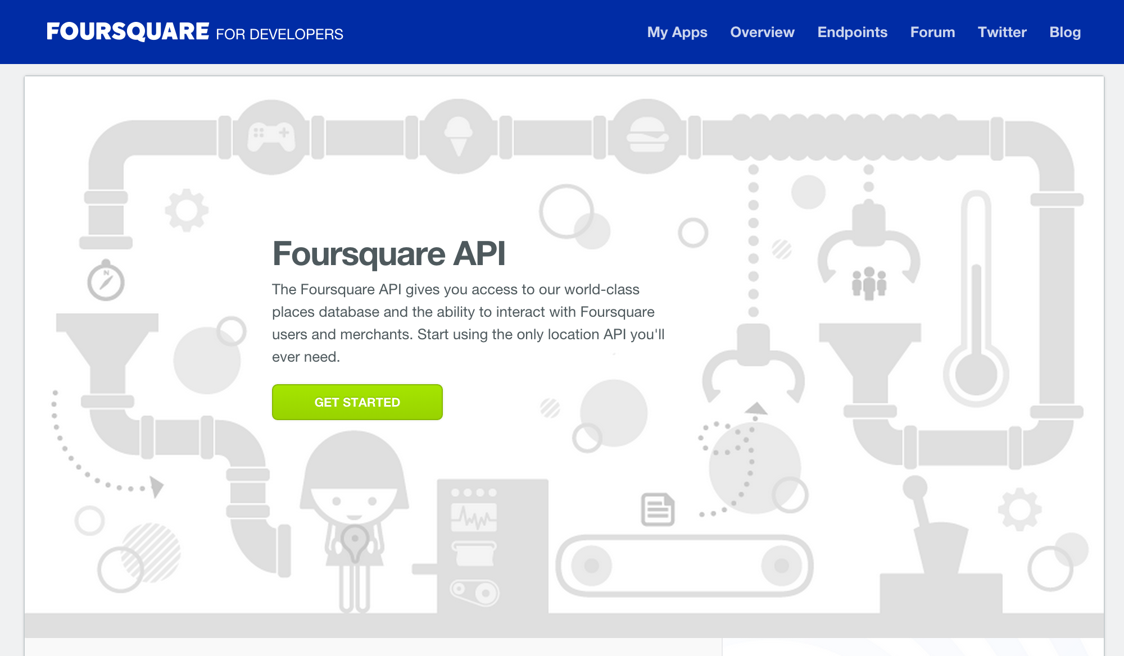
Foursquare API
Often begin with Getting Started section, providing a sample “Hello World” tutorial
Notes:
https://developer.foursquare.com/start

Slide 43
Youtube API
Lots of code samples, usually with syntax highlighting and surrounding narrative
Notes:
https://developers.google.com/youtube/v3/code_samples/apps-script

Slide 44
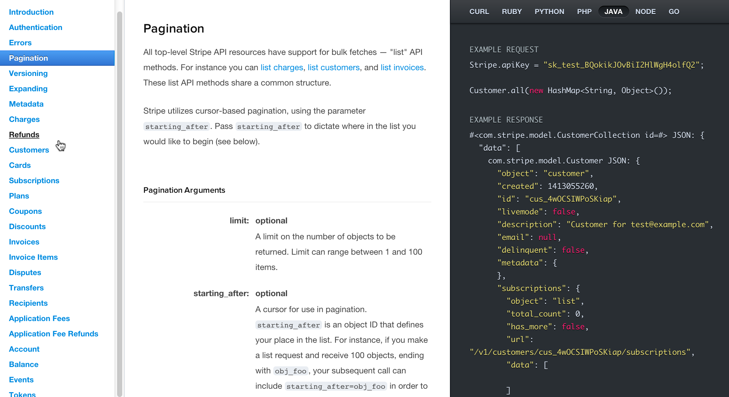
Stripe API
Code requests and responses next to doc
Notes:
Also http://ricostacruz.com/jquery.transit/source/ for docco sidebar style
Slate patterned after it, and docco

Slide 45
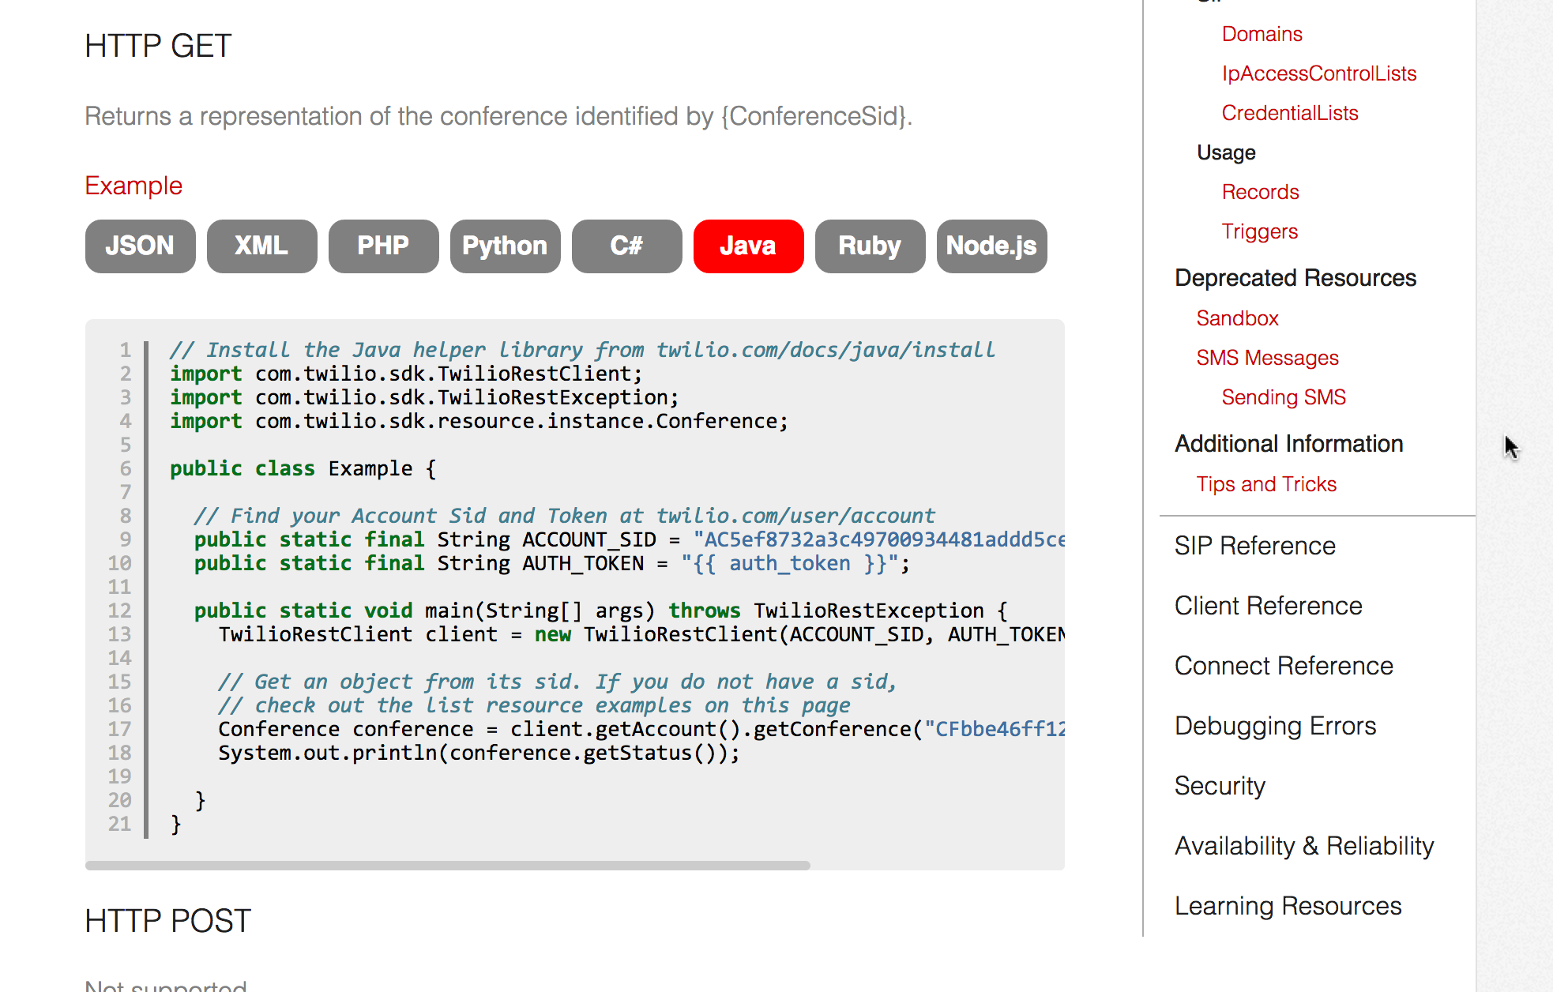
Twilio API
One output, with tabs to show different languages
Notes:
http://www.twilio.com/docs/api/rest/conference

Slide 46
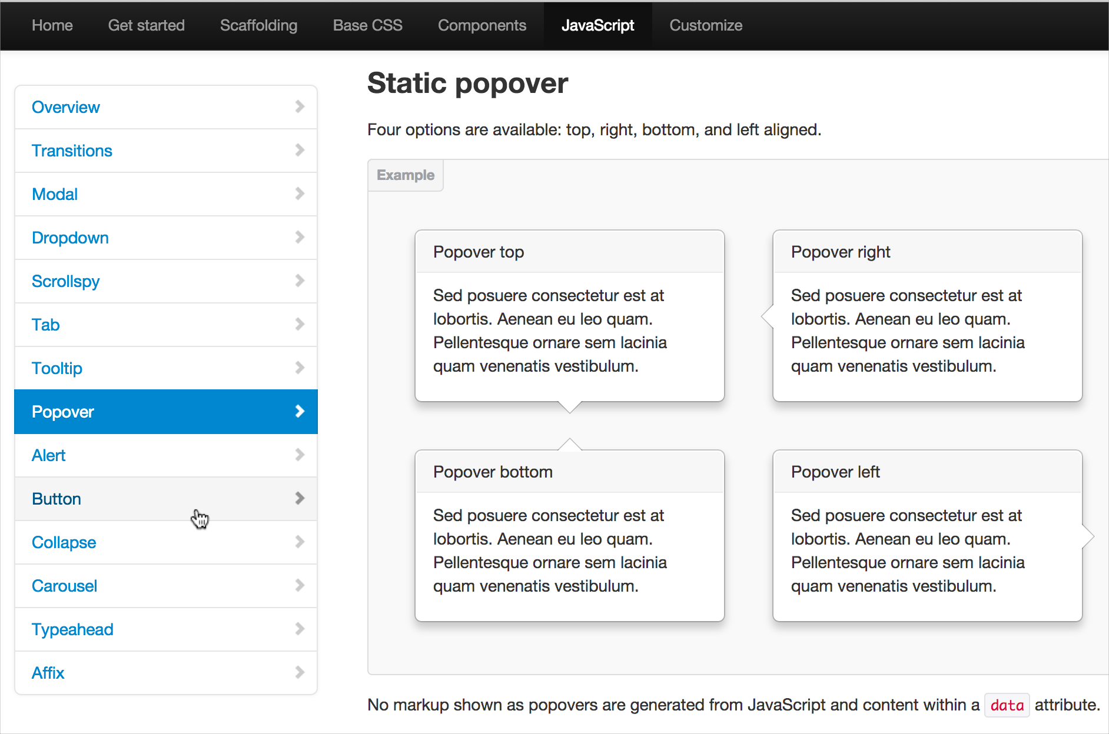
Get Bootstrap API
Everything on one page, with dynamic TOC highlighting as you scroll
Notes:
Article by bokardo: clicking is easier than scrolling: http://bokardo.com/archives/scrolling-easier-clicking/

Slide 47
Single page doc scroll demo

Slide 48
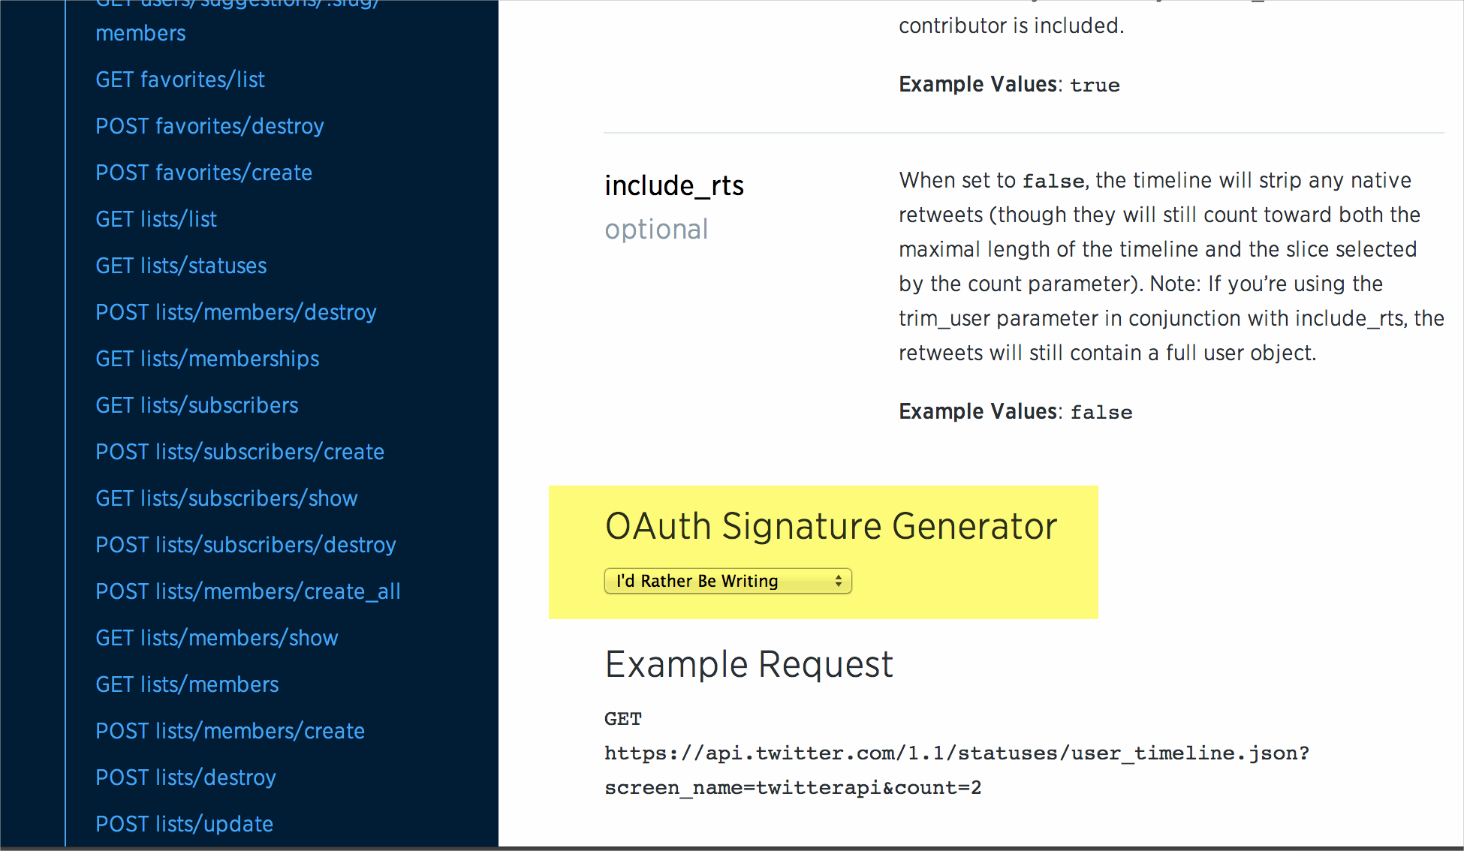
Twitter API
Real-time requests to make the doc interactive.
Notes:
https://dev.twitter.com/rest/reference/get/statuses/user_timeline

Slide 49
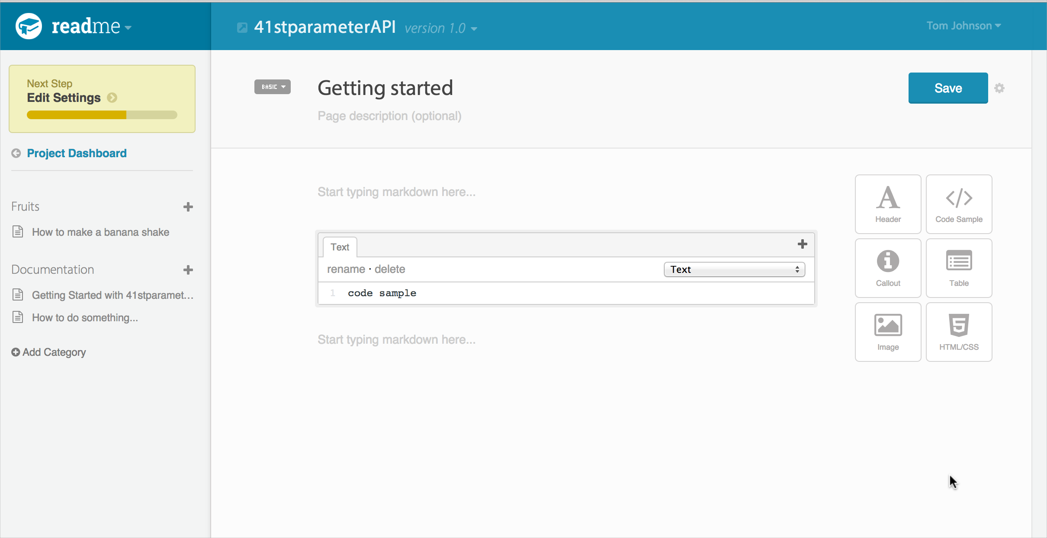
Readme.io API authoring tool
Says, “Start typing markdown here…”
Simple authoring methods, usually Markdown

Slide 50
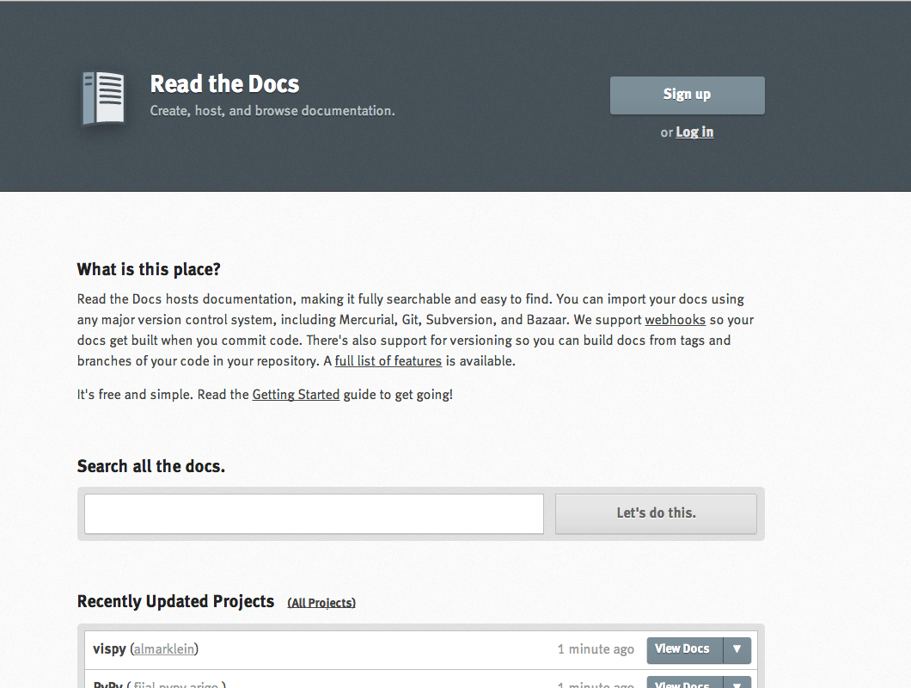
Read the Docs
Sphinx and Github

Slide 51
1. Edit on Github. 2. Commit change.
3. Rebuild view on readthedocs.org.

Slide 52
10 Trends
One seamless website
Product-branding
Minimalism
Getting started section
Emphasis on code samples
Side-by-side code
jQuery tabs
Single-page doc
Real-time requests/demo
Markdown

Slide 53
10 non-trends
PDF output
Collapsible sections
Short pages
Multiple outputs of content for different audiences
DITA or XML authoring models
EPUB and mobile formats
Comments on pages
Wikis
Tripane webhelp files
Video tutorials
Notes:
Splunk’s documentation is an exception to the non-wiki trend.

Slide 54
Question: How do tech writers make beautiful API doc websites?

Slide 55
Possible options
Cloud-based solutions
- Readme.io
- Miredot
- Apiary
API Blueprint
3scale.net
Turnapi
Github
Static site generators
Slate
Wintersmith
Nanoc
Jekyll
Pico CMS
Sphinx
Fixie docs
DITA-based
- WordPress
Wikis
- Mediawiki
- Ponydocs
- Confluence
Doc. generators
Enunciate
Docco
Dexy
Swagger
Mashery I/O docs
RAML
Notes:
http://blog.iwantmyname.com/2014/05/the-updated-big-list-of-static-website-generators-for-your-site-blog-or-wiki.html
https://github.com/skx/static-site-generators/blob/master/README.md
http://lwn.net/Articles/541299/

Slide 56
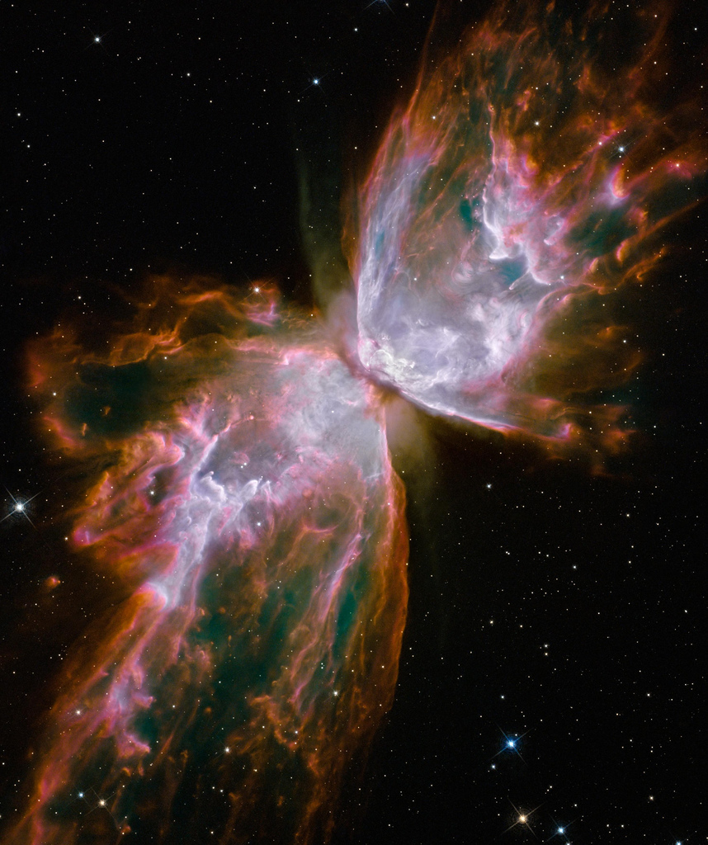
How do you merge worlds?
Keep DITA, or abandon DITA?
Is it possible to merge tech comm and API doc worlds, or are they too different?

Slide 57
Import DITA into WordPress (Pros)
Pros
Easy to build and theme a beautiful site.
Create a network of sites controlled from a single point.
Imports DITA flawlessly.
Include additional functionality (e.g., forums, Q&A).
Leverage existing plugins (auto-toc, jQuery menus, live search).
Easily hire out branding and code development.
Works with a lot of different systems (30,000 + plugins).
Dynamically serve conditional content to users.
Allow threaded comments (SME review, user feedback).
Include other content outside of doc (mktg., kb articles)
Much better analytics (e.g., see search queries on dashbrd)

Slide 58
Import DITA into WordPress (Cons)
Cons
Database model is slower than static files.
Import process isn’t a one-click job.
Requires MySQL, PHP, and Apache architecture.
May be problematic to integrate authentication with another system (e.g., Salesforce).
Regularly importing static files into a dynamic system may be subverting the fundamental design of WordPress.
May not be robust enough for massive doc projects.

Slide 59
Tom Johnson
Idratherbewriting.com
tom@idratherbewriting.com
@tomjohnson (Twitter)

Slide 60
Image Credits
Slide 2: Mars, once. By Kevin Dooley. http://bit.ly/ZFYI0T
Slide 4: 10 Reasons Developers Hate Your API (and what to do about it). By John Musser. Slideshare. http://slidesha.re/1pnnDRf
Slide 9. Spinning gears. By Brent 2.0. Flickr. http://bit.ly/1DexWM0
Slide 10. Lolcat Generator: Can haz posters? http://bighugelabs.com/lolcat.php
Slide 11. Code sample pulled from http://www.docjar.net/html/api/java/util/Collections.java.html.
Slide 16. Continental Drift. Wikipedia. http://en.wikipedia.org/wiki/Continental_drift
Slide 17: Biodiversity fail. By Martin Sharma. Flickr. http://bit.ly/1CodnKM
Slide 18. The Source of Bad Writing. Wall Street Journal. http://online.wsj.com/articles/the-cause-of-bad-writing-1411660188
Slide 19. Stray dog. By Jose Javier Perez Arenas. Flickr. http://bit.ly/1wau5NK
Slide 22. The false. By Cristopher Cotrell. Flickr. http://bit.ly/1F1et36. Quote from Jacob Kaplan Moss here: http://jacobian.org/writing/what-to-write/
Slide 23 and 54. Finger face with question. By Tsahi Levent-Levi. http://bit.ly/1sWdnln
Slide 32. Kin Lane, apievangelist.com. http://apievangelist.com/2012/03/08/automated-documentation-for-rest-apis/
Slide 37. Catwoman. http://bit.ly/11qDsNU
Slide 56. Nasa, new eyes: Butterfly. http://bit.ly/1u7ANzE

